Slide 1
The Maximum Multi Commodity Flow Problem
A Case Study of an Approximation Scheme
Notes:
Vorstellung des Themas, meiner Aufgabe und Erawehnung von JgraphT

Slide 2
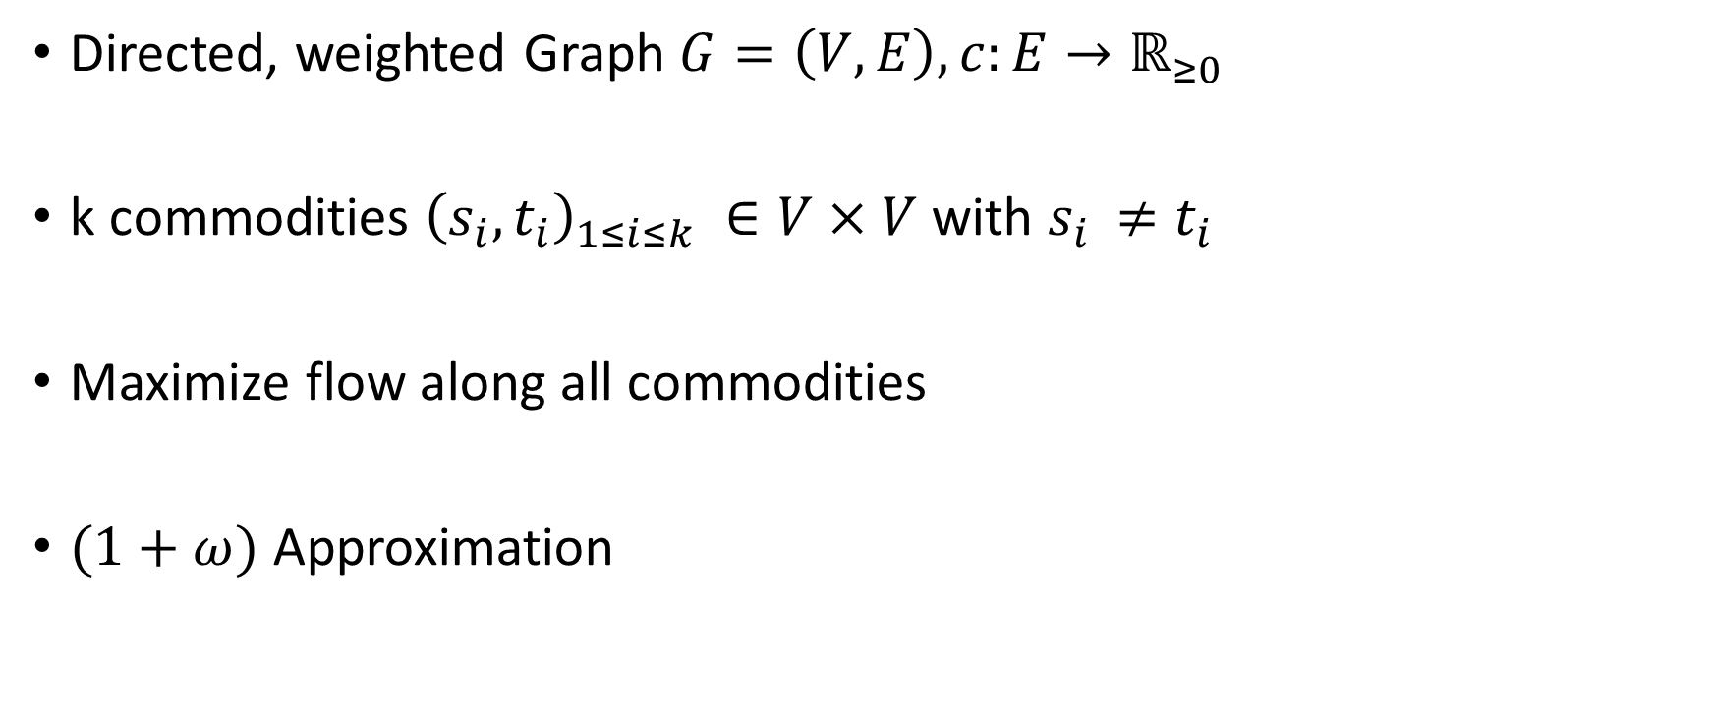
Maximum multicommodity flow
Directed, weighted Graph $G=\left(V,E\right), c:E→ℝ_{≥0}$
k commodities ${\left(s_{i},t_{i}\right)}_{1≤i≤k} ∈V×V$ with $s_{i }≠t_{i}$
Maximize flow along all commodities
$(1+ω)$ Approximation

Slide 3

Maximum multicommodity flow problem
Given:
Directed Graph $G=\left(V,E\right)$
$Capacities$ $c:E→ℝ_{≥0}$
k commodities ${\left(s_{i},t_{i}\right)}_{1≤i≤k} ∈V×V$ with $s_{i }≠t_{i}$
Task:
Maximize flow along all commodities
Notes:
(s,_i,t_i ) sind source und sink

Slide 4

MMCFP vs MFP: Example1
Commodities: $\left(a,c\right),(b,d)$
capacities
flow
a
3/3
c
0/2
b
2/2
d

Slide 5

MMCFP vs MFP: Example2
Commodities:$\left(a,e\right),\left(a,c\right)$
a
3
d
1
e
1
3
c

Slide 6

Polynomial-time approximation scheme
Algorithm:
Input:
Problem instance, accuracy $ω$
Output :
Solution not worse than $(1−ω)$ times the optimal for a maximization problem
Running time:
Polynomial in size of problem instance (not in $ω^{−1}$)

Slide 7
Garg and Koenemann Algorithm
Polynomial-time approximation scheme for MMCFP
Motivation:
Faster than previous known algorithms for a fixed or moderately small ω.
Idea:
Formulate MMCFP as a linear program, solve the dual problem and compute the solution for the primal as a byproduct.

Slide 8

Formulation as a Linear Program
$P=\{p⊆E : "p is a path from s_{i} to t_{i} for any 1≤i≤k "\}$
$P_{e}=\{p∈P:e∈p\text{\}}$

Slide 9
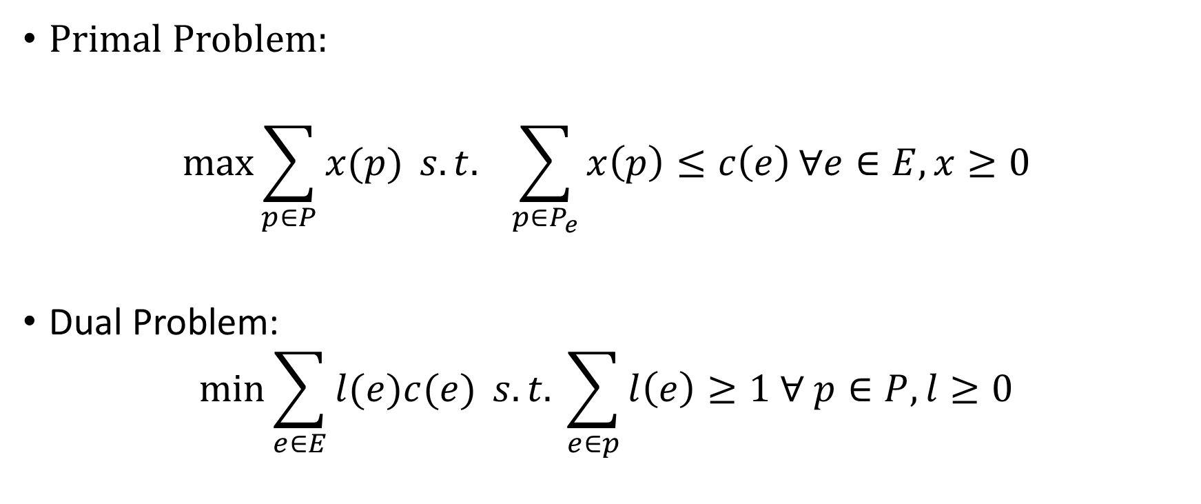
Formulation as a Linear Program
Primal Problem:
$$\max{\sum_{p∈P}{x(p)}} s.t. \sum_{p∈P_{e}}{x\left(p\right)≤c\left(e\right)}∀e∈E, x≥0$$
Dual Problem:
$$\min{\sum_{e∈E}{l(e)c(e)} s.t. \sum_{e∈p}{l\left(e\right)≥1 ∀ p∈P, l≥0}}$$

Slide 10
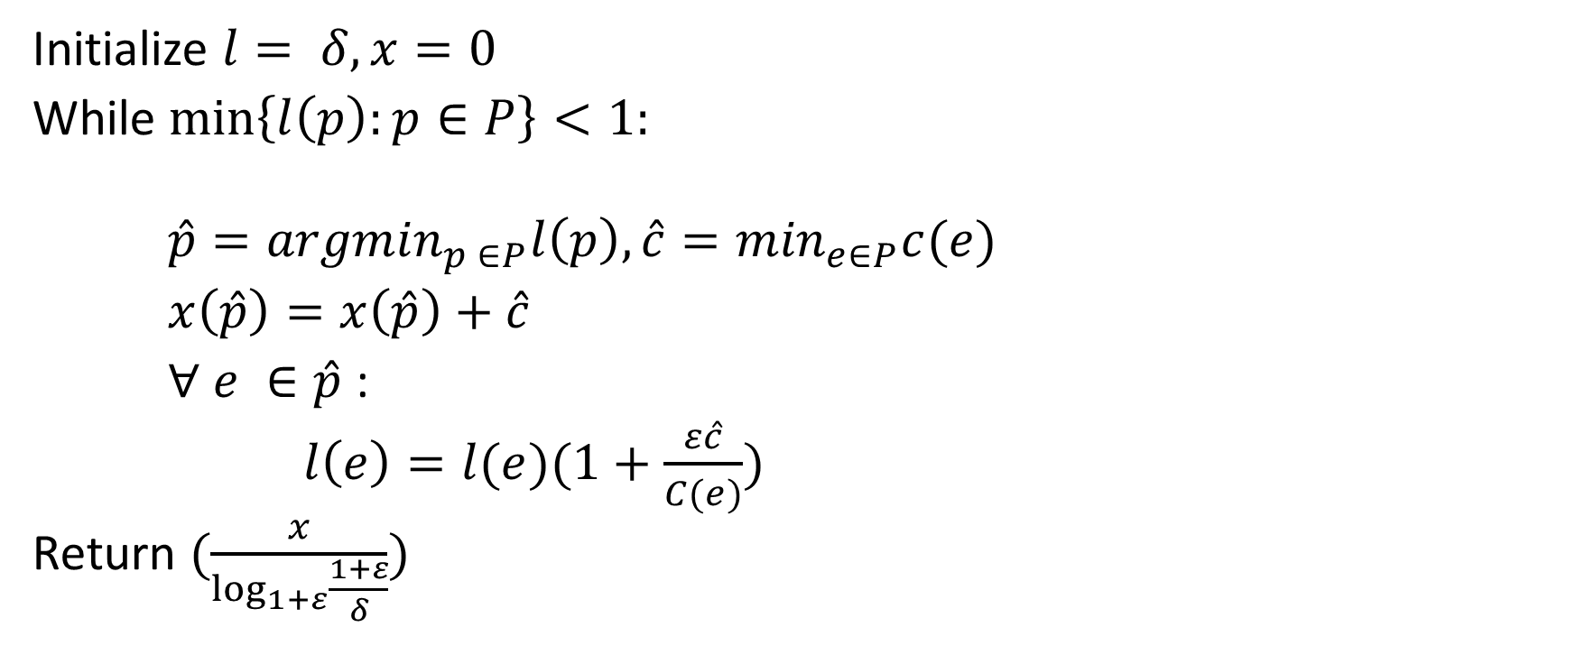
Algorithm
Initialize $l= δ, x=0$
While $\min\left\{l\left(p\right):p∈P\right\}<1:$
$\hat{p}={argmin}_{p ∈P}l\left(p\right), \hat{c}=\min_{e∈P}c(e)$
$x\left(\hat{p}\right)=x\left(\hat{p}\right)+\hat{c}$
$∀ e ∈\hat{p}$ :
$l\left(e\right)=l(e)(1+\frac{ε\hat{c}}{C(e)})$
Return $(\frac{x}{\log_{1+ε}{\frac{1+ε}{δ}}})$

Slide 11






Problem Instance
Commodities: $\left(a,b\right), (e,g)$
capacities
a
$$3$$
b
$$3$$
c
$$3$$
d
e
$$3$$
f
$$4$$
g

Slide 12










Initialization
capacities
flow
length
a
$$0/3$$
b
$$0/3$$
c
$$0/3$$
d
$$δ$$
$$δ$$
$$δ$$
e
$$0/3$$
f
$$0/4$$
g
$$δ$$
$$δ$$

Slide 13










First Iteration completed
capacities
flow
length
a
$$0/3$$
b
$$0/3$$
c
$$0/3$$
d
$$δ$$
$$δ$$
$$δ$$
e
$$3/3$$
f
$$3/4$$
g
$$δ(1+ε)$$
$$δ(1+\frac{3}{4} ε)$$

Slide 14
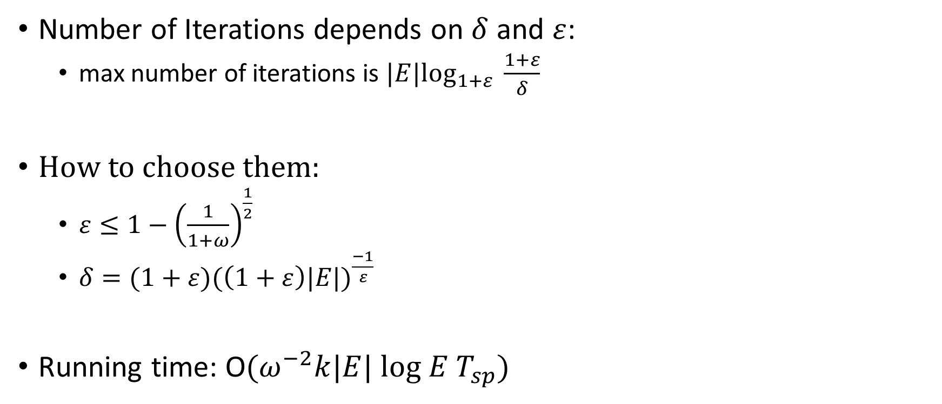
Analysis
Number of Iterations depends on $δ$ and $ε$:
max number of iterations is $|E|\log_{1+ε} \frac{1+ε}{δ}$
How to choose them:
$ε≤1−{\left(\frac{1}{1+ω}\right)}^{\frac{1}{2}}$
$δ=(1+ε)({\left(1+ε\right)|E|)}^{\frac{−1}{ε}}$
Running time: O$(ω^{−2}k|E| log E T_{sp})$

Slide 15
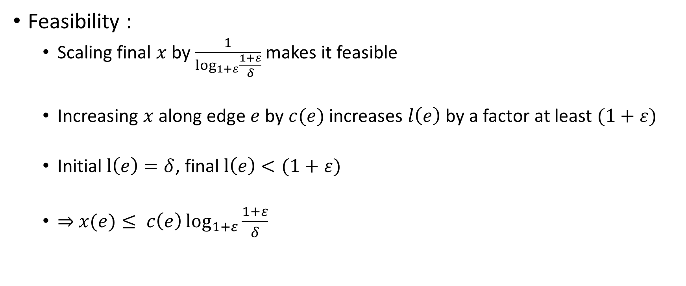
Analysis
Feasibility :
Scaling final $x$ by $\frac{1}{\log_{1+ε}{\frac{1+ε}{δ}}}$ makes it feasible
Increasing $x$ along edge $e$ by $c(e)$ increases $l\left(e\right)$ by a factor at least $(1+ε)$
Initial $l\left(e\right)=δ$, final $l\left(e\right)<(1+ε)$
$⇒$ $x(e)≤ c\left(e\right)\log_{1+ε}{\frac{1+ε}{δ}}$

Slide 16

Analysis
Flow value:
$v\left(x\right)≔\sum_{p∈P}{x\left(p\right)}$
$v\left(x\right)≔\sum_{p∈P}{x\left(p\right)}≥p.opt(1−ω)$
$⇔ \frac{d.opt}{v(x)}≤(1+ω)$

Slide 17

Implementation Difficulties
Small initialization values for big $|E|$ and small $ω$
|E|=1000,$ω$ = 0.05$→$ $ε≈0.024, δ≈$ 3.87*${10}^{\text{-}121}$
Huge variety of edge lengths

Slide 18




Modifications
Stop earlier if primal dual ratio is already smaller than $(1+ω)$
a
2/2
b
$$2/2$$
c
$$δ(1+ε)$$
$$δ(1+ε)$$

Slide 19

Modifications
Group commodities: $\left(d,c\right), \left(a,c\right) → (e,c)$
d
2
c
d
2
c
∞
e
2
∞
2
a
2
b
a
2
b

Slide 20
Modifications
Fleischner

