Slide 1
Kolloqoium
Maximum Multi Commodity Flow Problem

Slide 2
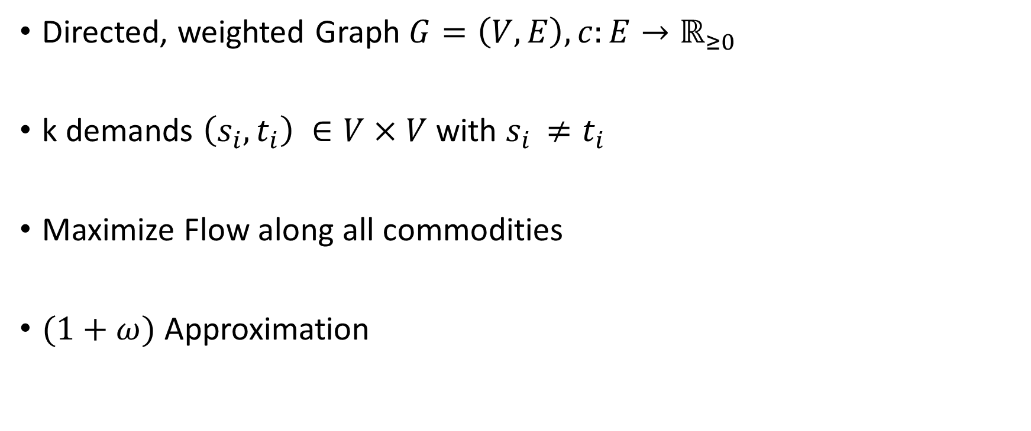
Problem Definition
Directed, weighted Graph $G=\left(V,E\right), c:E→ℝ_{≥0}$
k demands $\left(s_{i},t_{i}\right) ∈V×V$ with $s_{i }≠t_{i}$
Maximize Flow along all commodities
$(1+ω)$ Approximation

Slide 3

Formulation as a Linear Program
$P=\{p⊆E : "p is a path from any source to its sink"\}$
$X=\{x : x : P→ ℝ_{≥0}\}$
$x=\left(\begin{matrix}x(p_{1}) \\ \begin{matrix}. \\ . \\ .\end{matrix} \\ x(p_{|P|})\end{matrix}\right)$

Slide 4

Formulation as a Linear Program
$\max_{x∈X}{\sum_{p∈P}{x(p)}}$
$w.r.t.$
$$\sum_{p∈P_{e}}{x\left(p\right)≤c\left(e\right), where P_{e}=\{p∈P:e∈p\}}, x≥0$$

Slide 5

Dual Program
$\min{\sum_{c ∈E}{c(e)}}$

