Slide 1
The Maximum Multi Commodity Flow Problem
A Case Study of an Approximation Scheme
Notes:
Vorstellung des Themas, meiner Aufgabe und Erawehnung von JgraphT

Slide 2

Maximum multicommodity flow problem
Given:
Directed Graph $G=\left(V,E\right)$
$Capacities$ $c:E→ℝ_{≥0}$
k commodities ${\left(s_{i},t_{i}\right)}_{1≤i≤k} ∈V×V$ with $s_{i }≠t_{i}$
Task:
Maximize flow along all commodities
Notes:
(s,_i,t_i ) sind source und sink

Slide 3

Example1
Commodities: $\left(a,c\right),\left(b,d\right)$
capacities
flow
a
3/3
c
0/2
b
2/2
d

Slide 4

Example2
Commodities: $\left(a,d\right),\left(a,b\right)$
capacities
a
1
c
1
d
1
1
b

Slide 5

Fully polynomial-time approximation scheme
Algorithm:
Input:
Problem instance, accuracy $ω$
Output :
Solution not smaller than $(1−ω)$ times the optimal for a maximization problem
Running time:
Polynomial in size of problem instance and $ω^{−1}$

Slide 6
Garg and Koenemann Algorithm
Fully polynomial-time approximation scheme for MMCFP
Motivation:
Faster than previous known algorithms for a fixed or moderately small ω.
Idea:
Formulate MMCFP as a linear program, solve the dual problem and compute the solution for the primal as a byproduct.

Slide 7
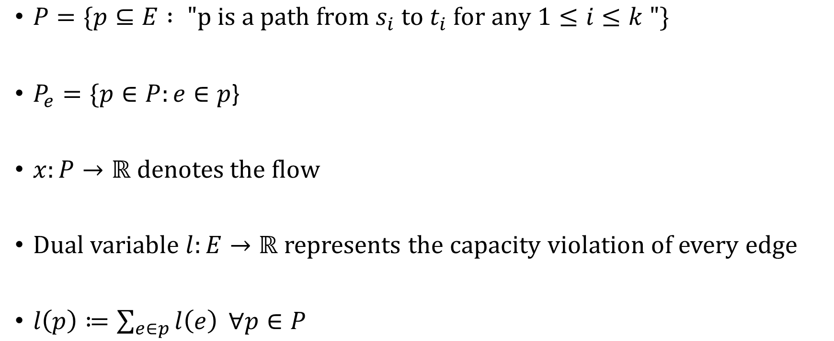
Formulation as a Linear Program
$P=\{p⊆E : "p is a path from s_{i} to t_{i} for any 1≤i≤k "\}$
$P_{e}=\{p∈P:e∈p\text{\}}$
$x:P→ℝ$ denotes the flow
Dual variable $l:E→ℝ$ represents the capacity violation of every edge
$l\left(p\right)≔\sum_{e∈p}{l\left(e\right)} ∀p∈P$

Slide 8
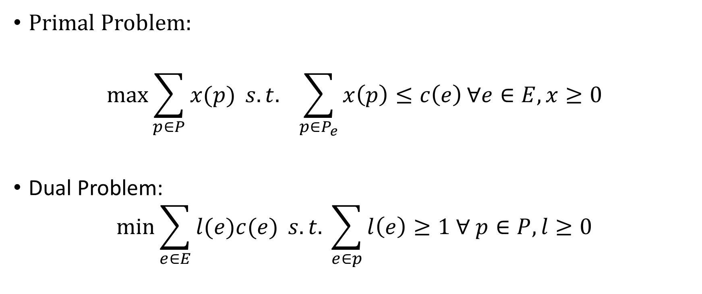
Formulation as a Linear Program
Primal Problem:
$$\max{\sum_{p∈P}{x(p)}} s.t. \sum_{p∈P_{e}}{x\left(p\right)≤c\left(e\right)}∀e∈E, x≥0$$
Dual Problem:
$$\min{\sum_{e∈E}{l(e)c(e)} s.t. \sum_{e∈p}{l\left(e\right)≥1 ∀ p∈P, l≥0}}$$

Slide 9
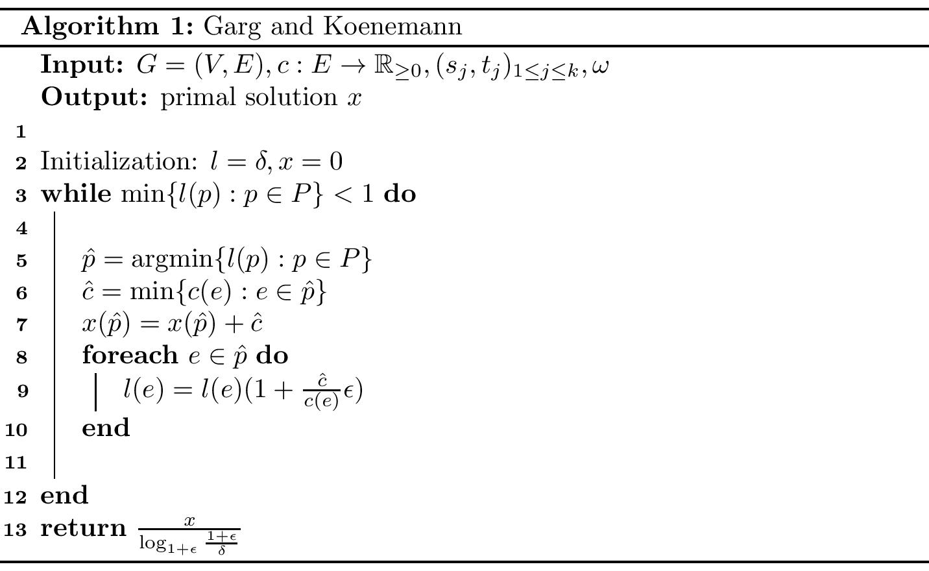
Algorithm

Slide 10






Problem Instance
Commodities: $\left(a,d\right), (e,g)$
capacities
a
$$3$$
b
$$3$$
c
$$3$$
d
e
$$3$$
f
$$4$$
g

Slide 11










Initialization
capacities
flow
length
a
$$0/3$$
b
$$0/3$$
c
$$0/3$$
d
$$δ$$
$$δ$$
$$δ$$
e
$$0/3$$
f
$$0/4$$
g
$$δ$$
$$δ$$

Slide 12




First Iteration completed
capacities
flow
length
a
$$0/3$$
b
$$0/3$$
c
$$0/3$$
d
$$δ$$
$$δ$$
$$δ$$
e
$$3/3$$
f
$$3/4$$
g
$$δ(1+ε)$$
$$δ(1+\frac{3}{4} ε)$$

Slide 13
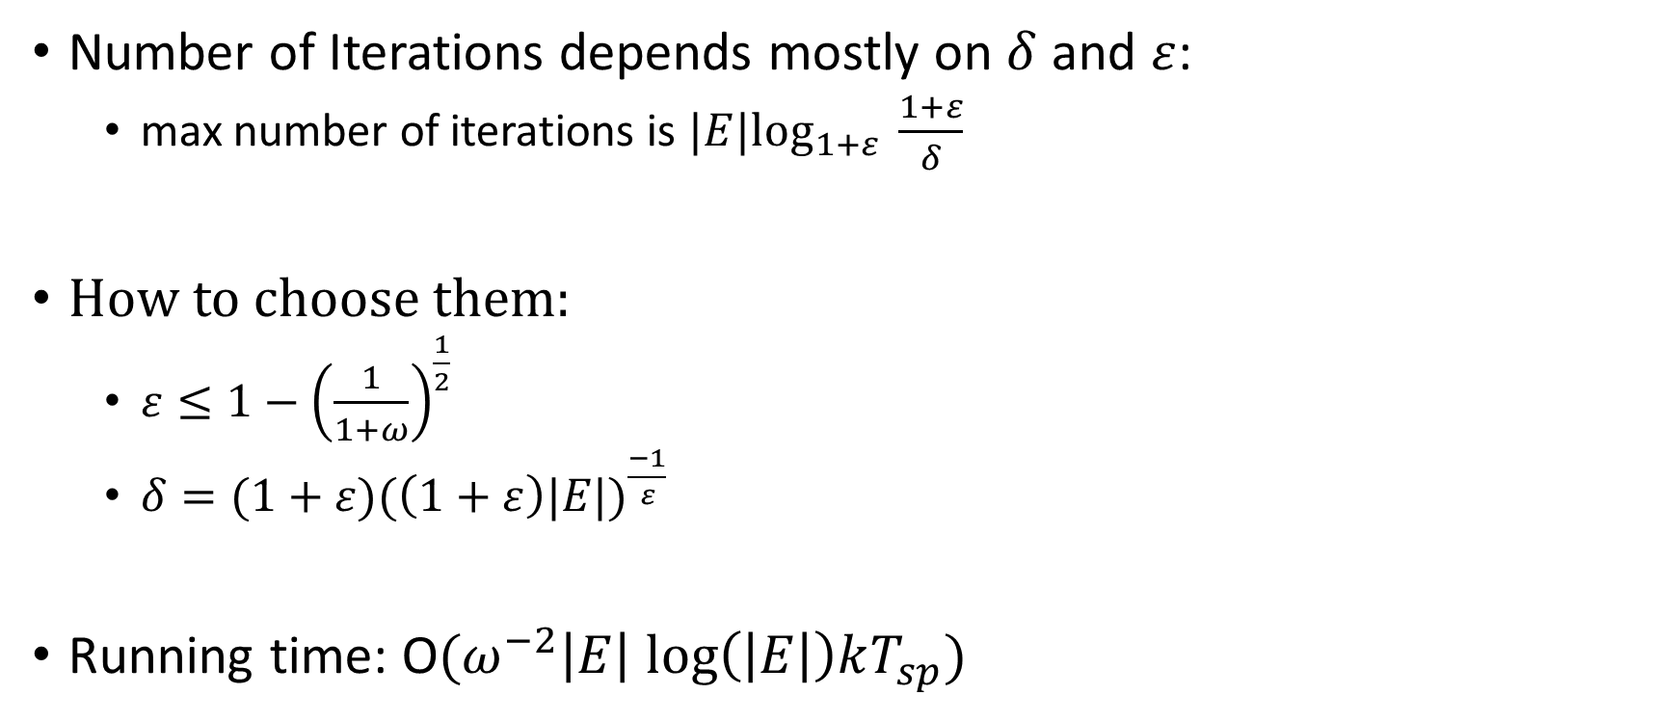
Analysis
Number of Iterations depends mostly on $δ$ and $ε$:
max number of iterations is $|E|\log_{1+ε} \frac{1+ε}{δ}$
How to choose them:
$ε≤1−{\left(\frac{1}{1+ω}\right)}^{\frac{1}{2}}$
$δ=(1+ε)({\left(1+ε\right)|E|)}^{\frac{−1}{ε}}$
Running time: O$(ω^{−2}\left|E\right| log\left(\left|E\right|\right)kT_{sp})$

Slide 14

Analysis
Feasibility :
Scaling final $x$ by $\frac{1}{\log_{1+ε}{\frac{1+ε}{δ}}}$ makes it feasible
Augmenting $x$ along edge $e$ by $c(e)$ increases $l\left(e\right)$ by a factor at least $(1+ε)$
$⇒∀e∈E:\sum_{p∈P_{e}}{x\left(p\right)}≤ c\left(e\right)\log_{1+ε}{\frac{1+ε}{δ}}$

Slide 15

Analysis
Flow value:
$p$ optimal primal objective value, $d$ optimal dual objective value
$v\left(x\right)≔\sum_{p∈P}{x\left(p\right)}≥\left(1−ω\right)p$
For $δ$ and $ε$ chosen as before:
$\frac{p}{v(x)}=\frac{d}{v(x)}≤(1+ω)$ $⇒v(x)≥\frac{1}{1+ω}p$

Slide 16
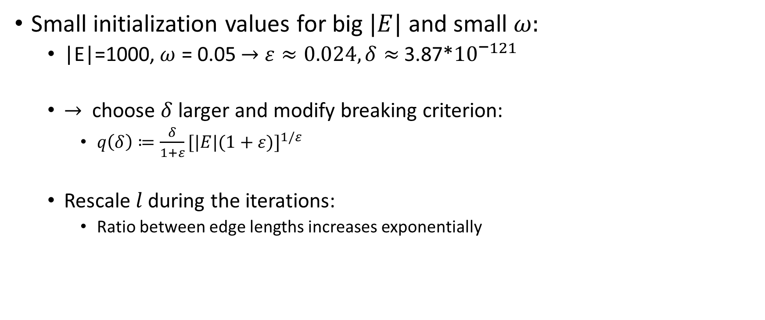
Implementation Difficulties
Small initialization values for big $|E|$ and small $ω:$
|E|=1000,$ω$ = 0.05$→$ $ε≈0.024, δ≈$ 3.87*${10}^{\text{−}121}$
$→$ choose $δ$ larger and modify breaking criterion:
$q\left(δ\right)≔\frac{δ}{1+ε}{[|E|(1+ε)]}^{1/ε}$
Rescale $l$ during the iterations:
Ratio between edge lengths increases exponentially

Slide 17
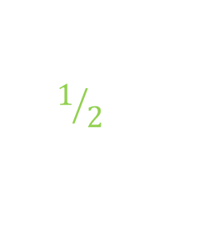


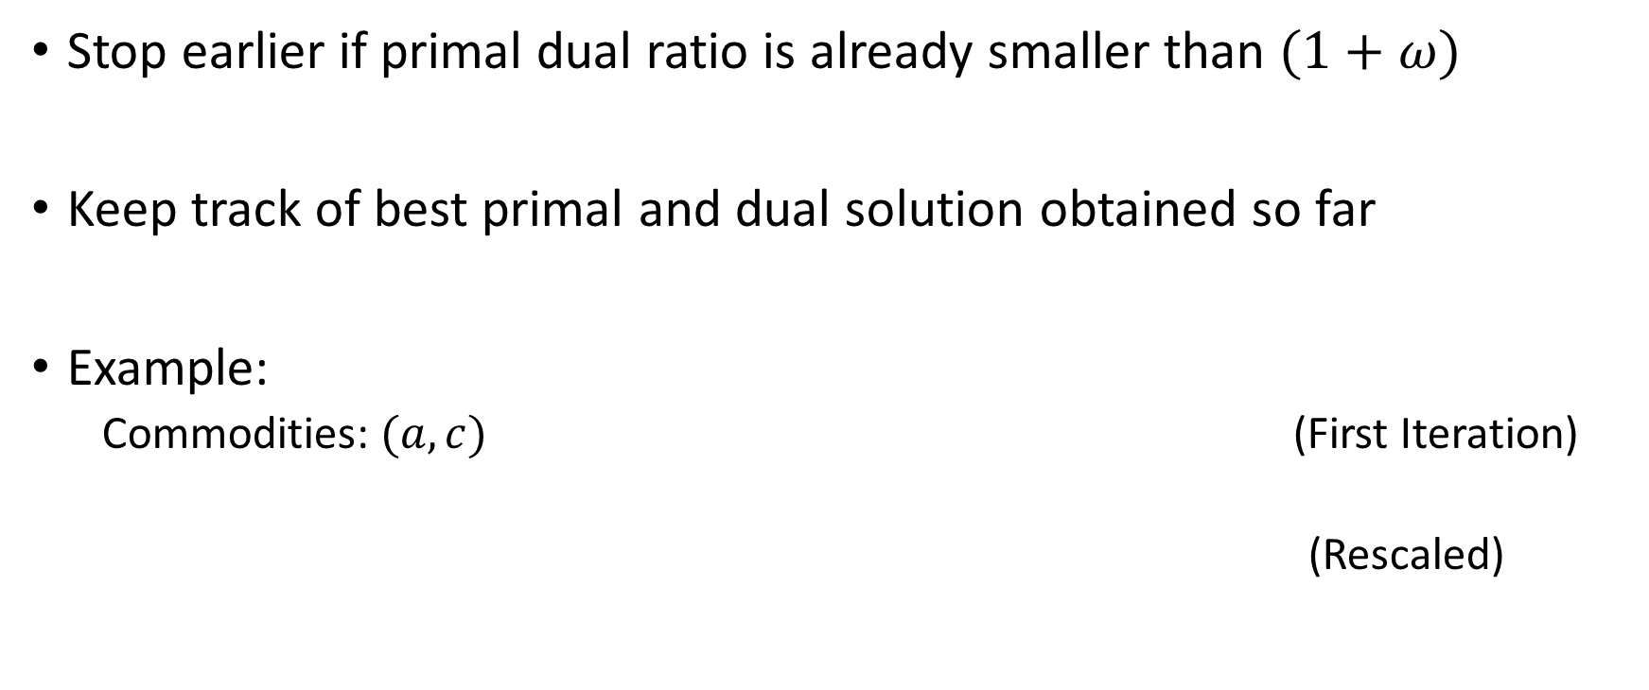



Modifications
Stop earlier if primal dual ratio is already smaller than $(1+ω)$
Keep track of best primal and dual solution obtained so far
Example:
Commodities: $(a,c)$ (First Iteration)
(Rescaled)
a
2/2
b
$$2/2$$
c
$$δ(1+ε)$$
$$δ(1+ε)$$
a
2/2
b
$$2/2$$
c
$$1/2$$
$$1/2$$

Slide 18

Modifications
Group commodities with the same sink
Example:
$$\left(d,c\right), \left(a,c\right) → \left(e,c\right)$$
$→$
d
2
c
d
2
c
∞
e
2
∞
2
a
2
b
a
2
b

Slide 19
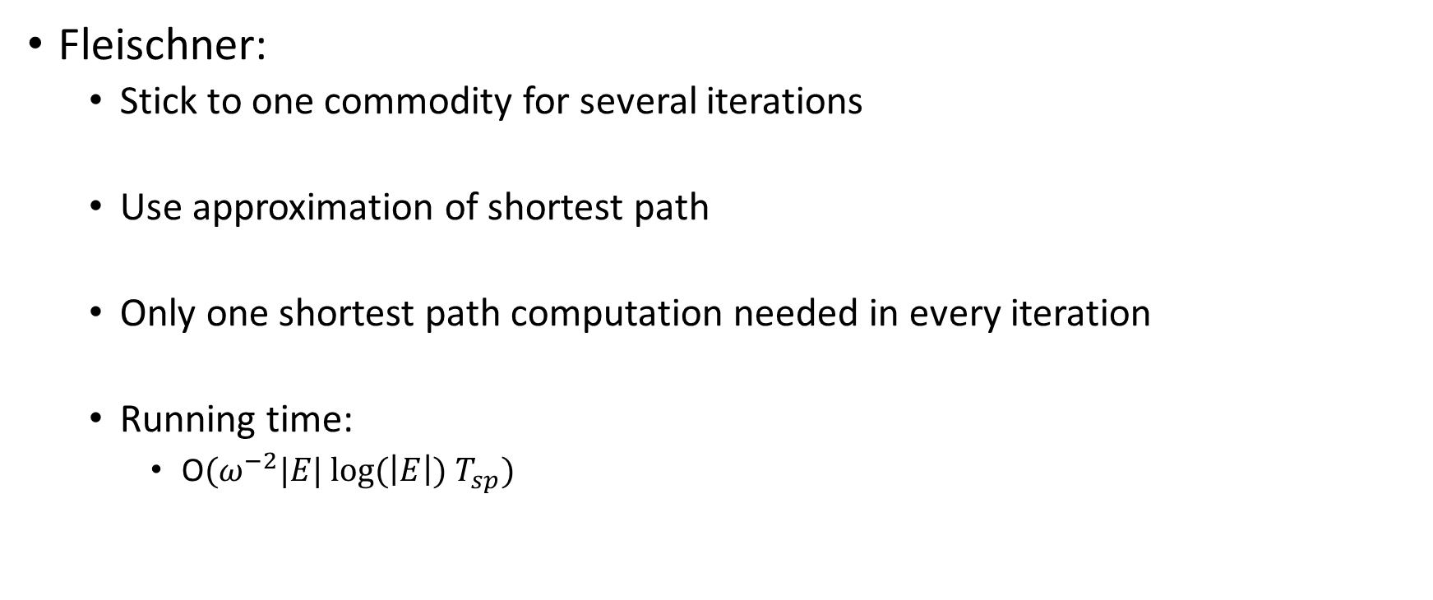
Modifications
Fleischner:
Stick to one commodity for several iterations
Use approximation of shortest path
Only one shortest path computation needed in every iteration
Running time:
O$(ω^{−2}|E| log(\left|E\right|) T_{sp})$

