Slide 1

MEGA SHARKS TRADING STRATEGY EVALUATOR
Dynamic Machine Learning-Based Stock Trading Model Evaluation

Slide 2

OBJECTIVE: Because Investors Need to know…
When to Buy
When to Sell
When to Hold

Slide 3
Agenda
Time (minutes) | Topic
1 | Project Roadmap
2 | Data Preparation
2 | Machine Learning technology employed
5 | Live Demo: Mega Sharks Trading Strategy Evaluator

Slide 4

Project Roadmap
Planning
User-driven data retrieval
Model-based results
Milestone 1
Conception
Sentiment Modeling
Sentiment Integration
Auto-selection of best model
Milestone 2
Commercialization

Slide 5
Data Collection & Preparation
Sources
Yahoo! Finance API
CSVs for prototyping
Prep
Date indexing
Results Delivery
Chart annotation
Number formatting
Streamlit compatibility conversions

Slide 6
Machine Learning & Custom Modeling
FBProphet
<description>
Cerebro
<description>
Custom
<description>

Slide 7
Demo
Please pardon the interruption as we transition to the live Mega Shark Trading Strategy Evaluator

Slide 8
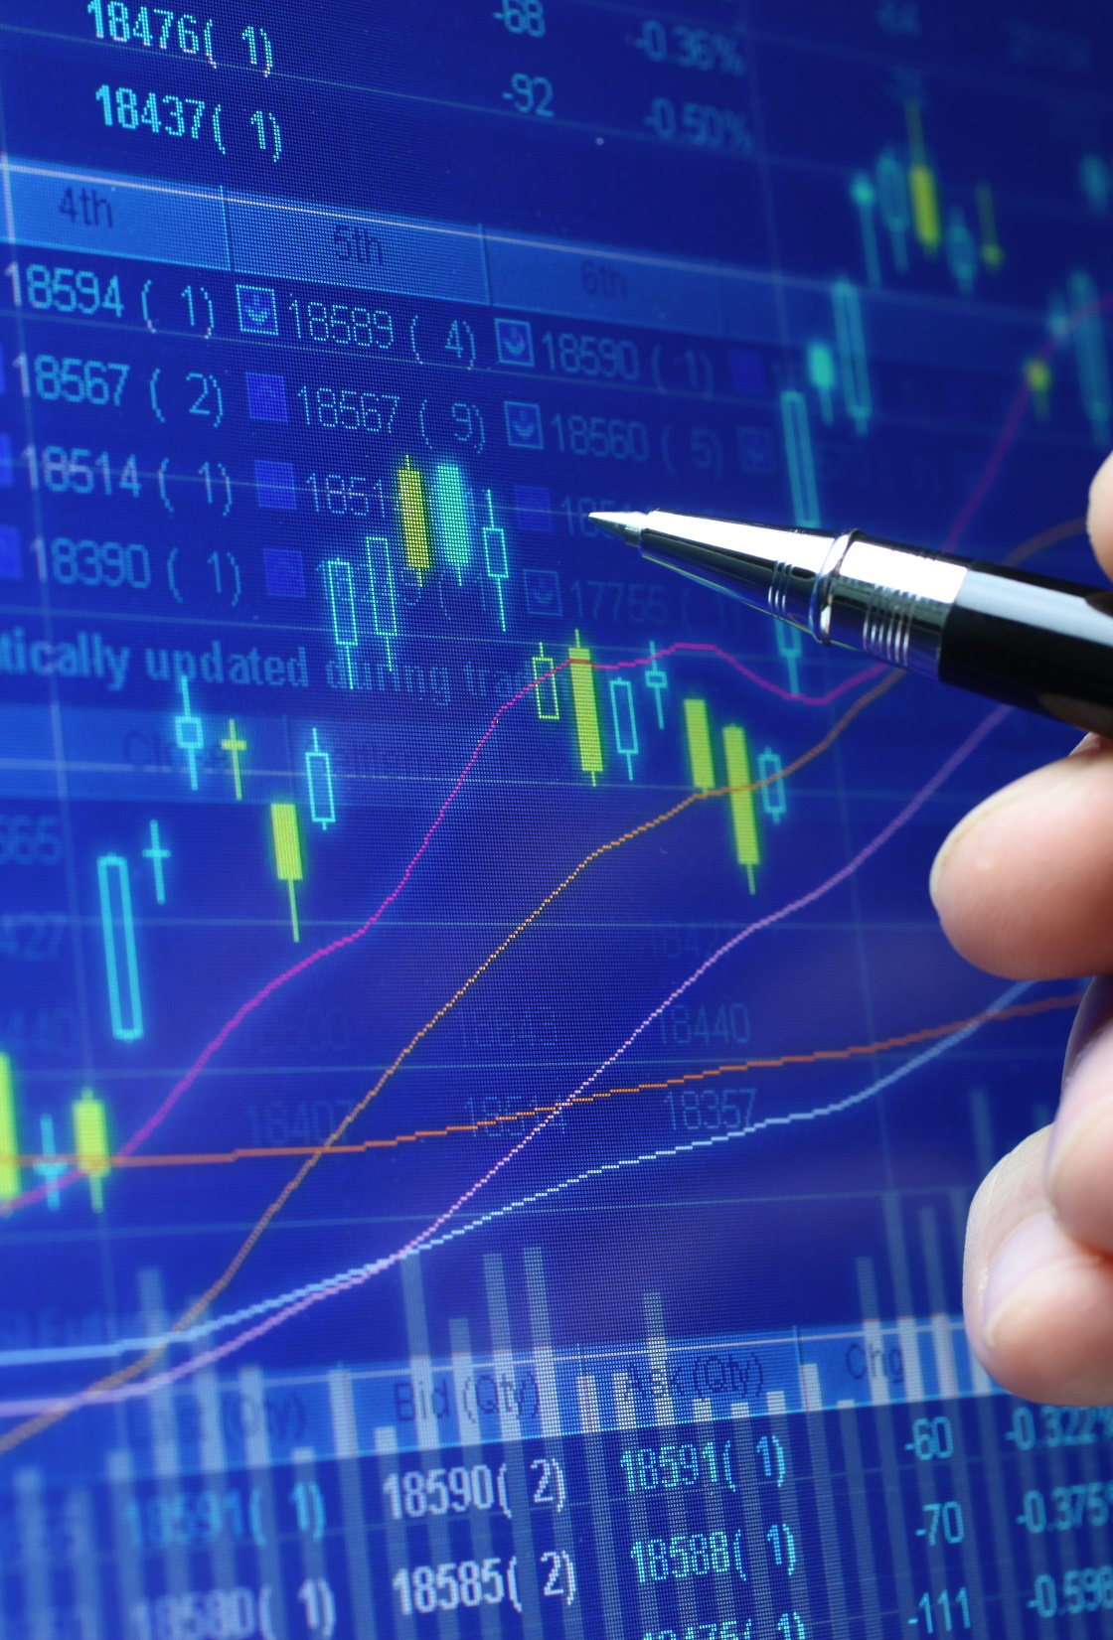
Thank you
The Mega Sharks Team
Emmanuel George: Lead Sentiment Analyst
Jacob Rougeau: Lead Integration Engineer
Tony Landero: Lead Data Scientist
Quentin Reynolds: Lead Innovation Analyst

