Slide 1

MEGA SHARKS TRADING STRATEGY EVALUATOR
Dynamic Machine Learning-Based Stock Trading Model Evaluation

Slide 2
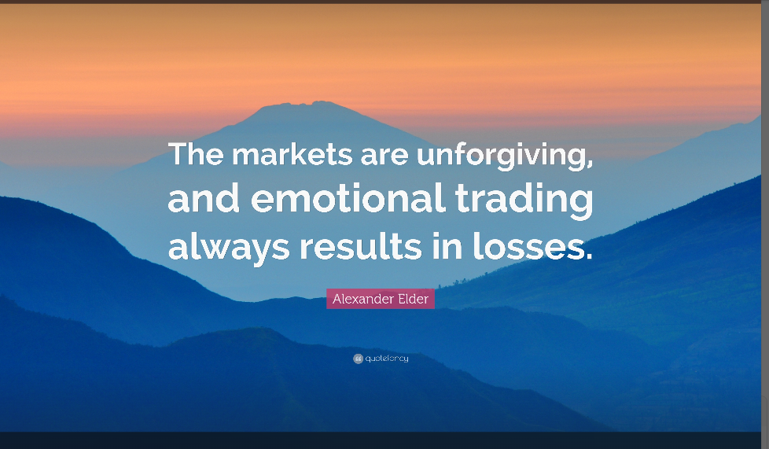

Slide 3

OBJECTIVE: To Remove all emotion in deciding …
When to Buy
When to Sell
When to Hold

Slide 4
Agenda
Time (minutes) | Topic
1 | Project Roadmap
1 | Data Preparation
1 | Machine Learning technology employed
7 | Live Demo: Mega Sharks Trading Strategy Evaluator
Notes:
Presenters:
Slides 1-7
Project Roadmap
Data Preparation
Machine Learning technology employed
Slide 8
Live Demo: Mega Sharks Trading Strategy Evaluator
-

Slide 5

Project Roadmap
Planning
User-driven data retrieval
Model-based results
Milestone 1
Conception
Sentiment Modeling
Sentiment Integration
Auto-selection of best model
Milestone 2
Commercialization

Slide 6
Data Collection & Preparation
Sources
Yahoo! Finance API
CSVs for prototyping (cnn.fg, CBOE)
Prep
Date indexing
Results Delivery
Chart annotation
Number formatting
Streamlit compatibility conversions
Concatenate CSV data sources
Jupyter Notebook for validation
DataFrame creation
Presentation ready DataFrame

Slide 7
Machine Learning & Custom Modeling
FBProphet
Price prediction
BackTrader/
Cerebro
ML trading strategies
Custom
Generate trading signals
Components trends
Backtesting strategies
Plotting strategy results
Identify Indicators
Backtesting
Sentiment Analysis

Slide 8
Trading Strategy Evaluator Live Demo
Please pardon the interruption as we transition to the live Mega Shark Trading Strategy Evaluator

Slide 9
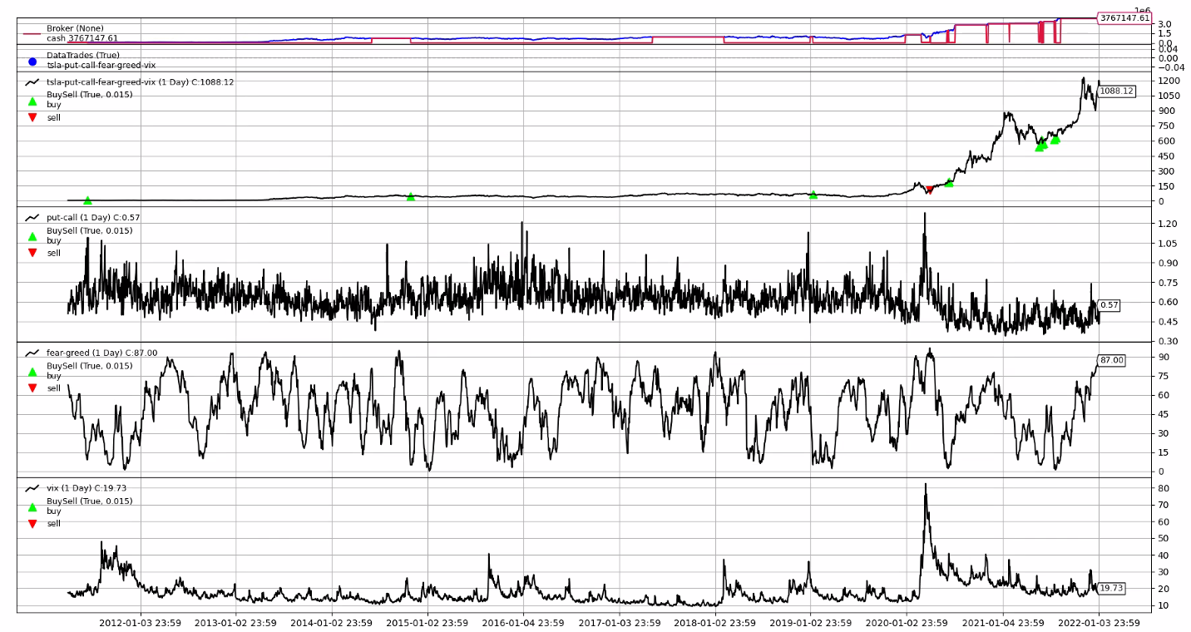
Notes:
VIX tracks only puts. it doesn’t track calls. Every time there’s a spike in the VIX, fear is running hard. The VIX spike here in January correlated to a spike in the fear/greed which also correlates to a skewed put-call ratio towards the puts. This presents a buying opportunity.

Slide 10
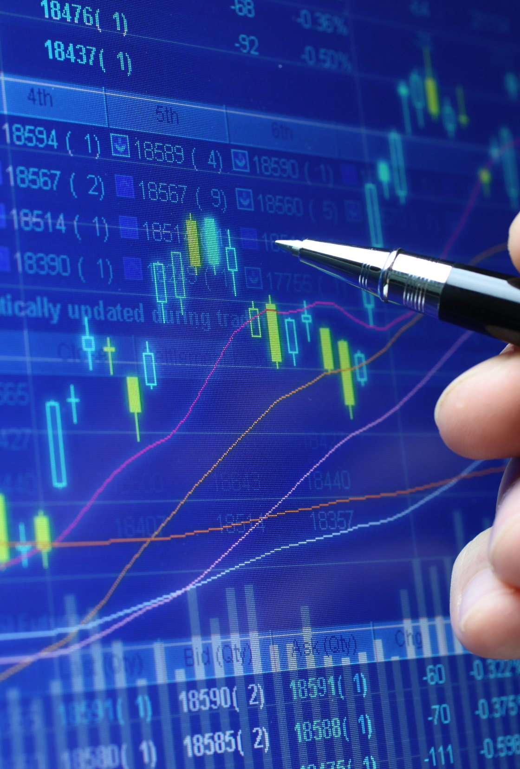
Thank you
The Mega Sharks Team
Emmanuel George: Lead Sentiment Analyst
Jacob Rougeau: Lead Integration Engineer
Quentin Reynolds: Lead Innovation Analyst
Tony Landero: Lead Data Scientist

