Slide 1

CYBERSECURITY PROJECT
Intrusion Detection
System (IDS)
A Python-based network monitoring tool that detects
SYN floods, ICMP floods, and port scanning in real time.
Tested live against a Kali Linux VM.
Built by Favour Isioma | Speedy-Dynamic Global Services & Sensi G-Technology

Slide 2







What is an Intrusion Detection System?
An Intrusion Detection System (IDS) monitors network traffic and system activity for signs of malicious behaviour, policy violations, or known attacks — and raises alerts when threats are detected.
INTERNET
Network IDS (NIDS)
FIREWALL
Sits on the network and inspects all passing packets — like a CCTV camera for your traffic.
IDS SENSOR
[ALERT] Threat Detected!
Host IDS (HIDS)
Monitoring traffic
Admin notified in real-time
Runs on a device and monitors local logs, files and processes for suspicious changes.
SWITCH
Alerts in Real Time
When an attack threshold is crossed, admins are notified instantly before damage spreads.
PC
Server
Laptop

Slide 3

Why IDS is Critical to Network Security
60%
197
24/7
99%
of breaches involve
network-level attacks
days avg. to identify
a data breach
continuous monitoring
with automated IDS
of attacks leave
detectable network traces
Key Benefits of Deploying an IDS
Real-time threat detection — catch attacks as they happen, not hours later
Forensic evidence — full packet logs for incident investigation and reporting
Compliance — helps meet PCI-DSS, HIPAA, ISO 27001 audit requirements
Reduced attacker dwell time — limits the damage window of a successful breach

Slide 4

How This IDS Works — Detection Logic
1
2
3
4
Capture Packets
Extract Source IP
Reset Counters
Raise Alerts
scapy sniff() captures every packet on the interface. store=0 prevents memory buildup.
Each packet is checked for IP layer. The source IP is extracted to track per-host activity.
Every 10 seconds, SYN and ICMP counters reset per IP — rate-per-window detection.
SYN > 100 or ICMP > 50 per window fires an ALERT. Port probes 1–1000 fire an INFO.
Attack Types Detected
SYN Flood > 100 SYN packets / 10s window
ICMP Flood > 50 ICMP packets / 10s window
Port Scanning TCP probes on ports 1–1000 detected

Slide 5

The Code — Python IDS
#!/bin/python
Key Design Decisions
from scapy.all import sniff, IP, TCP, ICMP
from collections import defaultdict
import time
scapy sniff()
ip_counts = defaultdict(
Captures raw packets off the wire. store=0 discards after processing — avoids memory exhaustion.
lambda: {'SYN':0,'ICMP':0,'time':time.time()})
def packet_handler(packet):
if IP in packet:
ip_src = packet[IP].src
Rate-window model
now = time.time()
if now - ip_counts[ip_src]['time'] > 10:
Counters reset every 10 seconds. Catches burst attacks that stay under long-term averages.
ip_counts[ip_src] = {'SYN':0,'ICMP':0,'time':now}
if TCP in packet and packet[TCP].flags == 'S':
ip_counts[ip_src]['SYN'] += 1
if ip_counts[ip_src]['SYN'] > 100:
Threshold alerts
print(f"[ALERT] SYN Flood from {ip_src}")
if ICMP in packet:
>100 SYN or >50 ICMP triggers ALERT — easily piped to a SIEM or log file.
ip_counts[ip_src]['ICMP'] += 1
if ip_counts[ip_src]['ICMP'] > 50:
print(f"[ALERT] ICMP Flood from {ip_src}")
if TCP in packet and packet[TCP].dport in range(1,1001):
Port scan detect
print(f"[INFO] Port probe from {ip_src}")
print("[*] Starting IDS...")
Any TCP to ports 1–1000 is flagged as INFO — mirrors Nmap's default scan range.
sniff(prn=packet_handler, store=0)

Slide 6
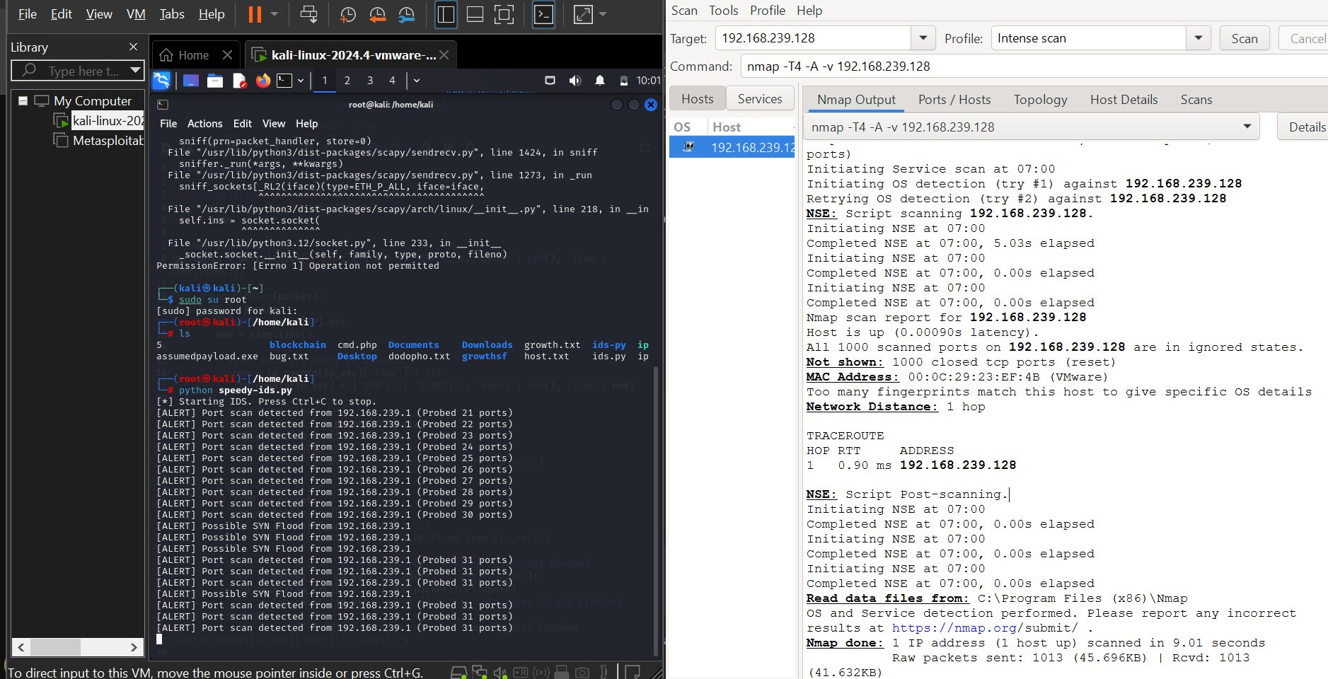
Live Demo — IDS in Action
[ALERT] Port scan & SYN Flood alerts firing as Nmap probes ports on 192.168.239.1
Nmap intense scan (-T4 -A -v) used as the attacking tool from Windows host
IDS running as root on Kali Linux VM — required for raw packet capture via scapy

Slide 7

Attack Scenarios & How the IDS Responds
SYN Flood Attack
Nmap / Port Scanning
Attack: Attacker sends thousands of TCP SYN packets to exhaust the server's connection table — a classic DoS technique.
Attack: Attacker probes ports 1–1000 to map open services for a later targeted attack — exactly what we tested live.
IDS Response: IDS counts SYN packets from each source IP. If >100 SYN packets arrive within a 10-second window, an ALERT fires with the attacker's IP.
IDS Response: IDS detects any TCP packet to ports 1–1000 and logs an INFO notice, allowing admins to identify reconnaissance as it happens.
ICMP Flood (Ping Flood)
Future: Payload Signatures
Attack: Attacker blasts the target with ICMP Echo Requests to saturate bandwidth and cause service disruption.
Attack: Known exploit payloads — shellcode, specific HTTP patterns — can be identified by matching packet content.
IDS Response: IDS counts ICMP packets per source. If >50 ICMP packets arrive within 10 seconds from one IP, an ALERT is fired to the console.
IDS Response: Architecture is extensible: add packet[Raw].load inspection to the handler for payload-level signature matching.

Slide 8

Summary & Takeaways
An IDS is a foundational security tool — it turns invisible network attacks into visible, actionable alerts.
This Python IDS uses Scapy with a sliding rate-window model to detect floods and port scanning live.
Tested live: Nmap intense scan on Kali VM triggered real-time ALERT and INFO messages within seconds.
Lightweight architecture — no database, no storage — deployable on any Linux machine with Python.
Next steps: log to file, SIEM integration, payload signature detection, and a web dashboard.

