Slide 1
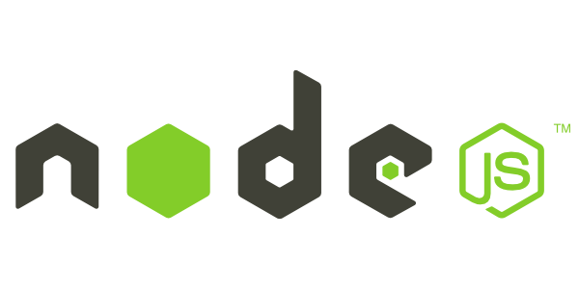
Introduction in NodeJS, Express, Websockets

Slide 2
What is NodeJS?
"Node.js is an open source, cross-platform runtime environment for server-side and networking applications". - Wikipedia
a platform for building JavaScript applications optimized for performing high speed input/output operations
a platform which contains a JavaScript execution engine (that engine is Google's Chrome V8 engine)

Slide 3
NodeJS's early beginnings
NodeJS was created in 2009 by Ryan Dahl, it was first published for Linux
debuted at the November 2009 European JSConf
the continued development was done by Joyent the company where Dahl worked

Slide 4
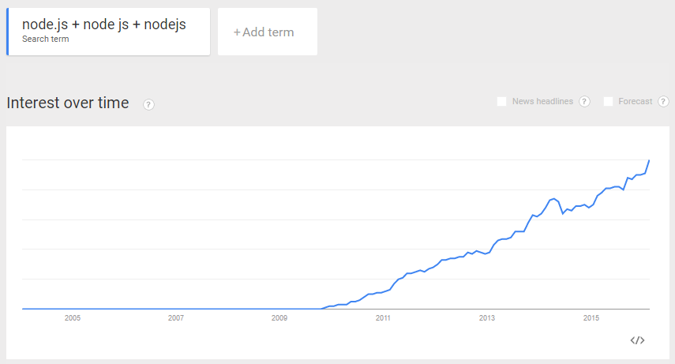
NodeJS's popularity

Slide 5
Who fell in node with it?
Backed by the Node.js Foundation
Got support from Google, Microsoft, IBM and legions of majority fat and single open source developers
Used by: Google, Microsoft, IBM, LinkedIn, Mozilla, PayPal, Uber and so many more, a true eye-catcher

Slide 6
Really now... why NodeJS?
crazy fast (core in C++ on top of V8 Engine)
Asynchronous I/O Framework
Single threaded (but that's ok, will explain later)
One language to rule them all (ECMAScript specification)
Swiss army knife for network
huge package ecosystem (npm)

Slide 7
I like NodeJS, but...
have to think async
don't use CPU intensive tasks
frameworks and tools may not be as mature, but they are in their teens/20s?; ready for production.
javascript "quirks"
callback hell

Slide 8
Single threaded vs. multithreaded
Single threaded non-blocking I/O is better than multithreaded blocking I/O

Slide 9
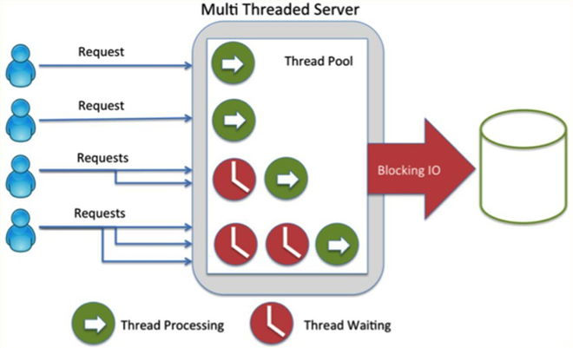
Multithreaded blocking I/O

Slide 10
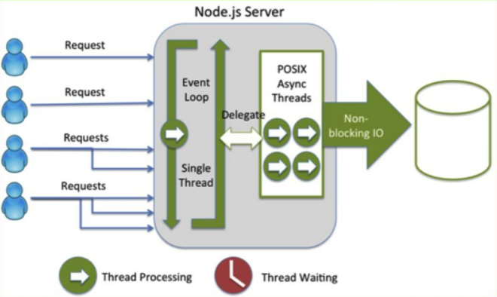
Single threaded non-blocking I/O

Slide 11
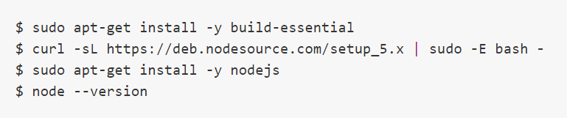
Enough bla, bla how do I use it?
Install NodeJS

Slide 12
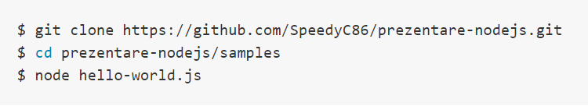
Run first program

Slide 13
What can I use it for?
executable nodes
networking nodes:
  TCP servers
  Websocket servers
  HTTP servers
  DNS server
Anything else (french fries, bike pedometer (already done that), etc)

Slide 14
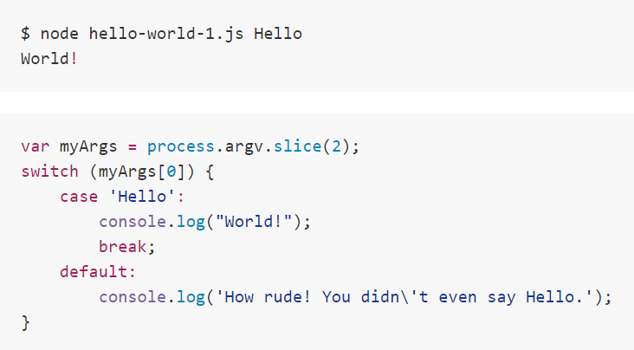
Executable nodes

Slide 15
Networking nodes
You can create a HTTP server with just 5 lines of Javascript
$ node hello-world-2.js
Go to: http://127.0.0.1:2222

Slide 16
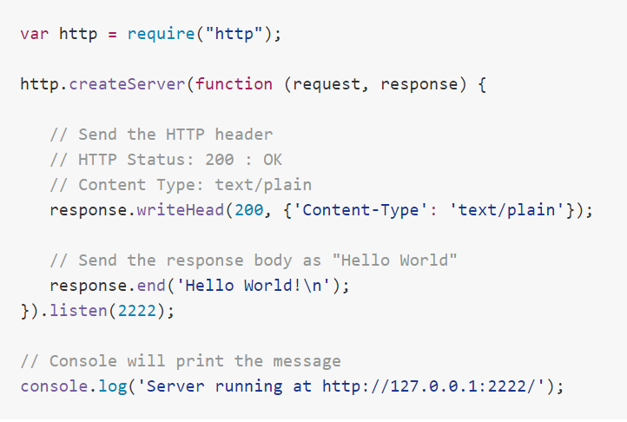
Networking nodes

Slide 17
Modules and NPM
NodeJS relies on modules that are included using the require keyword
One example would be the require("http") from the previous example
Modules can be created easily, just put the javascript code in to a separate js file include it using the require keyword
Libraries in NodeJS are called packages and they can be installed using the command $ npm install package
NPM (Node package manager) is the official package manager for Nodejs and comes bundled with the Nodejs installation

Slide 18
Web frameworks
Build powerful networking applications using NodeJS and the built-in networking features or instead of writing your Apache/Nginx NodeJS version use a web framework.
Web frameworks: Express, Connect, Zappa, ActionHero, etc

Slide 19
Express
fast, minimalistic
handles most of the functionality found in web servers
available at: //expressjs.com or by using NPM

Slide 20
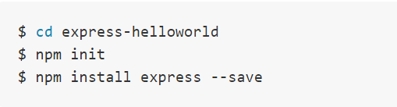
Install Express

Slide 21
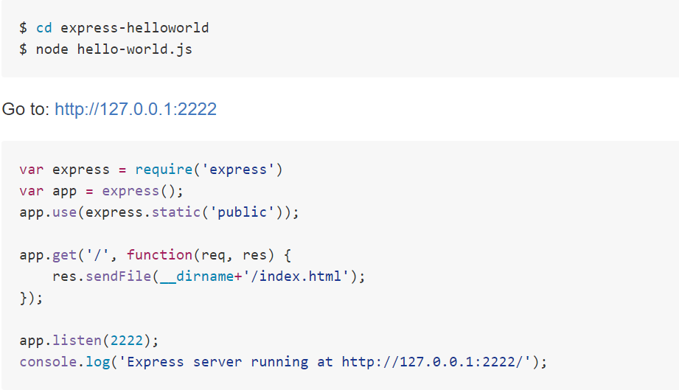
Run Express

Slide 22
Socket.IO
Ok, so we have client Javascript event handling, and server Javascript event handling but can we have full duplex server-client event handling what about realtime full duplex server-client event handling?
Yes we can!

Slide 23
Socket.IO
Supported transports:
  Websocket
  Adobe Flash Socket
  Comet:
    Ajax polling
    Ajax long polling
    JSONP Polling
    Forever Iframe

Slide 24
Socket.IO
What are these transports?
I don't know. But I don't need to know because Socket.IO is a gateway that shields me from having to know the details of each transport. It fallbacks to the transport that is supported by my browser. If I use a shitty browser it will go to a shitty almost realtime transport. If a use a modern browser it will go directly to Websocket.

Slide 25
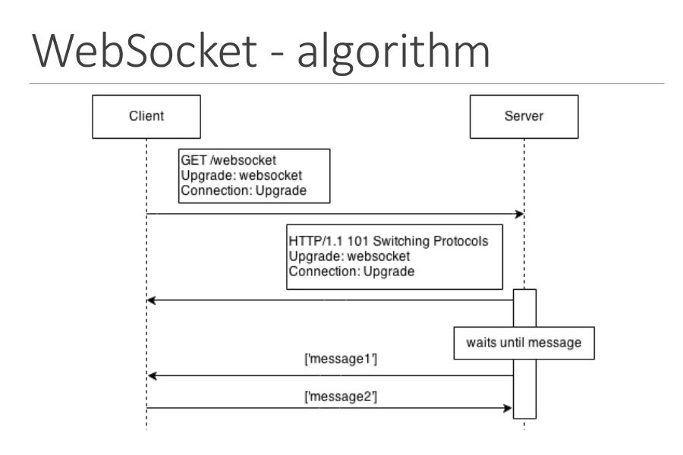
Socket.IO
Websocket

Slide 26
Socket.IO
Websocket
  Advantages:
    Bidirectional
    cross-domain
    binary or text data
  Disadvantages:
    browser compatibility: <IE10, <Android 4.4, <Safari 6.0
    possible problems with proxies (use wss in production)

Slide 27
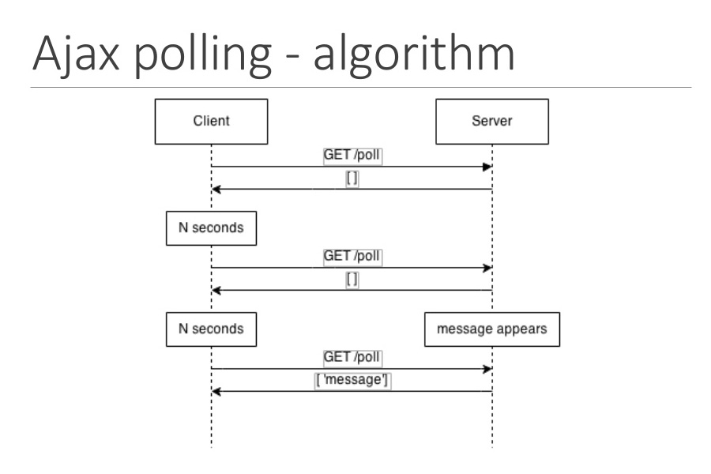
Socket.IO
Ajax polling

Slide 28
Socket.IO
Ajax polling
  Advantages:
    cross-domain requests
    unidirectional communication between client and server
    binary or text data
  Disadvantages:
    big delay between event and notification
    big number of requests
    big incoming traffic
    caching by browsers

Slide 29
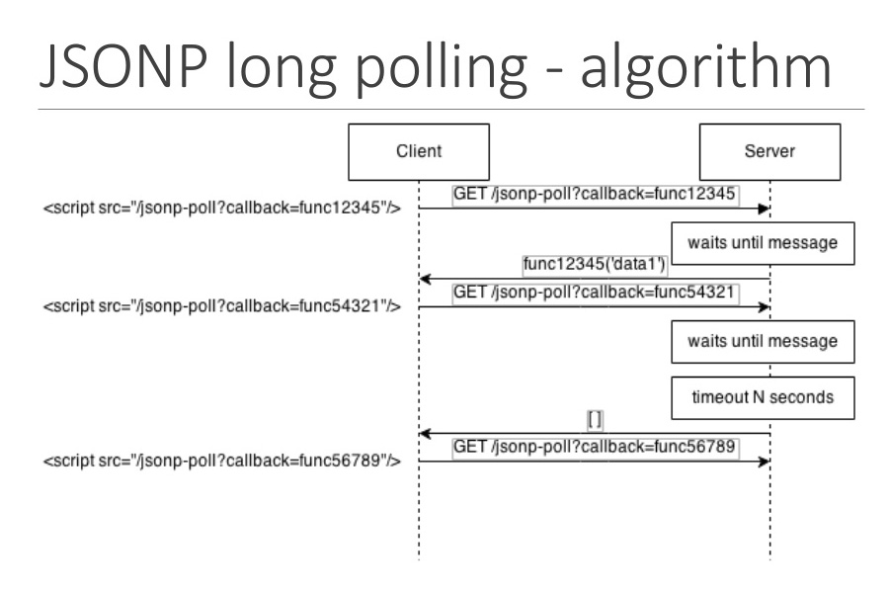
Socket.IO
JSONP long polling

Slide 30
Socket.IO
JSONP long polling
  Advantages:
    cross-domain requests
    unidirectional communication between client and server
    handling success and error callbacks
  Disadvantages:
    big delay between event and notification
    big number of requests
    big incoming traffic

Slide 31
Socket.IO
How to use?

Slide 32
Further reading:
https://nodejs.org
http://expressjs.com/
http://socket.io/
https://github.com/mongodb/node-mongodb-native
http://docs.sequelizejs.com/en/latest/
http://www.actionherojs.com/

Slide 33
Resources
https://os.alfajango.com/websockets-slides/
http://cjus.github.io/nodejs-presentation/
https://nodejs.org

