Slide 1

Traffic Accidents
With minor tangents along the way
Akassh

Slide 2
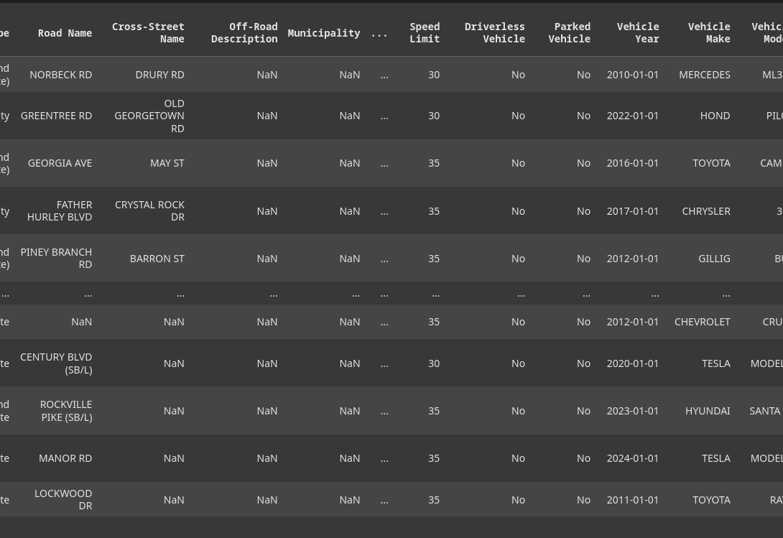
Data, or lack thereof
Data used: https://catalog.data.gov/dataset/crash-reporting-drivers-data

Slide 3

40 columns with more junk than a scrapyard

Slide 4
Why is there junk in GOVT data?!
Police reports contain so many strings like "unknown" or "invalid" or "other", even for things like Weather. -> Laziness or not relevant
Even columns that should tell us about party impairment, such as drug or alcohol usage is blank in some cases or contain strings like "unknown, unknown". This can be due to the accident not needing to know whether the driver has been impaired or not since the driver is already going to get charges for other items.

Slide 5
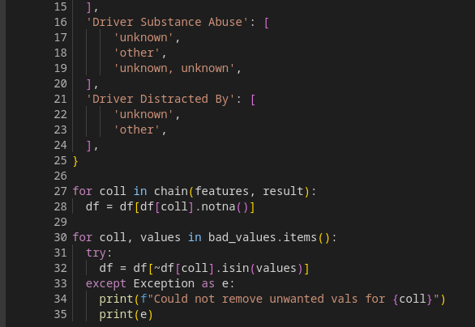
Step 1: Pre Processing
Remove Nas or Nans
Remove rows with unwanted values for our purposes

Slide 6
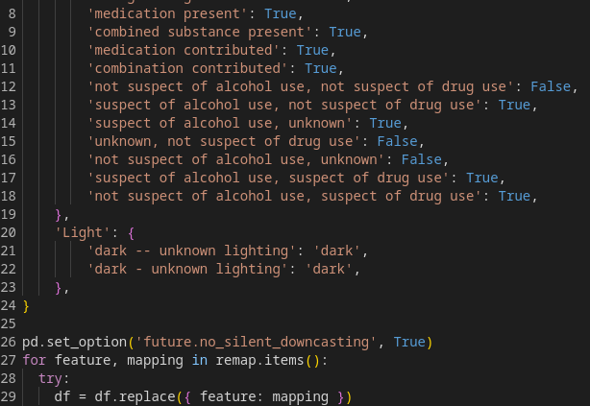
Step 2: More Pre Processing
Sometimes different values really mean the same thing

Slide 7
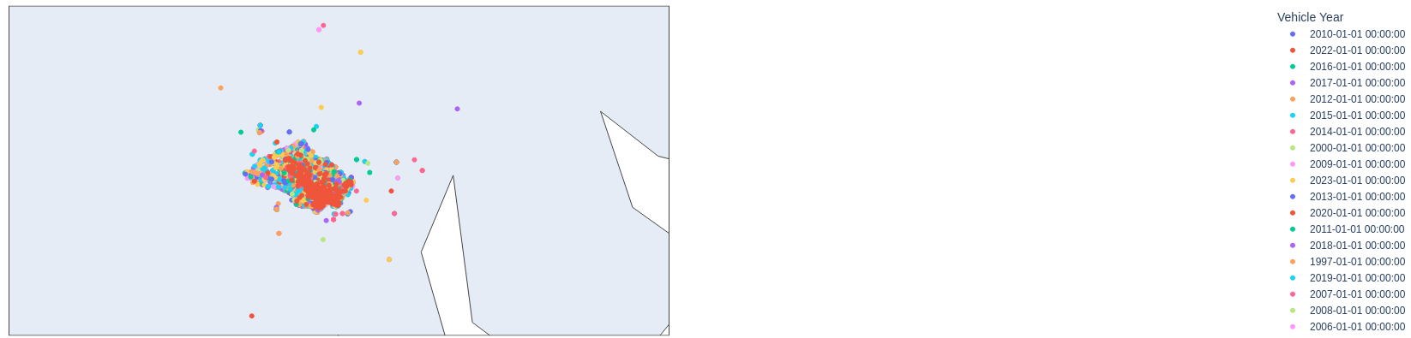
Step 3: Bask in the glory of maps

Slide 8
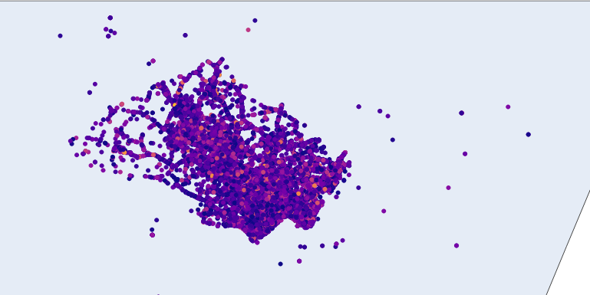
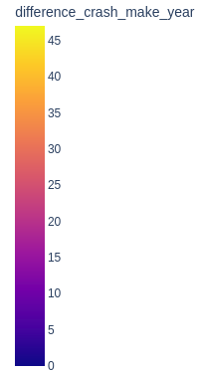
Step 3: Bask in the glory of maps

Slide 9
Tagent 1: GIS Geographic Information Systems (Specifically encoding and databases)
How do computers know that two events occurred close together in space?
It is hard just by looking at lat and long coords
Solution: GIS databases

Slide 10
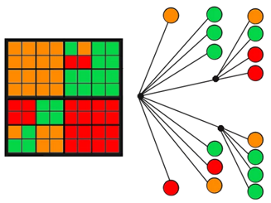
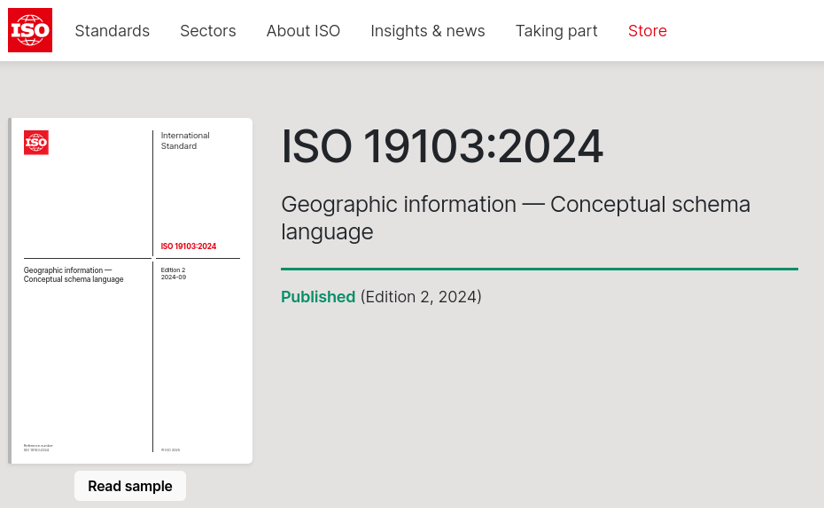
Tangent 1: GIS databases
https://www.iso.org/standard/83454.html

Slide 11
Step 4: One Hot Encoding
Text columns get taken to be categories
Low, Medium, High -> 0, 1, 2
But
(Driver distraction)
"adjusting audio and or climate controls", "by other occupants" cannot be different numerical values in the same feature. They are categorically different types of events!

Slide 12
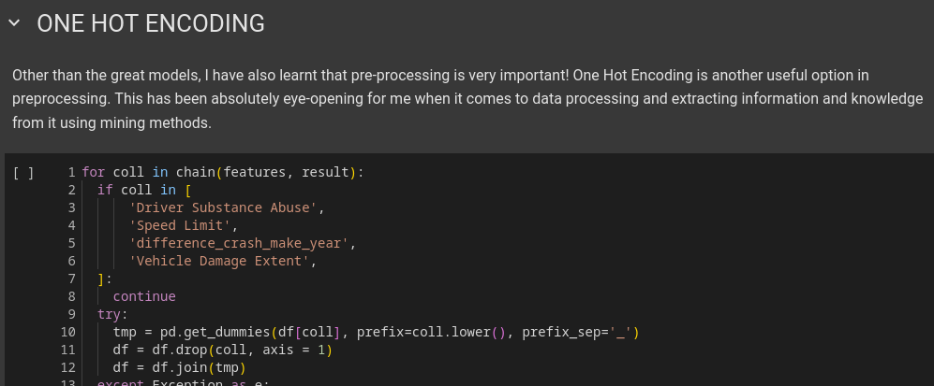
Step 4: One Hot Encoding

Slide 13
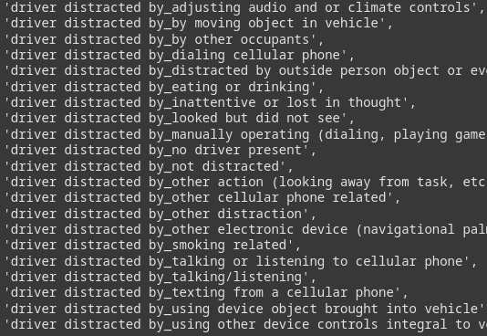
Step 4: One Hot Encoding
One feature gets split into multiple features with Boolean values

Slide 14
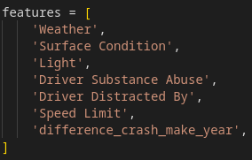
Step 5: TREEEEEE
How bad is the crash?
Based on?

Slide 15
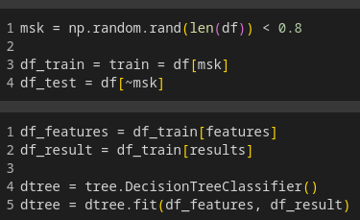
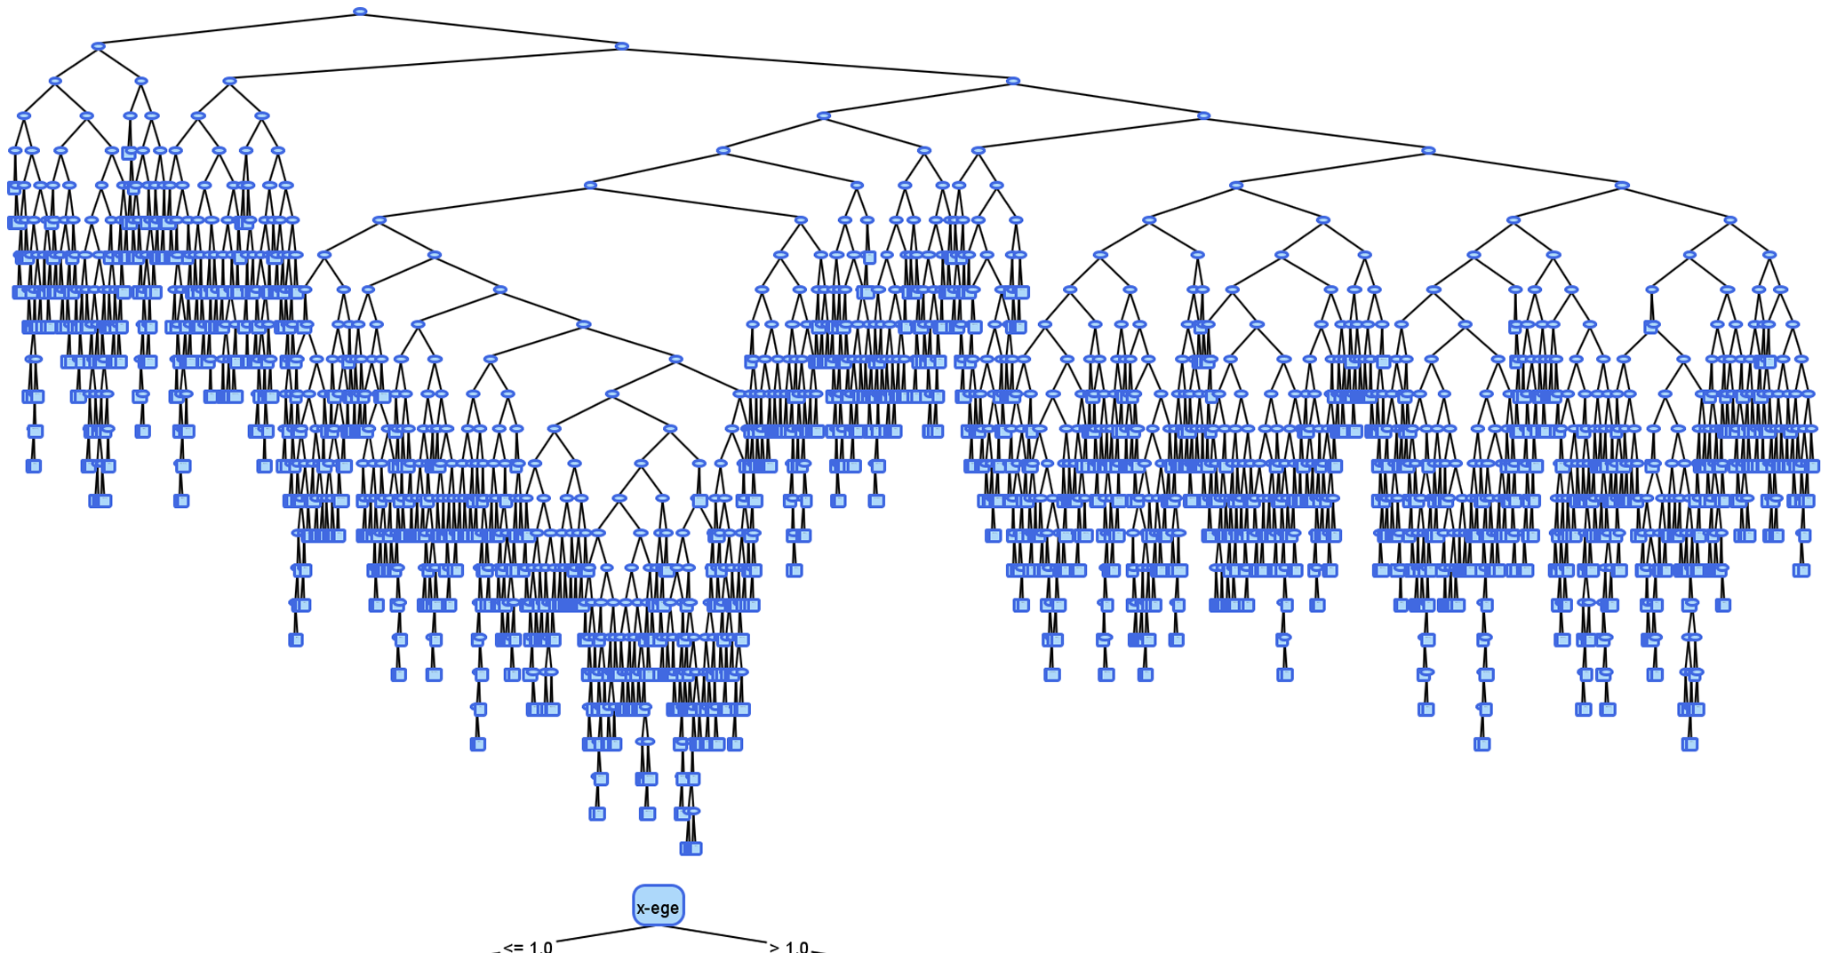
Step 5: TREEEEEE

