Slide 1



LEIM - PFC #24 Speedy Manager
Realizado por:
45109 Rui Inácio
45128 João Folgado
Orientador:
Eng. António Teófilo

Slide 2

Context
Task organization – lots of tasks
Personal tasks
Professional tasks
Task lists

Slide 3


Problem / Motivation
We have numerous tasks
Want shared tasks
We don’t want to lose/forget tasks

Slide 4
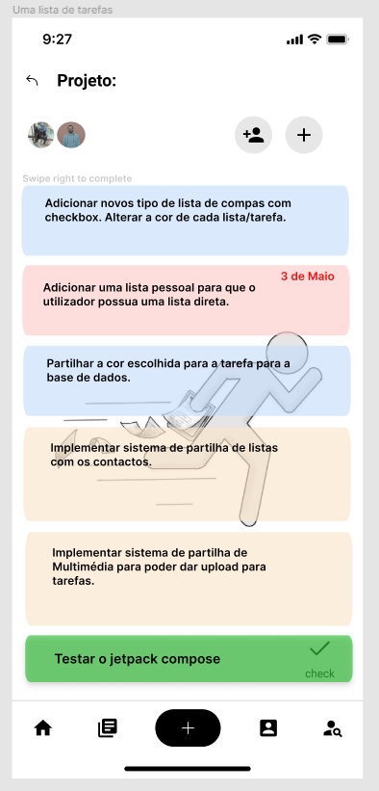
Speedy Manager
Mobile app and website that supports the organization of tasks and task lists cloudbased
Sharing tasks amoung people
Simultaneous handling of tasks
User-friendly and acessible interface

Slide 5
Features and details
Cloud database
Real-time synchronization
Task lists
Sharing lists between users
Drag tasks up and down
Swipe commands to delete or complete tasks
Friendly and intuitive interface
Image sharing
Chat function

Slide 6
Feature Comparison of similar applications
Features | Trello | Microsoft To Do | Google Tasks | Speedy Manager
Friendly, accessible, intuitive interface | ü | ü | û | ü
Task creation | ü | ü | ü | ü
Creating Task Lists | ü | ü | ü | ü
Swipe commands to complete tasks | û | û | ü | ü
Swipe commands to delete tasks | û | ü | û | ü
Tasks with colors | ü | û | û | ü
Tasks with images | ü | û | û | ü
Tasks with files (txt, pdf, images) | ü | ü | û | ü
Colored task lists | ü | ü | û | ü
Task lists with default application images | ü | ü | û | ü
Task lists with images of the user's choice | ü | û | û | ü
Task lists with task lists inside | ü | ü | ü | ü
Progress bar within task lists | ü | û | û | ü
Chat function | ü | û | û | ü
Shared task lists | ü | ü | û | ü
Real-time synchronization | ü | ü | û | ü
Drag tasks up and down | ü | ü | ü | ü
Tasks organized by date | ü | ü | ü | ü
Tasks organized by priority | ü | ü | û | ü
Calendar with tasks to be completed (independent of the list) | ü | ü | û | ü

Slide 7
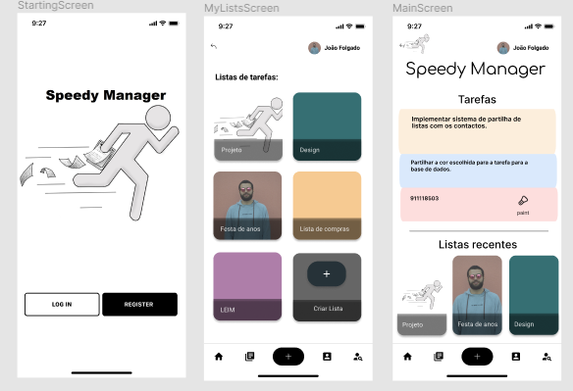
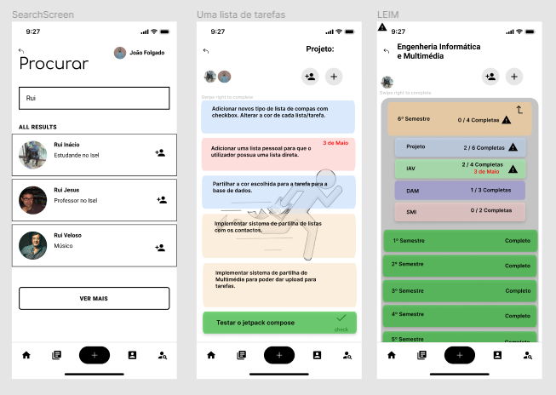
Design of a mobile application alike

Slide 8


Tools and Technologies

Slide 9
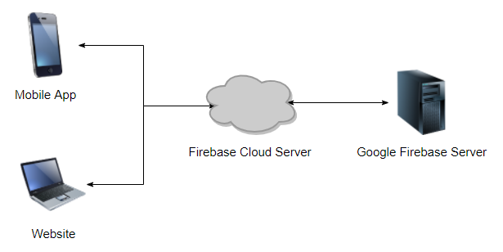
System architecture
Autentication
Realtime Database
Storage
Hosting

Slide 10
Tasks to do
Implementation of missing functionabilities
Design the web version
Finish Mobile application
Project a testing phase
Develop web aplication interface and firebase integration
Test the multimedia multiplantaform system.
Make interface look better
Present

Slide 11
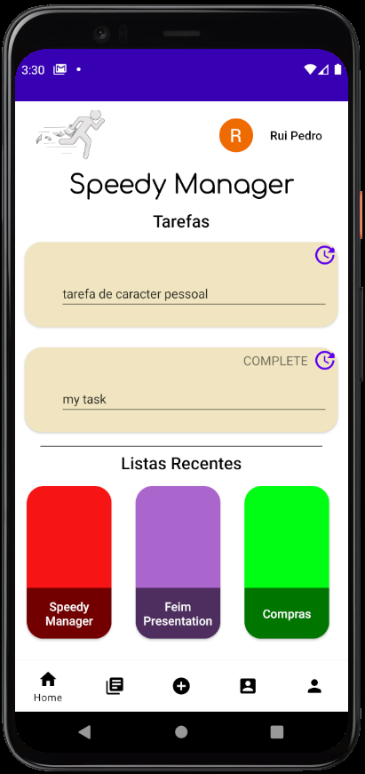
Conclusões
To the current day we have a prototype of the mobile application ready as well as a backend infraestruture ready to be expanded into a multi-plantaform system.

Slide 12
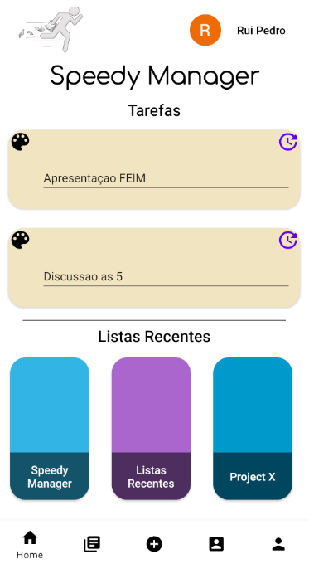
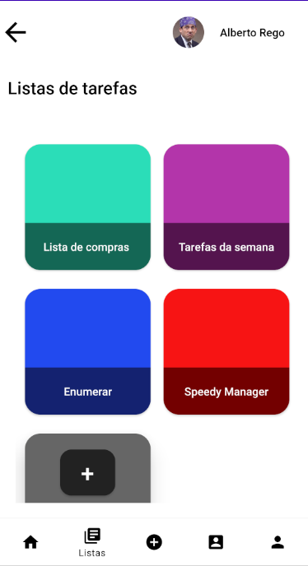
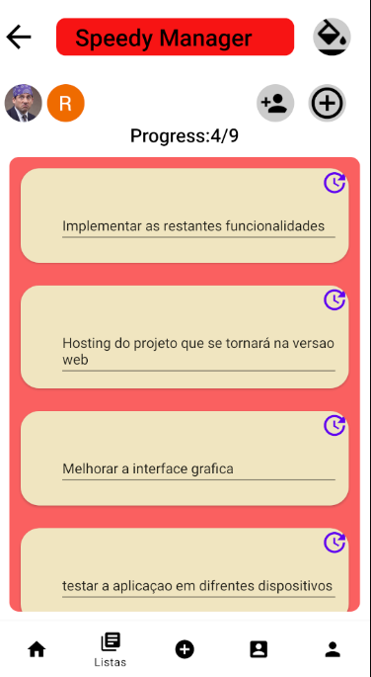
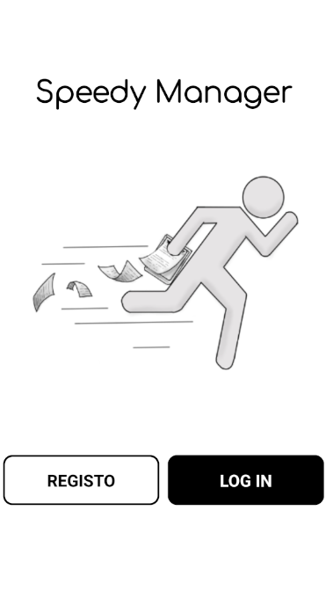
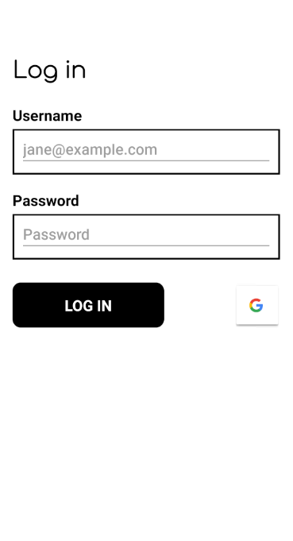
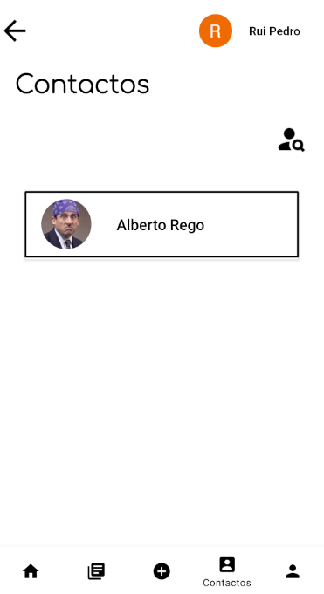
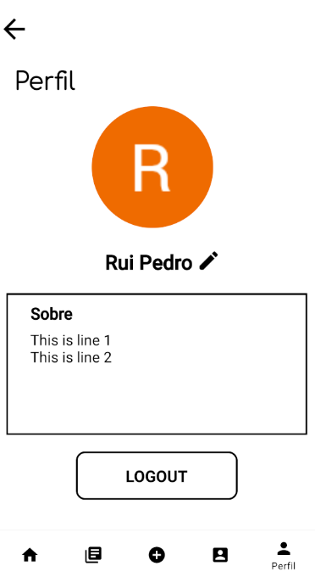
Protótipo desenvolvido

