Slide 1

Cover
Bolted flanges
A
B
C
Housing
Front view of the gear mechanism of the system in the housing, end caps removed
Input coupling connected to an electric motor, 50% of the power
Output coupling
Bolt holes
Shaft 2
Shaft 3
Top view with the cover and bolts removed
Shaft 1
n1
n2
n3
End caps
Input coupling connected to an electric motor, 50% of the power
Input: n1=2600rpm, 70 KW
n3 =400±3 rpm
100% efficiency
Choice of No. of teeth: at least one prime number for each pair is preferred.
d_{min} should be at least 20 mm.
F.S. ~ 1.27 or larger (for shafts, think, why?).
Group work and group submission, but individual grading.

Slide 2
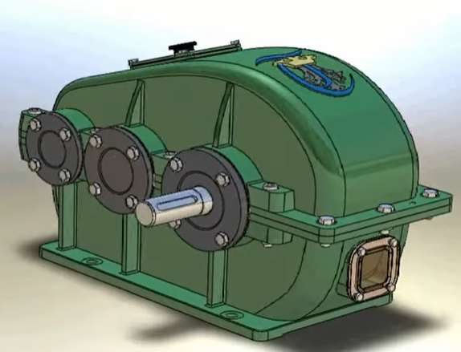
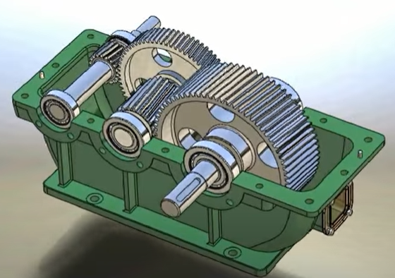
Recall
Gear reducers
https://www.youtube.com/watch?v=b66_rPsUD1w
https://www.youtube.com/watch?v=8Li8w9EH0Sk
https://www.youtube.com/watch?v=hvPhUIntHs0

Slide 3
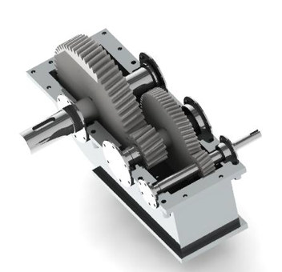
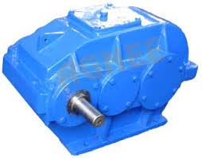
More two-stage gear reducers

Slide 4
How and where to start?
Gear train: Speed and speed ratio >>>> train design and gear geometry
Design and calculation: Knowing the power
Power and speed >>> torque for each shaft >>>>> shaft design
Gear forces and strength
Bearing selection

Slide 5
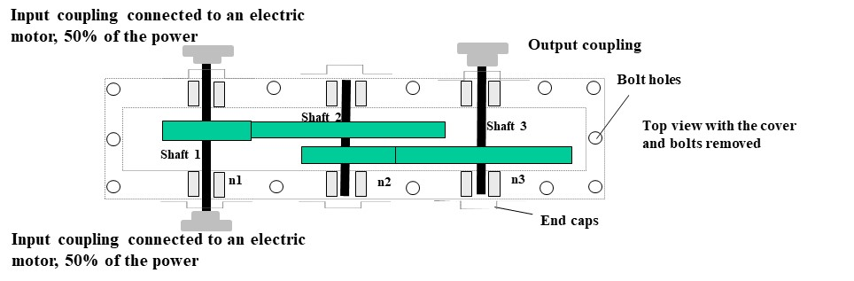
The distances between gears on the middle shaft: about 10 mm, use a should there.
Distance between gears and the housing inner wall: about 10 mm. Make sure the shaft deflections are small while avoiding interference. This means that the shaft cannot be two long and too thin.
As for the module and number of teeth of gears, think, which set is under a larger torque?
If the gear is small, consider a gear shaft.
The length of the shaft with an outlet should consider the size of the input/output element and the bolt heads on the end cap there.
Make sure you have proper shoulders for your shaft. The outlet shaft should also have a shoulder for the input/output element although we don't do its structural design.
The end cap that allows the shaft outlet should have a seal.
The shaft and gear, the shaft and bearing should have proper fits. Pay attention to how fits and tolerances are expressed on the assembly and part drawings.
The keyways of each shaft may be placed along the same line only for simplicity here.
Each assembly drawing needs overall dimensions and fit dimensions. No part dimensions should be on the assembly, but all parts should be labeled, numbered, and listed.

Slide 6
Keyway stress concentration factors. Based on Spotts and Shoup (1998)
for chrome-nickel alloys (or SAE 3140, S_{ut}~ 710 MPa) may be 2.07,
for medium-carbon steel (or SAE 1045, S_{ut}~ 550 MPa) may be 1.61

Slide 7
The major portion of your assembly is similar to this one, but you don’t need to draw the input-output elements. However, you need show the entire structure between end caps and proper assembly dimensions. You also need to label the parts and create a part list on top of your title block of the drawing.

Slide 8
Challenges
Any innovative design options?
A better arrangement? Compact design?
Using a novel gear (or new types of gears)?
Novel gear box structure?
Convenience for maintenance?
Multifunctional?
Additive manufacturing of parts or the housing?
…..

