Slide 1
Camp OAC Group C
Aidan Murphy, Cam Wilson, Karlen Speiser, Zach Prenovost

Slide 2
Software Description
Our objective is to develop a mobile friendly website to assist in the process of selling firewood bundles. The website will allow customers to place orders and choose a general pickup location around the Kelowna region.
Firewood stock will be automatically updated in our database after a transaction has been confirmed and can also be manually updated by staff. we will also be keeping track of transaction records and customer information. The website will allow debit/credit purchases using Square, and allow cash / E - transfer transactions through staff verification.

Slide 3
Target User Groups
Customers:
No login needed; Simply input contact information
Navigate website and create purchase requests
Select preferred pick up location
Make credit/debit purchases using Square
Staff:
Administrator login portal
The ability to manage inventory levels
Direct contact with customers for special cases
Able to confirm that cash payment has been received
Notes:
Customers:
No account creation or login, users should only have to input contact details (email/phone number)
They will navigate the website and create purchase orders
Fill in forms to complete credit/debit card payments
Staff:
Will login to admin portal
Manually adjust inventory levels
View customer contact information
Approve or deny large purchases and cash/E transfer payments

Slide 4
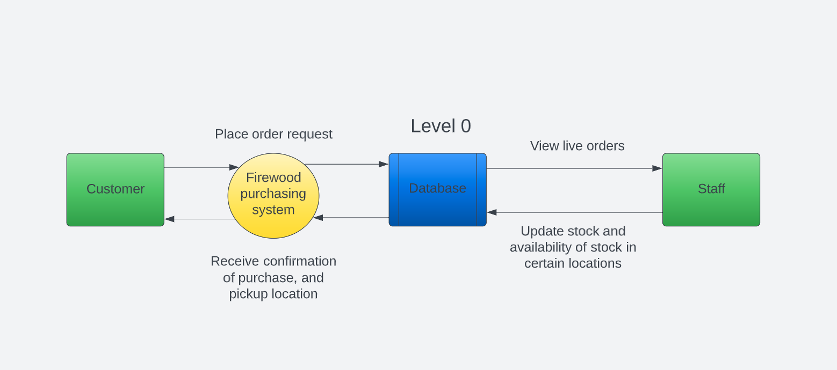
Data-Flow-Diagram Level 0
Notes:
The level 0 DFD depicts the major processes of our system.
Customers can make order requests for firewood and request a pick up location. All orders will be tracked through our database to confirm inventory availability as well as to keep a log of transaction records. Whenever a purchase is confirmed the customer will receive a purchase receipt with pick up location information attached.
The staff is able to view all live orders and manage ongoing purchase requests. They also are able to update inventory stock, and will have to approve cash / e-transfer orders

Slide 5
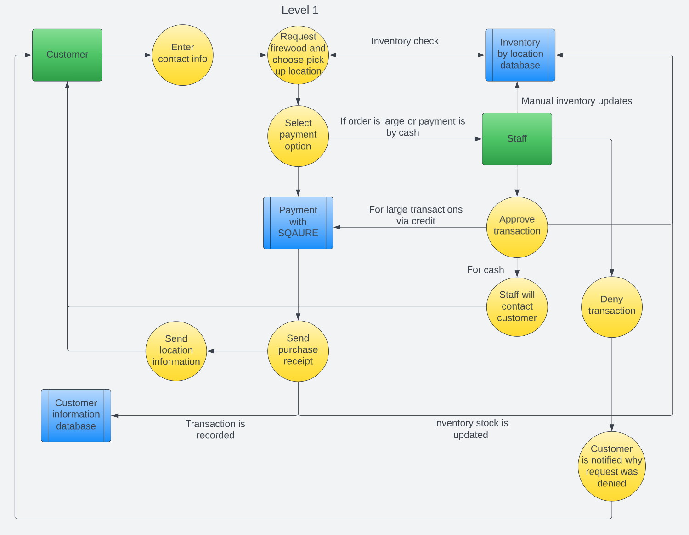
Data-Flow-Diagram Level 1
Notes:
Customers will input contact information, a quantity of firewood, and select their preferred pick up location. There will then be an inventory check before orders are approved to ensure quantity is available. Next the customer can choose their payment option:
if they want to pay with debit or credit, their transaction will be processed using Square. Then the customer will receive a purchase receipt with location information attached. Once the purchase is confirmed we will log the transaction information in our customer information database
If the case is the customer wants to pay by cash/e-transfer or there is a large firewood quantity request, then this will require staff verification. In the case of a large order, the staff can approve or deny the order based on firewood availability. If the transaction is denied the customer will receive a notification on why it was denied. If the transaction is approved the customer can then pay using Sqaure or if it is a cash/e-transfer transaction then staff will have to contact the customer to arrange cash payment.

Slide 6
Functional Requirements
Milestone 1 (Requirements report):
Milestone 2 (Peer testing I):
Frontend Structure
Firewood quantity and location input form
Calculate price, availability, and location
Milestone 3 (Peer testing II):
Full database integration
Process payments, integrate square
Milestone 4 (Finished product):
Staff portal & Notifications
Notes:
Milestone 1: Requirements Report
Milestone 2:
Basic Frontend Developed (pages built out, buttons put in place)
website will take user general location preference and firewood qty.
returns price, and location where qtyOrdered < locationQTY (in final product location will be hidden until after payment is processed ).
Milestone 3:
Read and write capability integrated for database:
This means that we can read from the database to determine qty by loaction and it will store customer and transaction information
Payment processing integrated with square, as well as separate options developed for cash and E-transfer.
Milestone 4:
Separate portal developed for administrators and vendors of the site. With specific access for these users to be able to update qty by location and view orders that need to be approved (cash and e-transfer) and manually approve these orders.
Notification system integrated to inform vendors when there is a cash or e transfer order to be approved.

Slide 7

Non-Functional Requirements
Concurrent users
Low maintenance/upkeep cost
Usability/UX
Flexibility of database
Privacy & security
Notes:
Non-Functional Requirements
Our DB should handle concurrent transactions, even though web traffic should be low
This website is being developed for a charitable cause, so we are trying to keep costs minimal for upkeep and maintenance
Of course usability is important, the website should be efficient and look nice
In accordance with low maintenance costs, our database should be flexible to make future changes easy and cheap
Info in the database should be private and secure, only accessible by staff

Slide 8


Tech Stack
Front-End:
JavaScript: Provides complex features for a dynamically updating front-end web page.
HTML: Structures web pages, enhanced by JavaScript to optimize performance on front-end.
CSS: Stylize HTML elements, improving UX and usability.
Toolkits:
ReactJS Library: Virtual DOM, reusable components, backward compatibility, largest growing community + easy to learn.
Notes:
For front-end will consist of the highly used JS, HTML, CSS.
HTML and CSS are most commonly used alongside JavaScript to structure and create visual layouts for web applications.
Using this configuration will be optimal for the performance on the front-end.
After researching multiple frameworks to work with this front-end, we decided the React library would be most suitable for our needs mainly because:
-uses a virtual DOM(Document Object Model), which optimizes performance
-has reusable components,
-less of a learning curve compared to other frameworks like angular

Slide 9

Tech Stack
Back-End:
JavaScript: Continued use of JavaScript on back-end, allows for use of Node.js runtime environment. Using JS on front and back end will increase the flexibility of project allowing for a agile development style.
Frameworks:
Node.js: JavaScript runtime environment, uses event-based model. Ideal for real-time applications with multiple users.
ExpressJS: Allows use of JavaScript on front and back end. Acts a middleware when installed in Node.js. Provides robust features for web applications.
Notes:
Continued use of JavaScript on back-end, Using node.js and JavaScript we can increase the overall efficiency of the web application. Node.js uses chromes V8 javascript engine, resulting in faster execution times. This combination is great for real-time applications, as it uses a single-threaded event loop to perform operations asynchronously.
We’re also going to use
ExpressJS which provides a robust set of functions as it acts as the middleware for our tech stack. ExpressJS gives us the ability to use JavaScript on the front-end and back-end.

Slide 10

Tech Stack
Database:
MongoDB:
Allows for flexible data storage
MERN Stack:
MongoDB ExpressJS ReactJS Node.js (MERN) is an already established stack
NodeJS, ExpressJS work efficiently with MongoDB
Notes:
MongoDB: Mongo is a non-relational document database. It allows for unstructured data storage in flexible JSON like documents.
These technologies together form the MERN stack, a tech stack ideal for agile web application development.

Slide 11
Testing procedure
Write test cases before beginning development on any new feature, and keep previous tests throughout development
We will run all tests before integrating new features
If any of the tests fail, revise changes
If all tests succeed continue to evaluate integration
Notes:
Write test cases before development of a new feature, save all tests
Run all tests before merging pull requests
If a test fails, do not merge the pull request
If the test succeeds, continue to evaluate pull request

Slide 12
Thank You!

