Slide 1

SmartCare: Hospital Patient Scheduling Simulator
Boston Karymshakov
Victor Liu
CMPSC472
December 2025

Slide 2
Goal
Explore how OS scheduling concepts can help improve fairness and efficiency in patient treatment
Why?
  Hospitals face:
    Limited staff and resources
    Emergency vs non-emergency patients
    Long wait times impacting outcomes

Slide 3
Concept
OS concept | Hospital
Process | Patient
Arrival time | Check-in time
Burst time | Treatment time
Priority | Severity
Scheduler | Hospital triage system
Backend calculates patient order
GUI shows results

Slide 4
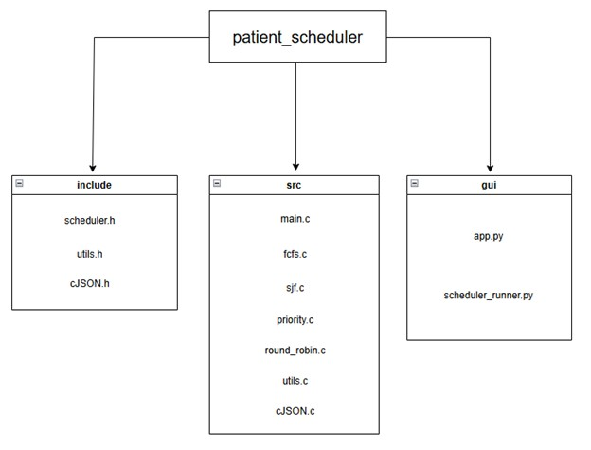
Architecture
C backend: handles scheduling logic
Python GUI: Streamlit; collects user input and display results
JSON: connects GUI with backend
Main Components
  Main.c: selects algorithm and output JSON
  Fcfs.c, sjf.c, priority.c, round_robin.c: scheduling logic
  App.py and scheduler_runner.py: GUI execution

Slide 5
Scheduling Algorithms
Scheduling Algorithm | Description
FCFS (First Come First Serve) | Non-preemptive, simple, can delay short burst time patients
SJF (Shortest Job First) | Non-preemptive, minimizes average wait times, may starve longer patients
Priority Scheduling | Non-preemptive, treats severe patients first, more realistic for ER
Round Robin (RR) | Preemptive, ensure fairness, slower for emergencies

Slide 6
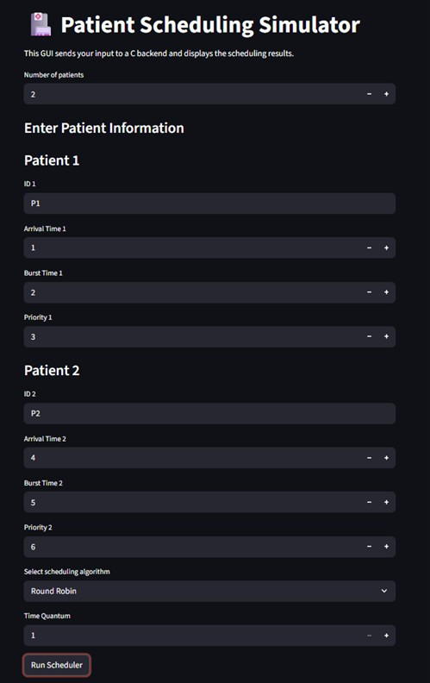
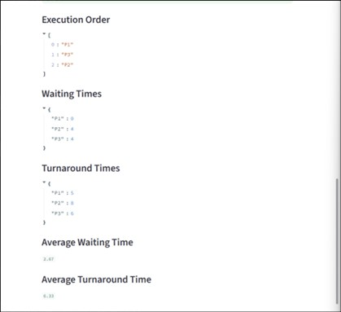
GUI Design

Slide 7
Conclusion
SmartCare demonstrates that operating system scheduling algorithms can be applied to real-world healthcare challenges
The simulator clearly shows how different scheduling strategies impact patient waiting times, fairness, and overall efficiency
By modeling patients as process, we gained insight into trade-offs between efficiency and fairness in hospital workflows

Slide 8
DEMO

