Slide 1
228 students completed the course
240 students selected peer to peer interviews
12 students dropped
300 students enrolled
30 students dropped in total
18 students dropped
60 selected TA interviews
42 students completed the course

Slide 2
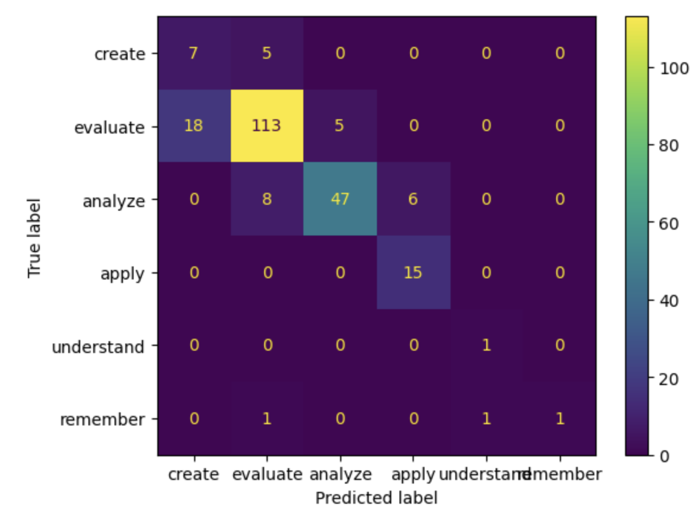
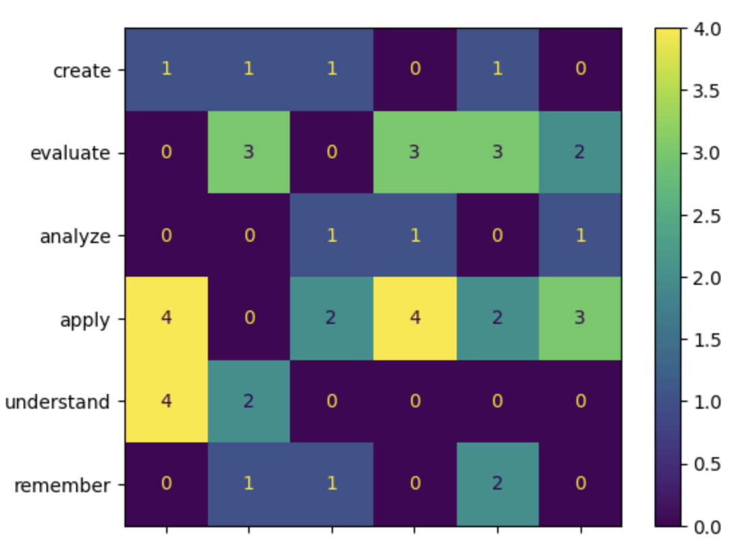
Peer to Peer Interviews
TA Interviews
Weighted Value
Student Estimation
Student Estimation

Slide 3
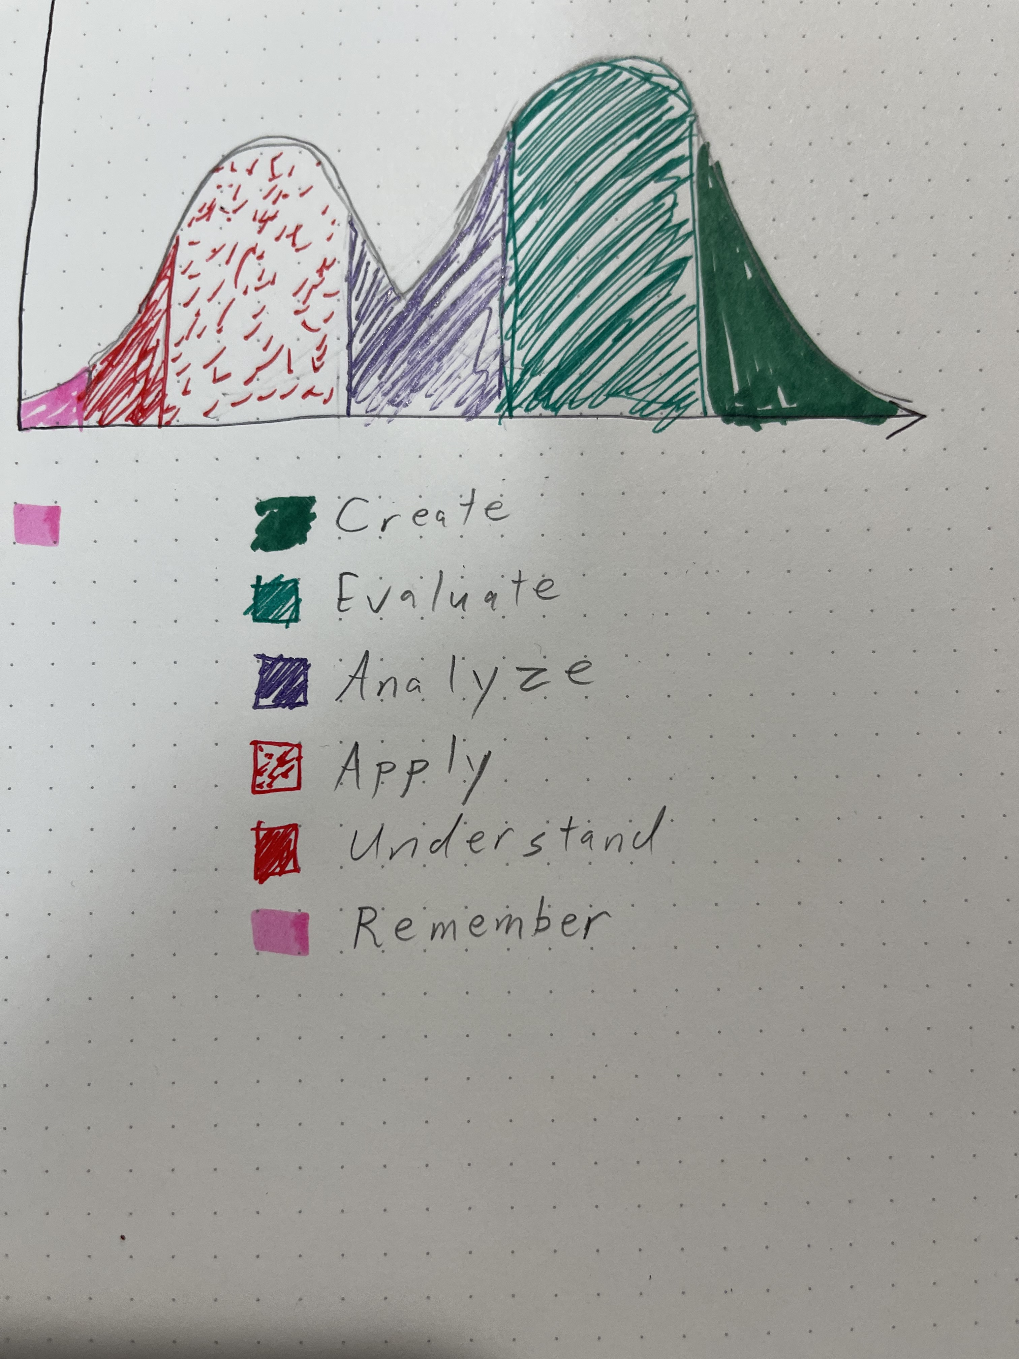

Slide 4
