Slide 1

www.makemegenius.com– Full of ingredients to make your child a genius.
“Don’t make me read, make me understand “

Slide 2

Creating Graphs

Slide 3
Where Does the Information Come From?
A question is asked.
What kind of ice cream does
everyone like in our class?

Slide 4
How Is the Information Gathered?
A survey is made.
Chocolate | 11111
Vanilla | 111
Strawberry | 1111
Mint & Chip | 111111
Rocky Road | 11
Bubble Gum | 1

Slide 5
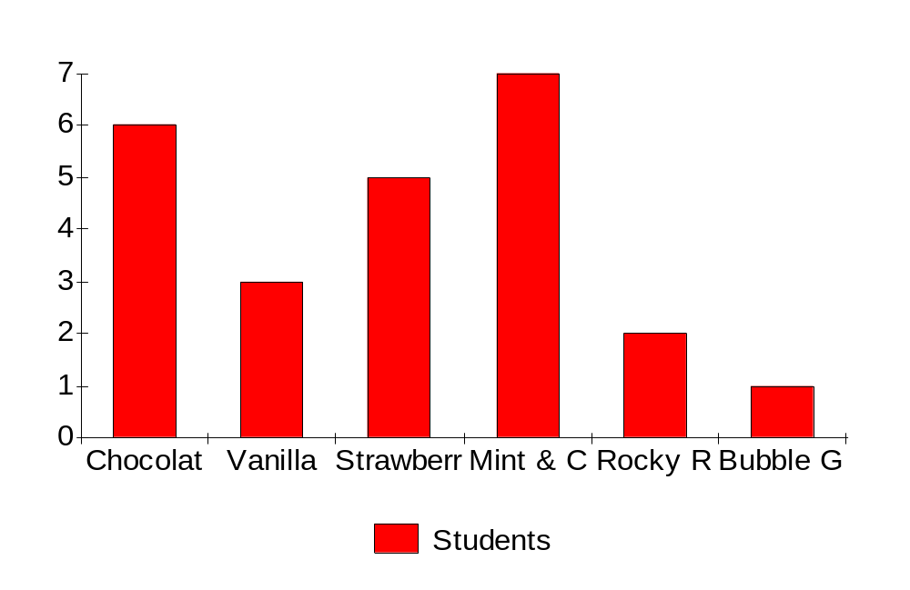
How Is the Information Presented?
A bar graph is made.

Slide 6
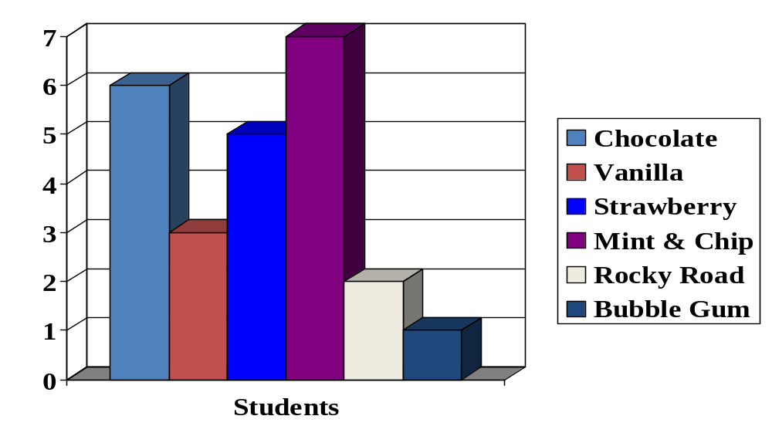
How Is the Information Presented?
A bar graph is made.

Slide 7
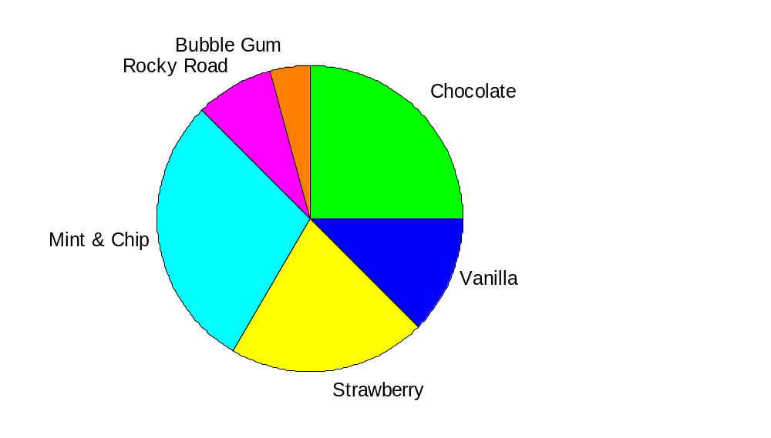
How Is the Information Presented?
A pie chart is made.

Slide 8
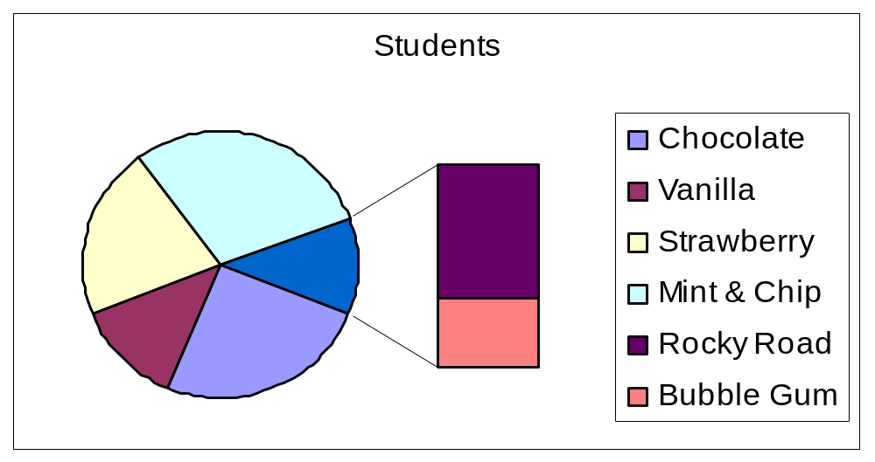
How Is the Information Presented?
A pie chart is made.

Slide 9
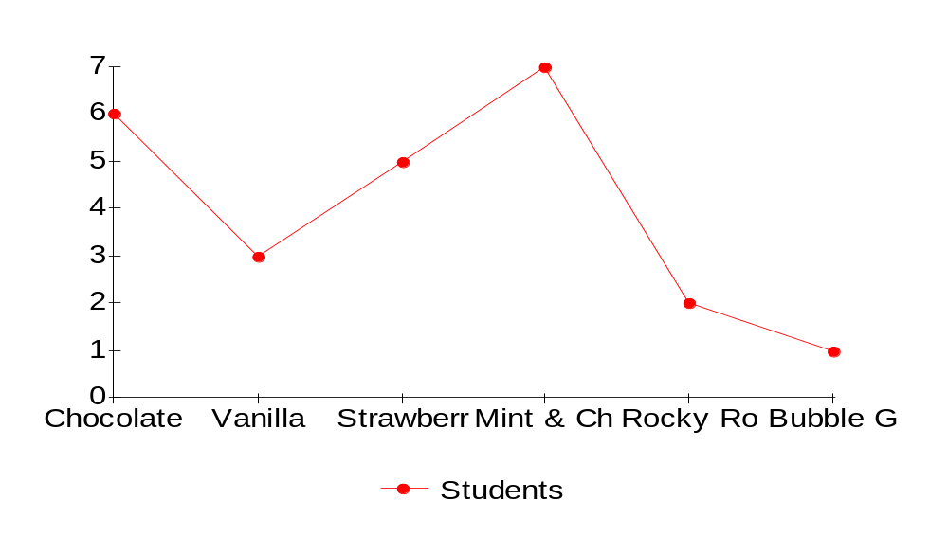
How Is the Information Presented?
A line graph is made.

Slide 10

How Is the Information Presented?
A pictograph is made.
Chocolate
Vanilla
Strawberry
Mint & Chip
Rocky Road
Bubble Gum

Slide 11

Thanks
Submitted by
Ajit
Gurgaon

Slide 12
If you also want to share your own or your kid’s presentation(ppt) please send it on info@makemegenius.com

Slide 13
www.makemegenius.com– Full of ingredients to make your child a genius.
“Don’t make me read, make me understand “

