Slide 1
Magnetism Lesson
www.makemegenius.com Free Science Videos for Kids

Slide 2
For Free
Science Video on
Magnetism & other subjects for Kids
www.makemegenius.com Free Science Videos for Kids

Slide 3

Visit
www.makemegenius.com
www.makemegenius.com Free Science Videos for Kids

Slide 4
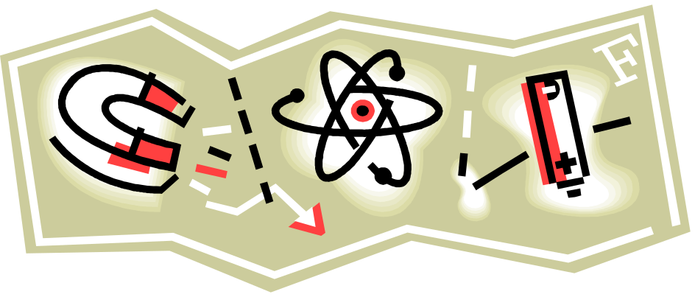
What is Magnetism?
Any material that attracts ferromagnetic materials including iron, steel, cobalt and nickel
Can be permanent or temporary
www.makemegenius.com Free Science Videos for Kids

Slide 5

Where does it come from?
Nature
Man-made materials from:
  Ceramic
  Alnico (aluminum, nickel, & cobalt)
  Flexible rubber-like material
Created using current (electricity)
www.makemegenius.com Free Science Videos for Kids

Slide 6

Magnetism Basics
Only Certain Types of Materials Exhibit Magnetism
N
S
Magnets can be made in a variety of shapes, but all magnets have 2 poles
  Opposite poles attract
  Like poles repel
All magnets have lines of force extending from one pole to the other in the 3 dimensional space around them
www.makemegenius.com Free Science Videos for Kids

Slide 7
Magnets have Poles
Just like the Earth has a North and South Pole, magnets also have two poles.
If you take a bar magnet and hang it from a string, the end that points north is the magnets North Pole, and the end that hangs south is the South Pole.
This is because the Earth is actually a HUGE magnet itself!
Similar magnetic poles repel, while opposite magnetic poles attract.
www.makemegenius.com Free Science Videos for Kids

Slide 8
Magnets Attracting Each Other
N S
N S
Pulling
www.makemegenius.com Free Science Videos for Kids

Slide 9
Magnets Opposing Each Other
N S
N S
Pushing Apart
www.makemegenius.com Free Science Videos for Kids

Slide 10
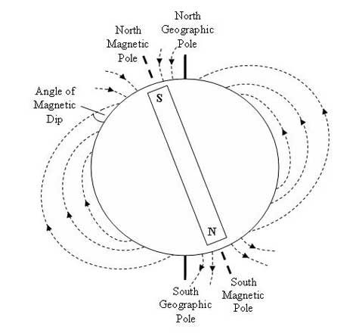
The Earth is a Magnet
www.makemegenius.com Free Science Videos for Kids

Slide 11
Magnets also have a Magnetic Field
Every magnet has a magnetic field around it. It can be thought of as a line of force running from the north end of the magnet to the south end of a magnet.
Earth’s magnetic field is what causes the needle of a compass to point north and south.
www.makemegenius.com Free Science Videos for Kids

Slide 12
Magnetic Lines of Flux
Magnetic Field
Magnetic lines do not cross
each other.
N magnet S
The lines go from North
to South on the magnet.
www.makemegenius.com Free Science Videos for Kids

Slide 13
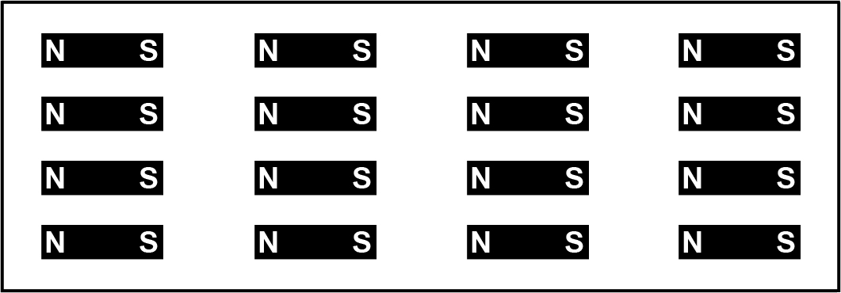
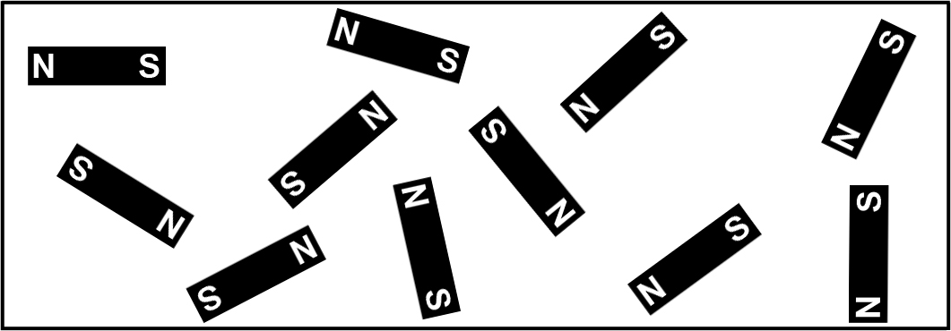
Magnetic Domains
www.makemegenius.com Free Science Videos for Kids

Slide 14
Uses of magnets
Magnets were first put to use in navigation because they always point north and south.
Magnets are used to hold, separate, control, convey and elevate products and to convert electrical energy into mechanical energy or convert mechanical energy into electrical energy.
www.makemegenius.com Free Science Videos for Kids

Slide 15



Uses for Magnets in Everyday Life
Cars
  Power locks
Homes
  Door bells
  Microwaves
  TV’s
  Refrigerators
  Earrings
  Electricity
Schools
  Whiteboard Magnets
www.makemegenius.com Free Science Videos for Kids

Slide 16
For Free
Science Video on
Magnetism & other subjects for Kids
www.makemegenius.com Free Science Videos for Kids

