Slide 1

www.makemegenius.com– Full of ingredients to make your child a genius.
“Don’t make me read, make me understand “

Slide 2

Refraction
Light bends towards the normal in a denser material

Slide 3
Refraction happens because the light slows down in the material
(the part of the beam that arrives first slows down first)

Slide 10


Slide 11
Glass
Air

Slide 12
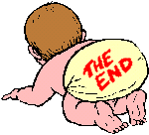
Thanks
Submitted by
Ashutosh
Kendriya Vidhyalaya

Slide 13
If you also want to share your own or your kid’s presentation(ppt) please send it on info@makemegenius.com

Slide 14
www.makemegenius.com– Full of ingredients to make your child a genius.
“Don’t make me read, make me understand “

