Slide 1

www.makemegenius.com– Full of ingredients to make your child a genius.
“Don’t make me read, make me understand “

Slide 2
Continents and Oceans
Our Earth is made up of seven continents and four oceans.
The continents include
North America,
South America,
Europe,
Asia,
Africa,
Australia, and
Antarctica.
The oceans include
The Arctic,
The Atlantic,
The Indian, and
The Pacific.

Slide 3
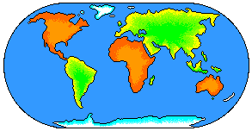
The Seven Continents
North America
Europe
Asia
Africa
South America
Australia
Antarctica

Slide 4
The Four Oceans
Arctic Ocean
Atlantic
Ocean
Pacific
Ocean
Indian
Ocean

Slide 5
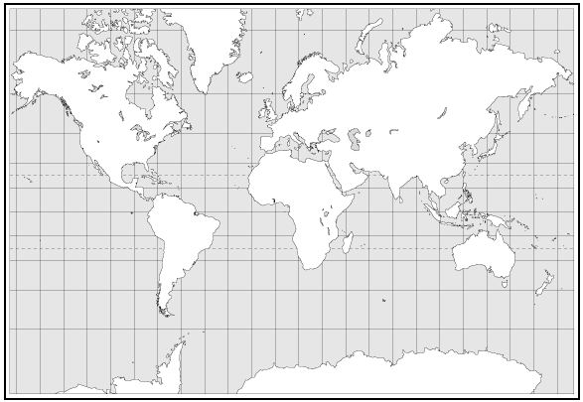
Africa

Slide 6
Europe
Africa

Slide 7
Europe
Asia
Africa

Slide 8
Europe
Asia
Africa
Australia

Slide 9
Europe
Asia
Africa
Australia
Antarctica

Slide 10
Europe
Asia
Africa
South
America
Australia
Antarctica

Slide 11
North
America
Europe
Asia
Africa
South
America
Australia
Antarctica

Slide 12
Hemispheres
Our Earth is also divided into four hemispheres. A hemisphere ishalf of a globe.
Two imaginary lines are used to create these hemispheres. These imaginary lines are the equator and the prime meridian.
The equator is a line around the middle of the earth that divides the globe into the northern and southern hemispheres.
The prime meridian is a line around the middle of the earth that divides the globe into the eastern and western hemispheres.

Slide 13
Hemispheres
Our Earth is also divided into four hemispheres. A hemisphere is
half of a globe. Two imaginary lines are used to create these
hemispheres. These imaginary lines are the equator and the
prime meridian. The equator is a line around the middle of the
earth that divides the globe into the northern and southern
hemispheres. The prime meridian is a line around the middle of
the earth that divides the globe into the eastern and western
hemispheres.

Slide 14
Hemispheres
Our Earth is also divided into four hemispheres. A hemisphere is
half of a globe. Two imaginary lines are used to create these
hemispheres. These imaginary lines are the equator and the
prime meridian. The equator is a line around the middle of the
earth that divides the globe into the northern and southern
hemispheres. The prime meridian is a line around the middle of
the earth that divides the globe into the eastern and western
hemispheres.

Slide 15
Hemispheres
Our Earth is also divided into four hemispheres. A hemisphere is
half of a globe. Two imaginary lines are used to create these
hemispheres. These imaginary lines are the equator and the
prime meridian. The equator is a line around the middle of the
earth that divides the globe into the northern and southern
hemispheres. The prime meridian is a line around the middle of
the earth that divides the globe into the eastern and western
hemispheres.

Slide 16
Hemispheres
Our Earth is also divided into four hemispheres. A hemisphere is
half of a globe. Two imaginary lines are used to create these
hemispheres. These imaginary lines are the equator and the
prime meridian. The equator is a line around the middle of the
earth that divides the globe into the northern and southern
hemispheres. The prime meridian is a line around the middle of
the earth that divides the globe into the eastern and western
hemispheres.
broken into parts

Slide 17
Hemispheres
Our Earth is also divided into four hemispheres. A hemisphere is
half of a globe. Two imaginary lines are used to create these
hemispheres. These imaginary lines are the equator and the
prime meridian. The equator is a line around the middle of the
earth that divides the globe into the northern and southern
hemispheres. The prime meridian is a line around the middle of
the earth that divides the globe into the eastern and western
hemispheres.
broken into parts
half the earth

Slide 18
Hemispheres
Our Earth is also divided into four hemispheres. A hemisphere is
half of a globe. Two imaginary lines are used to create these
hemispheres. These imaginary lines are the equator and the
prime meridian. The equator is a line around the middle of the
earth that divides the globe into the northern and southern
hemispheres. The prime meridian is a line around the middle of
the earth that divides the globe into the eastern and western
hemispheres.
broken into parts
half the earth

Slide 19
Hemispheres
Our Earth is also divided into four hemispheres. A hemisphere is
half of a globe. Two imaginary lines are used to create these
hemispheres. These imaginary lines are the equator and the
prime meridian. The equator is a line around the middle of the
earth that divides the globe into the northern and southern
hemispheres. The prime meridian is a line around the middle of
the earth that divides the globe into the eastern and western
hemispheres.
broken into parts
half the earth
can’t be seen

Slide 20
Hemispheres
Our Earth is also divided into four hemispheres. A hemisphere is
half of a globe. Two imaginary lines are used to create these
hemispheres. These imaginary lines are the equator and the
prime meridian. The equator is a line around the middle of the
earth that divides the globe into the northern and southern
hemispheres. The prime meridian is a line around the middle of
the earth that divides the globe into the eastern and western
hemispheres.
broken into parts
half the earth
can’t be seen

Slide 21
Hemispheres
Our Earth is also divided into four hemispheres. A hemisphere is
half of a globe. Two imaginary lines are used to create these
hemispheres. These imaginary lines are the equator and the
prime meridian. The equator is a line around the middle of the
earth that divides the globe into the northern and southern
hemispheres. The prime meridian is a line around the middle of
the earth that divides the globe into the eastern and western
hemispheres.
broken into parts
half the earth
can’t be seen

Slide 22
Hemispheres
Our Earth is also divided into four hemispheres. A hemisphere is
half of a globe. Two imaginary lines are used to create these
hemispheres. These imaginary lines are the equator and the
prime meridian. The equator is a line around the middle of the
earth that divides the globe into the northern and southern
hemispheres. The prime meridian is a line around the middle of
the earth that divides the globe into the eastern and western
hemispheres.
broken into parts
half the earth
can’t be seen

Slide 23
Label the
hemispheres
on the next
page.

Slide 24
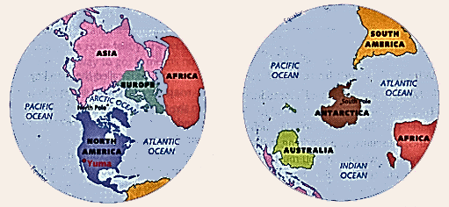
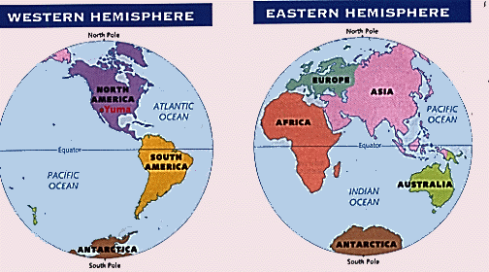
What line divides these hemispheres?
______________________
What line divides these hemispheres?
______________________

Slide 25
Northern Hemisphere
Southern Hemisphere
What line divides these hemispheres?
______________________
equator
Western Hemisphere
Eastern Hemisphere
What line divides these hemispheres?
______________________
prime meridian

Slide 26
Color the
lines of latitude
red.
Color the
lines of longitude
blue.

Slide 27
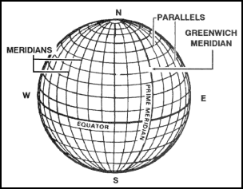

Slide 28
latitude
longitude

Slide 29

Thanks
Submitted by
Minal Shah
DPS Public School

Slide 30
If you also want to share your own or your kid’s presentation(ppt) please send it on info@makemegenius.com

Slide 31
www.makemegenius.com– Full of ingredients to make your child a genius.
“Don’t make me read, make me understand “

