Slide 1

www.makemegenius.com– Full of ingredients to make your child a genius.
“Don’t make me read, make me understand “

Slide 2
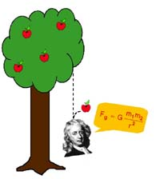
Two Important Forces – An Introduction to Friction and Gravity

Slide 3
Gravity
Gravity – the attractive force of one object on another object
-- gravity exists everywhere that matter exists
The strength of the gravitational force between two objects is dependant on two factors:
-- the masses of the objects (the more massive the object the greater the gravitational force)
-- the distance between the two objects (the closer the objects are together, the greater the gravitational force between them

Slide 4
Examples of Gravitational Force
Most objects in the universe are too small to have any noticeable gravitational effect on any other object
The two biggest gravitational forces that we notice are:
The sun (1.98892 x 10³⁰ kg) is the most massive object in our solar system and exerts a huge gravitational force. This is why all the planets stay in orbit around the sun.
The Earth (5.9742 x 10²⁴ kg) is so massive that its gravitational force keeps us from falling off the planet
When astronauts go into space, they “float” because they are far enough away from the center of the earth that the gravitational force isn’t strong enough to hold them down.

Slide 5
Weight
Most important fact of the day:
WEIGHT AND MASS ARE NOT THE SAME THING!!!
Mass is how much matter an object contains
-- mass does not change unless an object is physically altered
-- if you take a 200 g mass to the moon, it will still have a mass of 200 g
Weight is a measure of the force of gravity on an object’s mass
-- weight will change whenever the amount of gravitational force changes, as a 200 g mass will weight less on the moon than on Earth

Slide 6
Calculating Weight
Because weight is still a force, we can use the mathematical equation of Newton’s Second Law to calculate weight:
F = m x a EXCEPT:
F (force) is replaced by W (weight)
m is still the mass of the object
a (acceleration) is replaced by g (the acceleration due to gravity)
*** On Earth, g is a constant, and g = 9.8 m/s² ***
(therefore, all objects, no matter how massive, should fall at the same acceleration on Earth)
Our new equation: W = m x g We still use Newtons for weight!!!

Slide 7
Practice Problems
What is the weight on Earth of an 85-kg person?
2. What is the weight of a 5-gram pencil on Earth?
3. On the moon, a 100-kg astronaut has a weight of 180 N. What is the acceleration due to gravity on the moon?

Slide 8
Air Resistance
Air resistance is the force that air exerts upon a moving object
-- acts in the opposite direction of an object’s motion
Factors that affect air resistance:
1) Velocity
-- the faster an object is falling, the more air molecules are hitting it, and the more air resistance
2) Cross-sectional Area
-- the wider an object is, the more air molecules can hit it

Slide 9

Terminal Velocity
As an object falls, its velocity increases.
As velocity increases, air resistance increases.
Eventually, the air resistance will grow until it equals the force of gravity
-- at this point the forces are balanced and there is no more acceleration
When an object stops accelerating, it has reached what is called terminal velocity
F_{air}
F_{g}

Slide 10
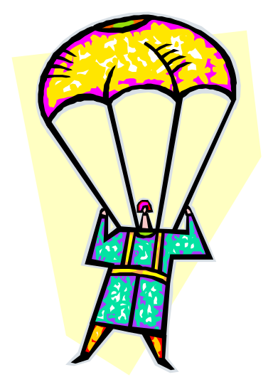
Why Do Parachutes Work?
Parachutes increase the cross-sectional area of a falling object, thus increasing air resistance.
The force of air resistance and the force of gravity become balanced much quicker with a parachute (and for a short time after the cord is pulled, air resistance is greater), therefore acceleration stops, and the skydiver falls at a safe terminal velocity

Slide 11
Friction
Friction is a force that opposes motion between two touching surfaces.
-- At a microscopic level, even the smoothest surfaces have rough edges
-- These rough edges push on each other, causing friction
F_{R} = - mg
F_{f}
F
F_{g} = mg

Slide 12
Types of Friction
There are three basic types of friction:
Sliding Friction – occurs when two surfaces slide directly on top of one another
-- like trying to push a file cabinet across the floor.
-- usually has a very high frictional force
Rolling Friction – occurs when one object rolls on another
-- like pushing my wheeled chair across the floor
-- wheels decrease frictional force
Fluid Friction – occurs between an object and a fluid
-- like an ice skater
-- also an airplane flying through air, the air molecules have fluid friction

Slide 13
Directional Frictional Forces
When the force applied to an object is the same as the force of friction, the velocity of the object will remain constant
If the force applied to an object to move it is less than the force of friction, the object will slow down
If the force applied to move an object is greater than the force of friction, the object will speed up
The force of friction between two object is described by the coefficient of friction (μ) (Greek letter Mu)

Slide 14
Coefficient of Friction
Dimensionless (no units!) scalar quantity
Describes the ratio between the force of friction between two bodies and the force pressing them together
F F = Pulling Force
N N = Normal resistive force
μ =

Slide 15
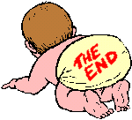
Thanks
Submitted by
Minal Shah
DPS Public School

Slide 16
If you also want to share your own or your kid’s presentation(ppt) please send it on info@makemegenius.com

Slide 17
www.makemegenius.com– Full of ingredients to make your child a genius.
“Don’t make me read, make me understand “

