Slide 1


Slide 2
Mountain
Mountains are parts of the landscape with steep slopes that rise 300 metres or more above their surroundings.
Mountains are found all over the world. Some stand on their own, most of these are volcanoes that rise from islands in the oceans. The majority of mountains stretch in ranges across the continents of the world. The Lake District in England and Snowdonia in Wales are both mountain ranges.
When mountain ranges are found together they make up a mountain chain. The Alps in Europe, the Himalayas in Asia, the Andes in South America and the Rocky mountains in North America are all mountain chains.

Slide 3

Kilimanjaro is the highest mountain in Africa. It is a volcanic mountain that is 5895m high.
Mount Everest is the highest mountain in the world. It is in the Himalayas, China and stands at 8848m.
Mount McKinley is the highest peak in the USA. It is 6194m high.
Mount Aconcagua is part of the Andes and is the highest mountain in Argentina at 6960m high.
Cotopaxi is a volcano in Ecuador that is 5897m high.
Mt. St Helens is a volcano in the USA and is 2400m high.
Mt. Fuji is a volcano in Japan. It stands at 3776m high.
Mt Vesuvius is a volcano in Italy. It is 1277m high.

Slide 4
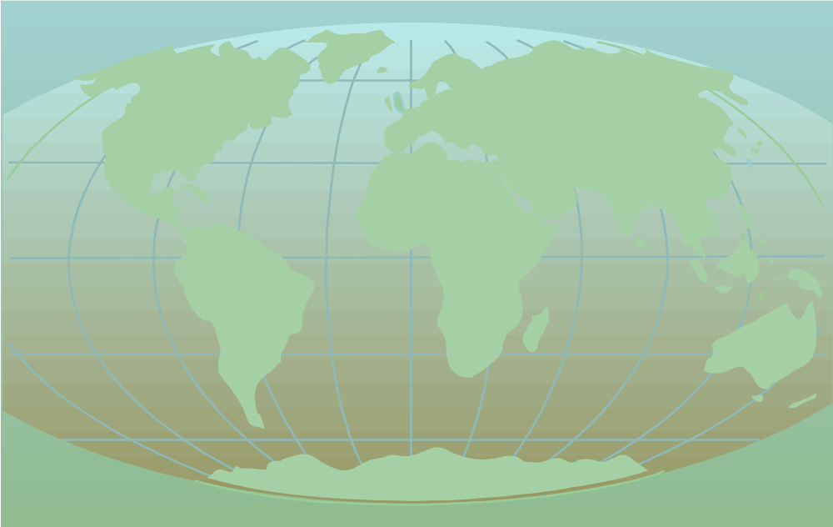
Locate following Mountain
Cotopaxi, Ecuador. Kilimanjaro, Africa Mt Vesuvius, Italy
Mt Fuji, Japan Mt St Helens, USA Ruapehu, New Zealand

Slide 5
Temperature on Mountain
It is colder at the top of a mountain than at the bottom. The sun warms the ground, but the air is warmed by the heat rising up. Therefore it is colder at the top because it is further away from the ground.
Temperatures may vary from:
17degrees C
27degrees C
La Paz (Bolivia) June.
Mountains have shiny white surfaces because of the ice and snow. These surfaces reflect the suns heat which helps to keep the temperatures freezing even through the Summer.
3658m

Slide 6
Ice on Mountain
Many mountain landscapes have sharp peaks, ridges and valleys. These are formed by frost, ice and glaciers.
In the Summer, the rain falls and the ice melts.The water seeps into the surface cracks of the mountain. When the water freezes again it expands and prises the rocks apart. The rocks are split away from the mountains and fall into the valleys. The ridges and peaks that are left can be steep and jagged with knife-edged points.

Slide 7

Glaciers and ice caps are made from snow that has never melted. All the snowflakes and crystals have been squeezed together by the weight and pressure of more snow falling on top. The world used to be much colder than it is today- a time known as the ice age. During this time many glaciers formed and changed the appearance of the mountains forever.
As a glacier goes down hill, any broken rock sticks to the bottom. These pieces of rock act like chisels and scrape away the floor of the valley. This is called erosion. The grating of the rocks that are pushed along by the ice, wears the valley away. Glaciers can leave large U-shaped valleys carved out of the rock in the mountains.

Slide 8
Mountains can be both magnificent and beautiful. The snow capped peaks and sparkling sunlight lure many people to attempt daring and dangerous climbs to be on top of the world. However, the mountain environment was not designed for human inhabitants and if climbers are unprepared, the mountains can be a deadly place to explore.

Slide 9
Precautions for Climbers
Climbers need to plan a mountain trek very carefully indeed. If the weather is bad, frost bite and hypothermia could set in. These illnesses are caused by severe cold. Frostbite is caused by crystals of ice forming on the skin and stopping the blood supply. It most commonly affects the face and ears because they are usually exposed. If frostbite is not treated, climbers may also lose their fingers or toes. Hypothermia is caused when the body temperature drops below 35 degrees centigrade. If it is not treated the climber will pass out and eventually die.

Slide 10
As a climber goes up a mountain the air gets ‘thinner’. This is because of the high altitude. (The altitude is the height above sea level, measured in metres.) A climber would have to breathe harder to get the oxygen that is needed to survive. There is less gas and fewer molecules in every breath taken. A climber would not be able to use muscles efficiently and may become dizzy, short of breath and tired. Each movement would take more effort than usual. The air does not soak up heat so well when it is thinner so it becomes very cold. The highest mountains have permanent snowlines at high altitudes because the air is always below freezing.

Slide 11
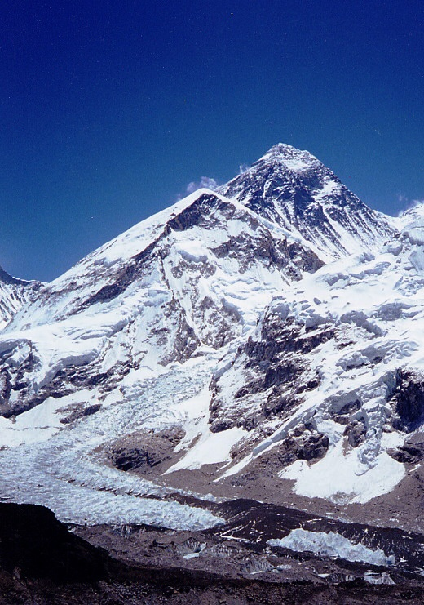
Mount Everest
Himalayan Range, Mount Everest, Nepal. 8850m
Highest peak in the world
GPS was used in 1999 to verify its height.
First scaled in 1958.
600 climbers from 20 countries have reached the peak.
100 have died.

Slide 12
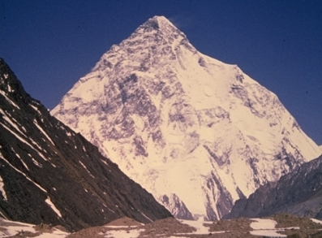
K2 – Karakoram Range
Chinese/Pakistan border
World’s 2nd highest mountain at 8612m.
Named using surveyors notation.
A giant pyramid of sheer ice with a maze of precipices
Ultimate climbers peak.
Between 1900-50 many unsuccessful attempts made.
Finally scaled 1954.

Slide 13
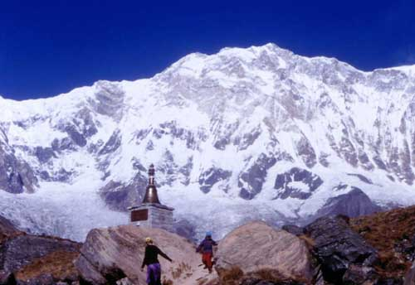
Annapurna – Himalaya, Nepal
8091meters high, 10th highest in world.
Name means ‘The Provider’
Giant glaciers empty into the Kali Gandaki river.

Slide 14
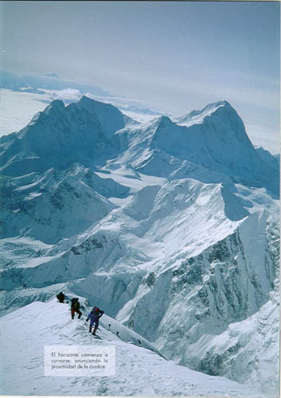
Malaku Himalaya, Nepal
8462m, 5th highest.
Very isolated Pyramid shape
4 sharp ridges
Picture taken from Everest.

Slide 15
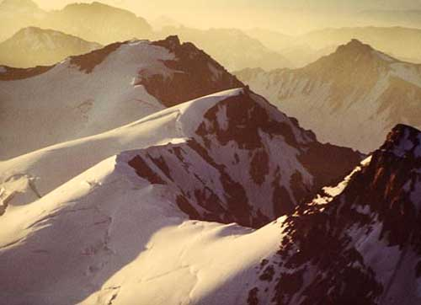
Aconcagua - Andes, Argentina.
At 6962m – the highest peak in Western Hemisphere.
Death tolls high, as climbers go up too fast.
No respect for altitude or weather.

Slide 16
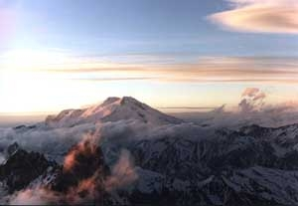
Mt. Elbrus – Caucauses, Russia.
At 5642m, Europe’s highest peak
A long extinct volcano with a distinct conical shape, gently sloping sides.
Countless glaciers
Mountain covers 56 miles.

Slide 17
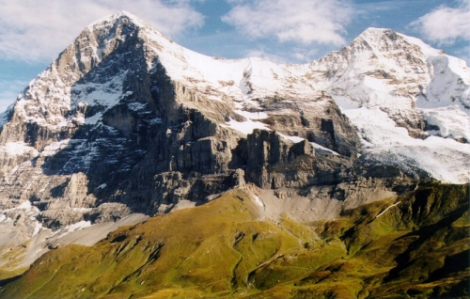
The Eiger - Swiss Alps.
At 3970m, one of Europe’s most fearsome
Peaks – extremely difficult to climb.
Its name means‘Ogre’, and it has a severely towering North face.
Has claimed the lives of many Climbers.

Slide 18
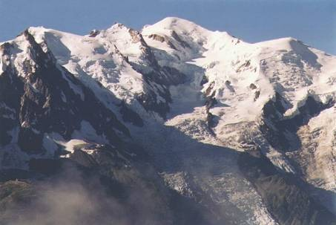
The Eiger – Swiss Alps.
The Matterhorn to the right (4476m) and Mont Blanc below (4807m) both part of the range of mountains called the Alps which runs across Europe.
M.Blanc is the highest peak in the Range. The Matterhorn was the focus
of the golden age of climbing in
the 1850’s when the sport
first got going. The British
camped out in Zermatt and
scaled all the peaks in the area.
using only the most primitive of
equipment.

Slide 19
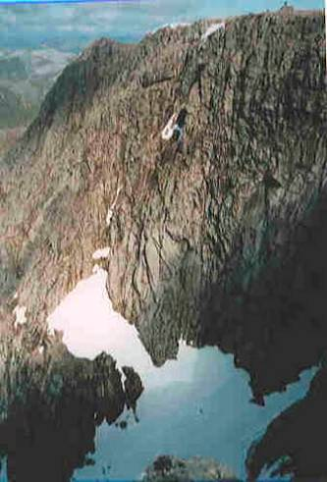
British Peaks – Ben Nevis (1343m) and Snowdonia (1085m)
Not in the same league in terms of height - but just as impressive and challenging to climbers as the changeable weather in mountain environments remains a constant danger.

Slide 20
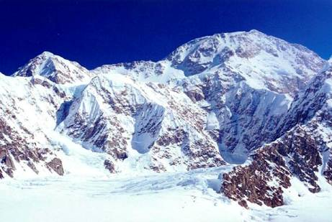
Mountains in the US
McKinley(6194m) and El Capitain(2307m)
Part of the Alaskan range, McKinley is the highest mountain in the US. Known more commonly by its native name of ‘Denali’ meaning ‘The Great One’, this Giant snowy mass has 5 glaciers, and a steep southern slope 12 miles long. In the Sierra Nevadas, El Capitain dominates Yosemite Nat.Park and is a 4 day free climb.

Slide 21
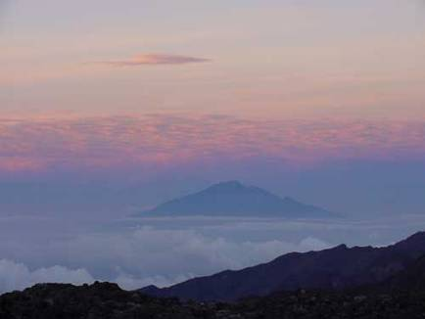
Mountains in Africa – Kilimanjaro (5963m)and Mount Kenya(5199)
Kili is the biggest extinct volcano in the world, and Africa’s highest mountain.
Mt Kenya is also an extinct volcano. Both mountains rise up from the flat plains.
Their sides are covered at lower levels in scrub which is rich in wildlife and vegetation. Elephant, leopard and rhino hide in the scrub, and bamboo and camphor grow along side alpine flowers on the upper slopes.

Slide 22
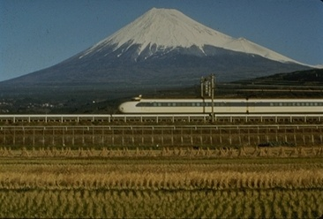
Japan’s highest mountain
Mount Fuji (3776m)
What sort of mountain is this ? Look at its shape.
Close to Toyko, this mountain is a centre for winter and summer sports. Sacred to the Shinto and Buddist religions
It was first climbed by a monk in the 7th century. People still climb it today as a form of pilgrimage. There are three temples on the summit.

Slide 23
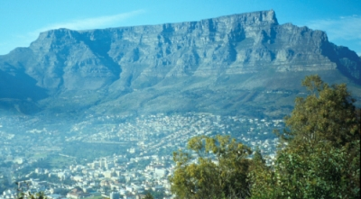
Some funny shaped examples
Known as ‘Sugar Loaf’ and ‘Table’, these mountains show the variety of shapes
That mountains come in, depending on the exact circumstances surrounding
Their creation. Some come into being as a result of tectonic plates crashing
Into each other, some due to plates pushing one under the other, and still others
From plates moving away from each other as we shall see.
Can you tell what might have caused these shapes ?

Slide 24
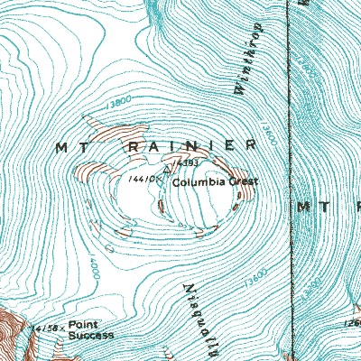
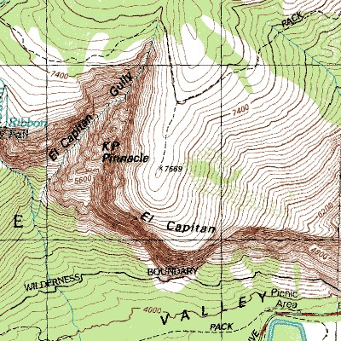
This is what a mountain looks like on a map.
What do you notice about the lines on the map ? Can you read the numbers ?
What do they mean ? Look at an atlas and find a place where the ground is
high. Can you identify a hill or a mountain ?

Slide 25

Thanks
Submitted by
Manas Chandra
Mumbai

Slide 26
If you also want to share your own or your kid’s presentation(ppt) please send it on info@makemegenius.com

Slide 27

www.makemegenius.com– Full of ingredients to make your child a genius.
“Don’t make me read, make me understand “

