Slide 1

www.makemegenius.com– Full of ingredients to make your child a genius.
“Don’t make me read, make me understand “

Slide 2
Oxygen
Pertinent information
Atomic Number – 8
Electron Configuration – [He] 2s2, 2p4
Atomic Mass – 15.9994
Most common elementary substance –O2+O3

Slide 3
Characteristics
Oxygen is a colorless, odorless, and tasteless gas
  -No wonder it was so difficult to discover
Oxygen makes up 21% of the atmosphere
Slightly soluble in water
Poor conductor of heat and electricity

Slide 4
Characteristics
Oxygen supports combustion but does not burn
It is an extremely active chemical
Oxygen can form compounds with almost all elements except inert gases
It unites with other elements to form “oxides” e.g. carbon monoxide

Slide 5
Characteristics
Oxygen is denser than “air”
It is a gas at room temperature
Combines with hydrogen to form water
Part of the “polar covalent bond” of water, useful for attracting opposite charges
Contains 6 electrons in its outer shell

Slide 6
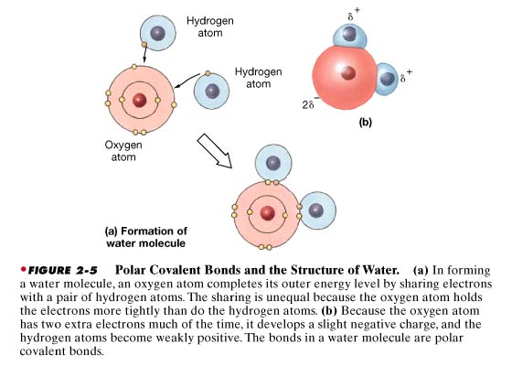
Oxygen in the Formation of Water Molecule

Slide 7

Thanks
Submitted by
Nilesh
Mumbai

Slide 8
If you also want to share your own or your kid’s presentation(ppt) please send it on info@makemegenius.com

Slide 9
www.makemegenius.com– Full of ingredients to make your child a genius.
“Don’t make me read, make me understand “

