Slide 1

www.makemegenius.com– Full of ingredients to make your child a genius.
“Don’t make me read, make me understand “

Slide 2
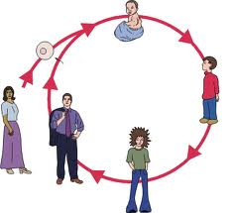
Animal Life Cycle

Slide 3




Stages of Life
Animals have a life cycle that includes
birth, growth, reproduction and death.
Birth
Growth
Reproduction
Death

Slide 4
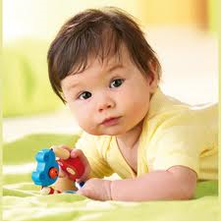
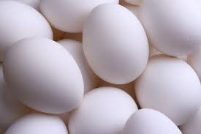
Birth
Some animals are born live, others hatch from eggs.
Mammals have live young.
Fish birds and reptiles mostly lay eggs.

Slide 5
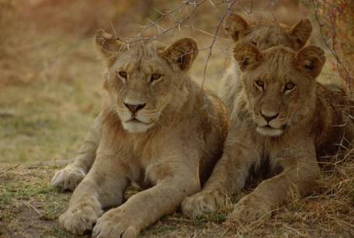
Growth
Young animals grow to become adults

Slide 6
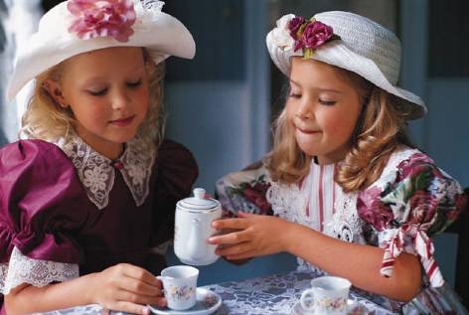
Growth
Humans grow from babies to adults too

Slide 7
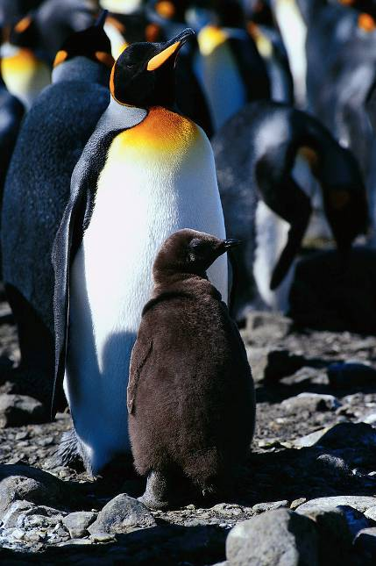
Reproduction
Adult animals have young of their own

Slide 8
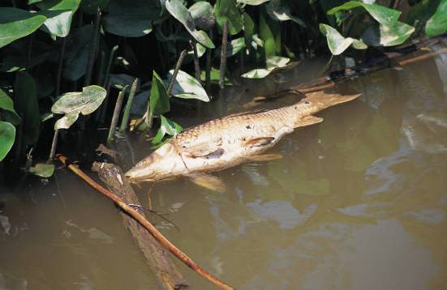
Death
Death is part of every animal’s life cycle.

Slide 9
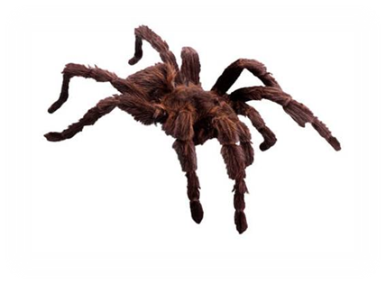
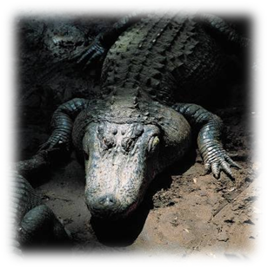


Life Span
A life span begins with an animal’s birth and ends with its death.
Different animals have different life spans .
Female Tarantula: 10 – 20 years
Alligator: 50 – 60 years

Slide 10
Interesting Life Cycles
Some Parasitic wasps lay their
eggs in the head of ants.
When the eggs hatch the baby wasps
eat the ant from the inside out.

Slide 11
Interesting Life Cycles
Kangaroos have very tiny babies.
After their birth they crawl into the mother’s pouch where they feed and grow.

Slide 12
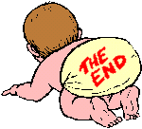
Thanks
Submitted by
Swati Sharma
KV, Delhi

Slide 13
If you also want to share your own or your kid’s presentation(ppt) please send it on info@makemegenius.com

Slide 14
www.makemegenius.com– Full of ingredients to make your child a genius.
“Don’t make me read, make me understand “

