Slide 1

www.makemegenius.com– Full of ingredients to make your child a genius.
“Don’t make me read, make me understand “

Slide 2
Introductory Unit on Electricity

Slide 3
Concepts Covered
Electricity basics
  electricity vocabulary
  sources of electricity
Circuits
  basic definition
  series and parallel
  break in the circuit

Slide 4
Concepts Covered
Power Grid
  basic parts of the power grid
  definition of the parts
Electricity and Solar Energy Fun
  electricity kit for playing with circuits (inquiry)
  solar power kits and car (how it works)

Slide 5

Electricity – Part I
An Introduction

Slide 6
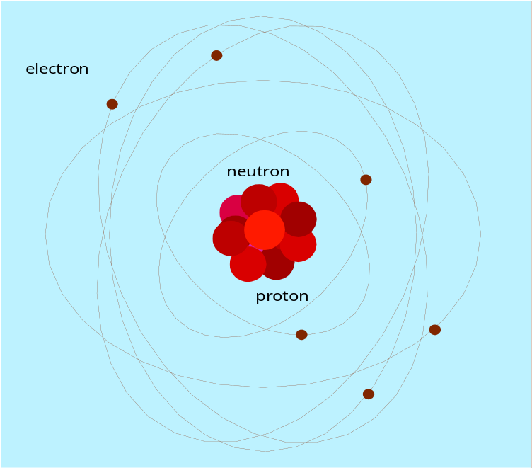
What is Electricity?
Electricity is generated from the motion of tiny charged atomic particles called electrons and protons!
Protons = +
Electrons = -

Slide 7

Types of Sources used to make Electricity
Thermal
Geothermal
Nuclear
Hydroelectric
Solar
Wind

Slide 8





Pictures of each Source

Slide 9
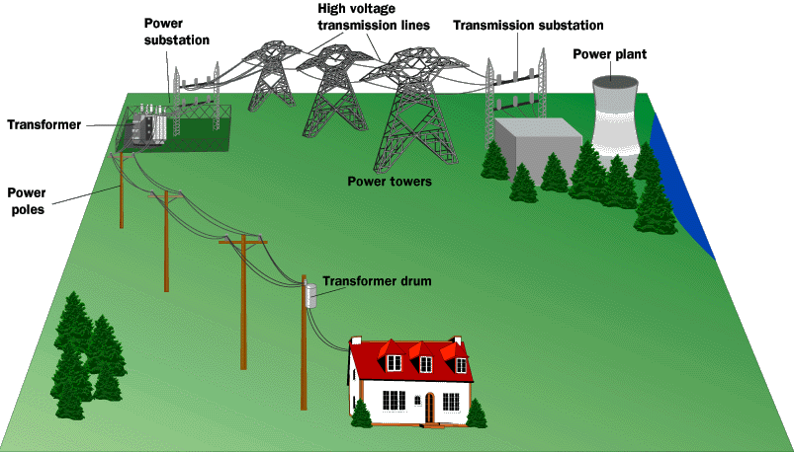
How do we get Electricity?
Energy from one of the sources is converted by machines at the power plant to Electricity and then put onto the Electric Power Grid
Electric Power Grid
  Power Plants
  Transmission Lines
  Substations
  Power Lines
  Transformers
  Electrical Wiring and Circuit Box

Slide 10

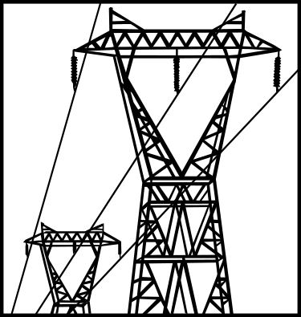

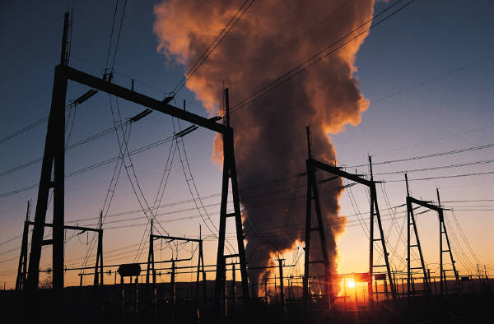

Pictures of each piece of the Power Grid!

Slide 11
Your Electric Vocabulary
Circuit
Transformer
Series Circuit
Parallel Circuit
Insulator
Conductor
Proton
Electron

Slide 12

Life without Electricity---!!!
How would you prepare your lunch?
How would you wash clothes?
When would you go to bed?
Think about all the luxuries the discovery of Electricity has brought us!
  No Television
  No Radio
  No Lights

Slide 13
Inventors and Inventions
1752 – Lightning Rod 1879 – Light Bulb
  Ben Franklin Thomas Edison
1800 – Electric Battery 1888 – AC Power
  Count Alessandro Volta Nikola Tesla
1805 – Refrigerator 1910 – Flashlight
  Oliver Evans Conrad Hubert
1876 – Telephone 1920 – Traffic Light
  Alexander Graham Bell Garrett Morgan

Slide 14
More Inventors and Inventions
1927 – Television 1973 – Internet
  Philo T. Farnsworth Vinton Cerf
1945 – Computer 1991 - WWW
  Mauchley and Presper Tim Berners-Lee
1954 – Microwave 1955 – TV Remote
  Percy Spencer Eugene Polley

Slide 15

Thanks
Submitted by
Ashmit Verma
St.Paul Public School
Noida

Slide 16
If you also want to share your own or your kid’s presentation(ppt) please send it on info@makemegenius.com

Slide 17
www.makemegenius.com– Full of ingredients to make your child a genius.
“Don’t make me read, make me understand “

