Slide 1

www.makemegenius.com– Full of ingredients to make your child a genius.
“Don’t make me read, make me understand “

Slide 2
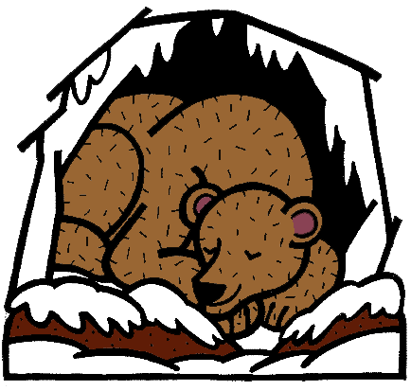
Animals in the Winter

Slide 3

What do animals do during the winter?

Slide 4
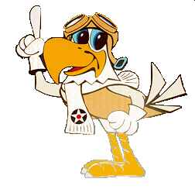
What do animals do during the winter?
Migrate

Slide 5
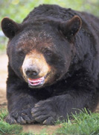
What do animals do during the winter?
Migrate
Hibernate

Slide 6
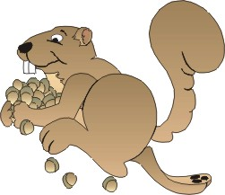
What do animals do during the winter?
Migrate
Hibernate
Adapt

Slide 7

Migrate
Some birds will fly to warmer places for the winter months.

Slide 8
Hibernate
Some animals will hide and sleep during the winter months.

Slide 9
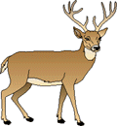
Adapt
Some animals will adapt to their surroundings by growing a thicker coat or use camouflage by changing their color.

Slide 10
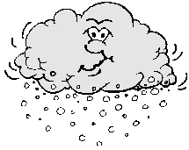
Surviving Winter
All animals have a way to survive the winter.

Slide 11

What are the three ways an animal will survive during the winter?

Slide 12
What are the three ways an animal will survive during the winter?
Migration
Hibernation
Adaptation

Slide 13

Thanks
Submitted by
Manish Pandey
Varanasi

Slide 14
If you also want to share your own or your kid’s presentation(ppt) please send it on info@makemegenius.com

Slide 15
www.makemegenius.com– Full of ingredients to make your child a genius.
“Don’t make me read, make me understand “

