Slide 1
Introduction
Name Elephant
It is an Endangered species.

Slide 2
What They Look Like
Long Trunks
Big Ears
Fat Body
Big Eyes
10,000 Pounds
Big Tusks
Little Hair
Big Toe Nails

Slide 3
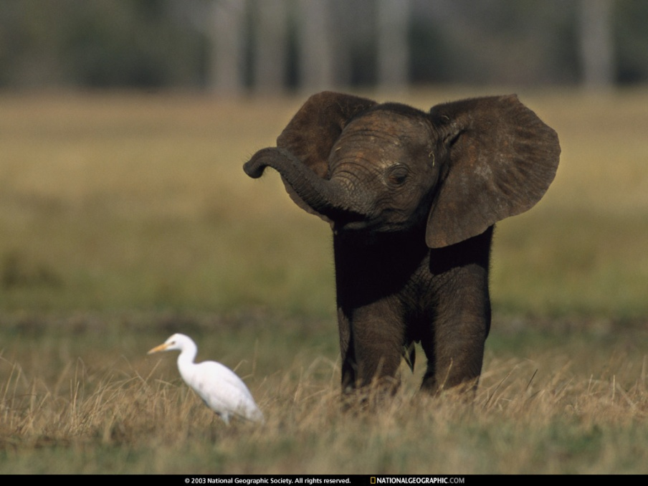
Lifespan
Asian Elephants can live to be 80 years old
African Elephants can live to be 60 years old
Elephants are endangered.

Slide 4
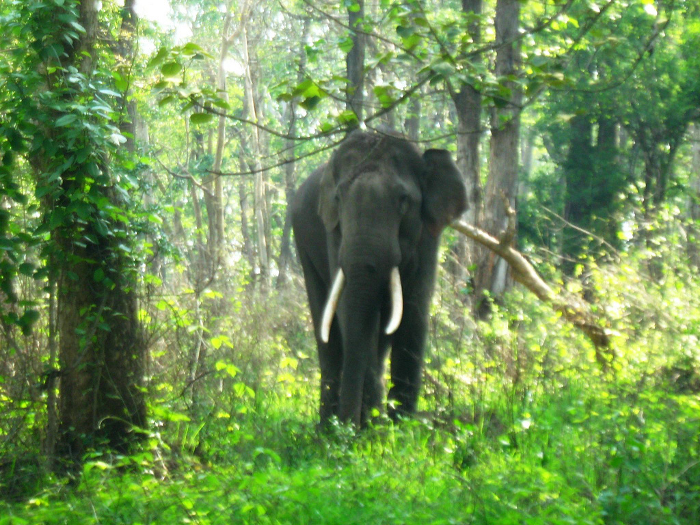
Habitat
The Asian and African Elephants Habitat are Forests, Woodlands, Grassy Plains, Swamps, and Deserts.

Slide 5
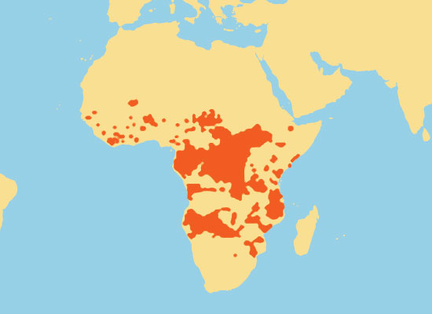
Climate
An African Elephants Climate is in the Desert,
it is hot and dry and it rarely rains
An Asian Elephants climate is also hot and dry.

Slide 6

Landforms
The landforms near Elephants are Rivers, Grasslands, and Deserts

Slide 7
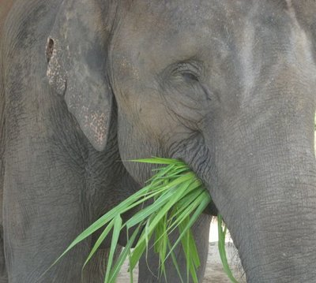
What They Eat
Elephants are hebavores
Elephants food is mostly leaves and bushes
Zoo Elephants eat 660 pounds of veggies a day
African and Asian Elephants eat roots, grass, fruit, and bark
Elephants feed themselves by sucking up food in there trunks and putting it in there mouth
Elephants also love peanuts

Slide 8
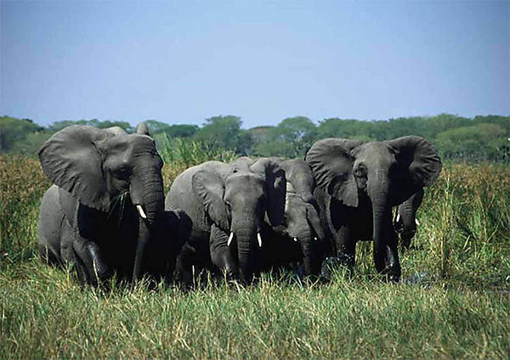
Behavior
Elephants stay in groups called “Herds” that helps them defend themselves
The social behavior is that a male and female are very different
The female spend there lives in a family of Daughters, Sisters, Mothers, Aunts
When the group gets too big the older daughters will break off and form a new group
The males fight each other to determine who is the leader
To keep cool they suck up water in their trunk and spray it on themselves
They are not territorial…they travel a lot to find food

Slide 9
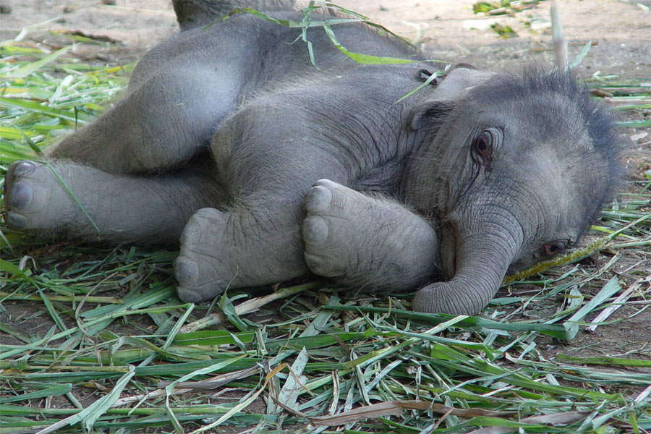
Babies
The babies are called “Calves”
15 minutes after the baby is born it stands
At birth the Elephant weighs about 200 pounds and stands 3 feet tall

Slide 10
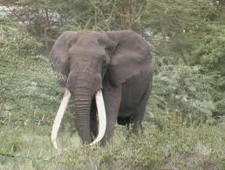
Physical Adaptation
Long trunks help it them eat or take a bath
Sharp tusks help it scare away predators
Big ears can be used to fan itself to bring it’s temperature down
Also it’s ears help it hear any danger coming

Slide 11
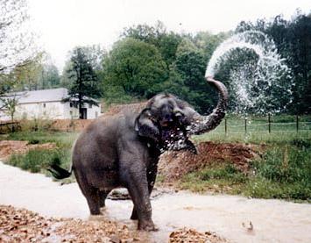

Behavioral Adaptations
Elephants say hi by hitting their tusks together which helps them live in groups
Fanning itself with it’s big ears keeps the elephant cool on the hot days
Picking food up with it’s trunk and putting it in it’s mouth helps it reach food in difficult to get places
They use their trunks to spray water on themselves to keep cool

Slide 12
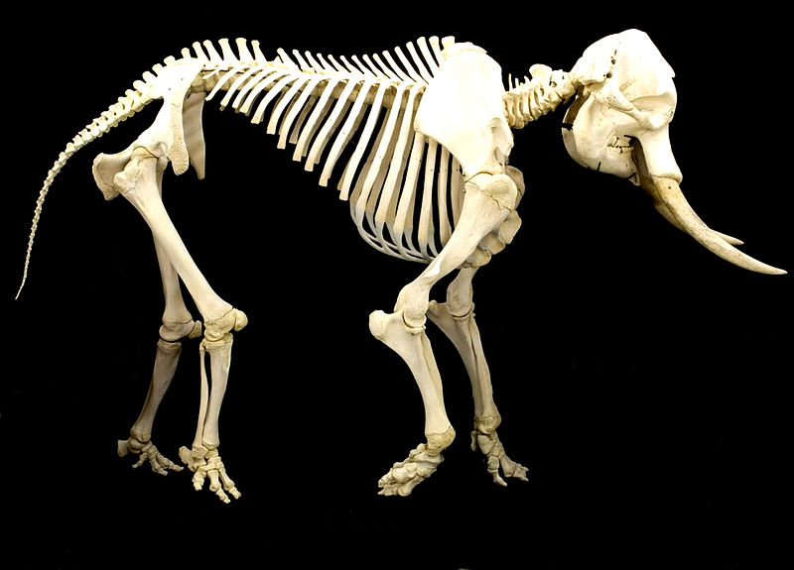
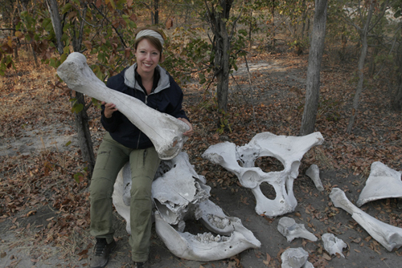
Physiological Adaptations
Elephants are warm blooded and that helps because they can adjust their body temperature so they are not to hot or to cold
Elephants have massive bones, this allows them to have a maximum amount of support for their big weight
The blood vessels in their ears are used as cooling systems because the weather is so hot
An Elephants heartbeat goes 28 beats a minute while the Elephant is resting to help it survive it’s big body.

Slide 13
FUN Facts
Elephants love water and are great swimmers
There big feet help them from sinking into the ground
Elephants walk on their tippy toes and they have a sack that supports their foot
Elephants are very smart

Slide 14
The End
Name: Zaid Samouh
Grade:3B
Teacher -Esraa abu-nijem
Sharjah

