Slide 1

www.makemegenius.com– Full of ingredients to make your child a genius.
“Don’t make me read, make me understand “

Slide 2
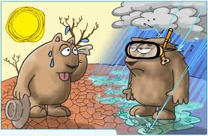
Climate

Slide 3
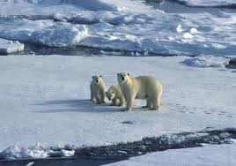
What Causes Climate?
Climate is the name for the general conditions of temperature and precipitation for an area over a long period of time.
The climate of a region is determined by two basic factors:
Temperature and
Precipitation.

Slide 4
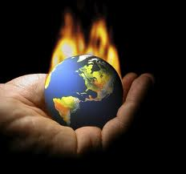
Factors that affect Temperature
There are three natural factors that affect the temperature at a particular location.
Latitude,
Elevation and the
Presence of ocean currents

Slide 5
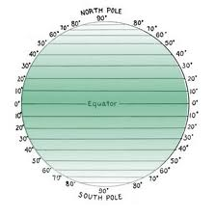
Latitude
Latitude is the measure of the distance north and south of the equator.
Latitude is measured in degrees.
Areas close to the equator, or 0 degrees latitude, receive the direct rays of the sun. These direct rays provide the most radiant energy. Areas near the equator have a warm climate. Polar regions have a cold climate.

Slide 6
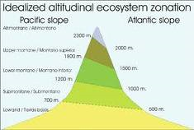
Elevation
Elevation, or altitude, is the distance above sea level.
As elevation increases, the air becomes less dense.
This means there are fewer gas molecules in the air and they are spread far apart. Less- dense air cannot hold as much heat as denser air. So as elevation increases, temperature decreases.

Slide 7
Location
Land areas near warm water currents have warm temperatures.
The surface temperature of water affects the temperature of the water above it. Warm water warms the air and cold water tends to cool it.
The Gulf Stream is an ocean current that carries warm water along the eastern coast of the United States. The California Current travels toward the equator carrying cold water along the west coast of the United States.

Slide 8
Factors that Affect Precipitation
The two factors that affect the amount of precipitation at a particular location are
Prevailing winds and
Mountain ranges.

Slide 9
Prevailing Winds
A wind that blows more often from one direction that from any other direction is called a prevailing wind.
Prevailing winds have a great influence on the climate of regions in their path.
Different prevailing winds carry different amounts of moisture. The amount of moisture carried by a prevailing wind affects the amount of precipitation a region receives. Winds formed by rising warm air tend to bring precipitation.

Slide 10
Direction of Prevailing Winds
The direction from which a prevailing wind blows also affects the amount of moisture it carries.
Some prevailing winds blow from the water to the land (sea breeze).

Slide 11
Now Some interesting terminologies
about Climate

Slide 12
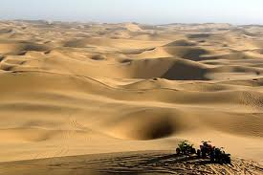
Desert
A region that receives less than 25 centimeters of rainfall a year is called a desert.
The Sahara Desert is bordered on the west by the Atlantic Ocean. The prevailing winds that blow across the Sahara originate far inland, carry little moisture and are caused by sinking cold air.

Slide 13
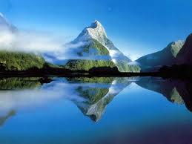
Mountain Ranges
The amount of precipitation at a particular location is also affected by mountain ranges.
A mountain range acts as a barrier to prevailing winds. The windward side of a mountain has a wet climate. On the leeward side, relatively dry air moves down the side of the mountain and results in very little precipitation. A good example is the Great Basin on the leeward side of the Sierra Nevada Mountain Range.

Slide 14
Climate Zones
The Earth’s climate can be divided into general climate zones according to average temperatures.
Scientist classify localized climates as microclimates. The three major climate zones on the Earth are the
Polar,
Temperate, and
Tropical zones.

Slide 15
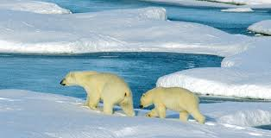
Polar Zones
In each hemisphere, the polar zone extends from the pole to about 60 degrees latitude.
In polar zones, the average yearly temperature is below freezing. There are some areas in the polar zones, such as the northern coasts of Canada and Alaska and the southern tip of South America, where the snow melts during the warmest part of the year.

Slide 16
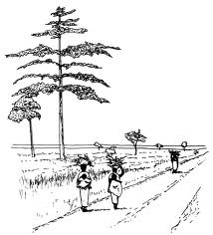
Temperate Zones
In each hemisphere, the temperate zone is found between 60 degrees and 30 degrees latitude.
In the areas of the temperate zones farther from the equator, snow is common in the winter. In the areas of the temperate zones closer to the equator, rain normally falls all year round. The average amount of precipitation is about the same throughout. The average temperatures range from 5 degrees C to 20 degrees C.

Slide 17
Deserts in the Temperate Zone
Deserts in the temperate zones are usually located in land, far away from the oceans.
The winds that blow across these inland deserts carry little moisture. Although very hot during the day, temperatures at night can drop to below freezing. Inland deserts are found in Australia (the Great Sandy Desert) and Central Asia ( the Gobi Desert).

Slide 18

Tropical Zones
The tropical zones, which extend from 30 degrees north and south latitude to the equator, have high temperatures and high humidity.
Tropical zones are also known as low-latitude climates. The average temperature during the coldest month of the year does not fall below 18 degrees C. Many deserts are located on the western coasts of the continents. This is because the prevailing winds, the trades, blow from east to west.

Slide 19
Changes in Climate
The three natural factors responsible for climate changes are the slow drifting of the continents, changes in the sun’s energy output and variations in the position of the Earth relative to the sun. These natural factors are not related to human activity. The results of the human activity of the burning of fossil fuels may also lead to changes in climate.

Slide 20
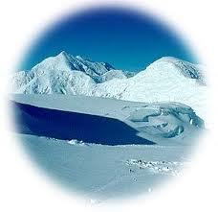
Ice Ages
Periods when much of the Earth’s surface has been covered with enormous sheets of ice are called ice ages or major glaciations.
Scientists have found evidence of four major ice ages during the last 2 million years each lasting about 100,000 years. The average temperature was 10 to 15 degrees C.
The causes are not known but they are probably associated with variations in the tilt of the Earth’s axis and the shape of the Earth’s orbit around the sun.

Slide 21
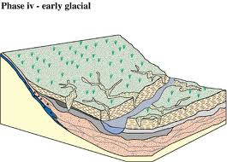
Interglacials
Inter-glacials are the time periods between major glaciations.
Interglacials are warm periods.
During an interglacial, the average temperature was about 4 to 6 degrees higher than the average temperature during a major glaciation. A cold period called the Little Ice Age lasted from 1500 to 1900.

Slide 22
Drifting Continents
About 230 million years ago, all the Earth’s landmasses were joined in one super continent, Pangaea. The slow drifting apart of the continents caused dramatic changes. As the continents moved toward their present-day locations, the sea level dropped, volcanoes erupted, and much of the Earth’s surface was pushed upward. The combined effect was a drop in temperature and precipitation all over the Earth. These changes were gradual.

Slide 23
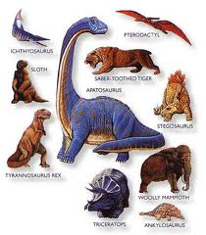
Extinction of the Dinosaurs
The climate change caused by the drifting of the continents may have resulted in the extinction of the dinosaur. Many types of plants also became extinct. Dinosaurs that depended on these plants died. Meat-eating dinosaurs that depended on plant-eating dinosaurs died. Other scientists believe that dinosaurs became extinct as the result of a giant asteroid striking the Earth 65 million years ago.

Slide 24
Variations in Radiant Energy
Many scientists have tried to relate changes in the Earth’s climate to changes in the sun’s energy output. During periods of high energy output, the Earth’s temperature would rise. The temperature would drop during periods of low energy output. No evidence has been found to support this theory.

Slide 25
Global Warming
IN the mid-nineteenth century industrialization led to the increased burning of fossil fuels, including coal, oil and natural gas. Then these fuels are burned they release carbon dioxide that traps heat. As a result, the atmosphere becomes warmer. Meteorologists found that temperatures in the 1990’s were the highest in more than 100 years.

Slide 26

Thanks
Submitted by
Nishi
DPS Public School

Slide 27
If you also want to share your own or your kid’s presentation(ppt) please send it on info@makemegenius.com

Slide 28
www.makemegenius.com– Full of ingredients to make your child a genius.
“Don’t make me read, make me understand “

