Slide 1
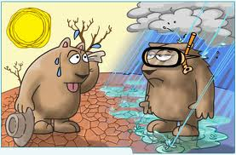
Climate Lesson
What factors contribute to a region’s climate?
www.makemegenius.com Free Science Videos for Kids

Slide 2
For Free
Science Videos for Kids
www.makemegenius.com Free Science Videos for Kids
www.makemegenius.com Free Science Videos for Kids

Slide 3
Weather vs. Climate?
Weather: Atmospheric conditions (temperature, rainfall, etc…) at a specific point in time
Climate: Atmospheric conditions (temperature, rainfall, etc…) of a region over a long period of time
www.makemegenius.com Free Science Videos for Kids

Slide 4
Factors affecting Climate
Zones of Latitude
Wind Currents
Ocean Currents
El-Nino
Global Warming
www.makemegenius.com Free Science Videos for Kids

Slide 5
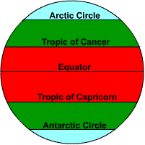
Zones of Latitude
A region’s latitude (distance from the equator) can impact its climate.
Polar
Temperate
Tropical
Tropical
Temperate
Polar
www.makemegenius.com Free Science Videos for Kids

Slide 6
Zones of Latitude
Tropical Zones: Warm weather year round. Area between the Tropic of Cancer (23 ½ º N) and the Tropic of Capricorn (23 ½ º S).
Temperate Zones: Warm summers and cold winters (four seasons). Areas between Tropic of Cancer (23 ½ º N) and Arctic Circle (66 ½ º N) and Tropic of Capricorn (23 ½ º S) and the Antarctic Circle (66 ½ º S).
Polar Zones: Cold year round. Areas north of the Arctic Circle and south of the Antarctic Circle.
www.makemegenius.com Free Science Videos for Kids

Slide 7
Wind Currents
Wind currents help distribute the sun’s heat from one part of the world to another.
Warmer air has lower pressure than cooler air. The cooler air rushes into the low pressure areas causing wind.
Warm air currents make areas warmer than normal. Cold air currents make areas cooler than normal
High Pressure Air
Low Pressure Air
Wind blows from areas of High Pressure to Low Pressure
www.makemegenius.com Free Science Videos for Kids

Slide 8
Ocean Currents
Ocean current move in large circular systems
Ocean currents affect temperature and precipitation of an area.
Warm ocean currents make surrounding areas warmer and rainy.
Cool ocean currents make surrounding areas cooler and drier
Warmer and Rainy
Warm Ocean Current
Cool Ocean Current
Cooler and Drier
www.makemegenius.com Free Science Videos for Kids

Slide 9
El Niño
The natural warming of waters off the west coast of South America about every 2 – 7 years due to a reversal of wind direction.
El Nino causes floods and mudslides in the Americas.
El Nino causes droughts in Australia and Asia.
www.makemegenius.com Free Science Videos for Kids

Slide 10
Global Warming
Global Warming is the build up of carbon dioxide (greenhouse gases) in the atmosphere trapping heat and causing increase temperature and shifting weather patterns.
Global Warming is being caused by both the human release of greenhouse gases from the burning of fossil fuels (oil, coal) and a natural warming cycle the Earth is going through
As the global temperature begins to rise many changes will occur to climates around the world
Check the global warming video on www.makemegenius.com?
www.makemegenius.com Free Science Videos for Kids

Slide 11
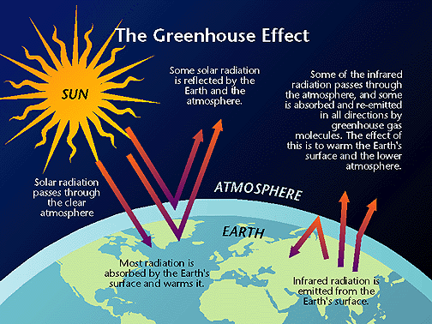
Check the green house effect video on www.makemegenius.com
www.makemegenius.com Free Science Videos for Kids

