Slide 1

www.makemegenius.com– Full of ingredients to make your child a genius.
“Don’t make me read, make me understand “

Slide 2
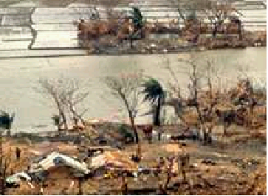
Floods
A certain surface is affected by excessive water for an indeterminated period of time.
They can be
seasonal or sudden.

Slide 3


Natural Causes
Excesive rains.
Overflowing of
rivers, lagoons,
lakes,etc.

Slide 4

Human causes
Bad agricultural practice
Bad infraestructure
Deforestation
Urban increase

Slide 5

Most important consequences
Population mortality
Economic losses
Population evacuation
Infraestructure destruction

Slide 6
Recent examples in Argentina
Flood in the northwest of Buenos Aires (1994)
Flood in Litoral (1998- around Corrientes province)
By Agustín Melsa and Leandro Merelas.

Slide 7

Thanks
Submitted by
Minal Shah
DPS Public School

Slide 8
If you also want to share your own or your kid’s presentation(ppt) please send it on info@makemegenius.com

Slide 9
www.makemegenius.com– Full of ingredients to make your child a genius.
“Don’t make me read, make me understand “

