Slide 1

www.makemegenius.com– Full of ingredients to make your child a genius.
“Don’t make me read, make me understand “

Slide 2
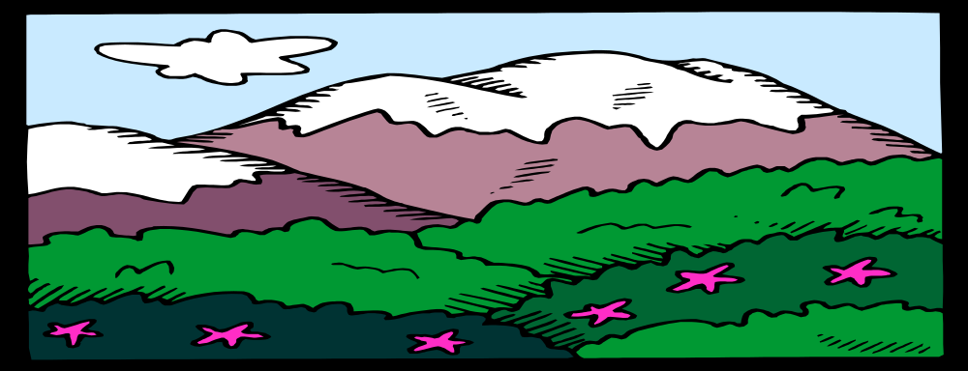

LANDFORMS
What are Earth’s major landforms?

Slide 3
LAKES
A lake is a body of water surrounded by land.
Lakes are usually made up of fresh water.
A lake is smaller than an ocean.
Some lakes are formed by building dams
across rivers.
How can we use lakes?

Slide 4
Rivers
A river is a large body of water that flows over land.
  Most rivers begin high in the mountains.
Most rivers begin high up in the mountains.
The Nile River which is in Africa is the longest river in the world.
What are some rivers you can find in the
state of Texas?

Slide 5
Oceans
An ocean is a large body of salty water that covers
more than 70% of the Earth’s surface.
The Earth’s four main oceans, in order of size, are the Pacific Ocean, the Atlantic Ocean, the Indian Ocean, and the Artic Ocean.
Most landforms can be found under the ocean.
What are oceanographers?

Slide 6
Mountains and Hills
Mountains are the highest kind of land.
A hill is land higher than the land around it
but, it is lower than a mountain.
Mountain ranges are important because
they determine the climate and water flow
of surrounding regions.
What is the highest mountain in the world?

Slide 7
Valley
A valley is low land between hills or mountains.
Most valleys are formed by erosion.
The bottom of the valley is called its floor
and is often very fertile soil.
What else could you find in a valley besides
farmland?

Slide 8
Plains
Plains are large regions of mostly flat land.
Plains usually have good soil and are used for farming.
Some plains were formed as mountains and
hills were worn down by wind, water, and
glaciers. Others were formed by soil deposits.
What are some of the crops grown on plains?

Slide 9
Peninsula
A peninsula is land that has water on three sides.
  Peninsulas can be connected by a large or narrow strip of land.
What state is a peninsula?

Slide 10
Island
An island is land that is surrounded by water.
There are five main kinds of islands and
each is formed in a different way.
Our Hawaiian Islands were formed by
volcanoes.
What is the largest island?

Slide 11
Desert
Deserts are hot areas that have little rainfall
but are not wastelands.
Deserts are some the hottest places on Earth.
Many kinds of plants and animals thrive
in deserts.
Deserts cover about a fifth of the Earth’s
land area.
What is an oasis?

Slide 12
Icecaps
Icecaps are land areas where the snow never
completely melts off.
It is estimated that about 70% of all the
fresh water on Earth is in the form of ice.
Icecaps cover most of Antarctica and
Greenland.
Why is the north pole not an icecap?

Slide 13

Thanks
Submitted by
Arpita Awasthy
KV , Indore

Slide 14
If you also want to share your own or your kid’s presentation(ppt) please send it on info@makemegenius.com

Slide 15
www.makemegenius.com– Full of ingredients to make your child a genius.
“Don’t make me read, make me understand “

