Slide 1
Tsunamis

Slide 2
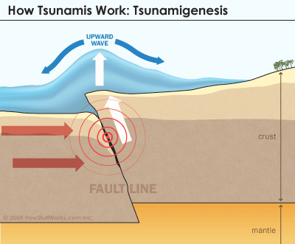
What is Tsunami ?
Tsunami is a Japanese word meaning ‘Harbour Wave’.
In the past the scientific community sometimes referred to them as ‘tidal waves’ or ‘seismic sea waves’.
Tsunamis are the hydrosphere’s most destructive force.
They are giant waves that are caused by sudden movement of the seabed during an earthquake or volcano.

Slide 3

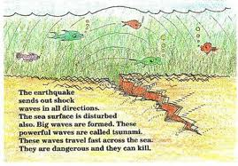
Out at sea tsunami waves are low and not very high about the size of a normal wave.
As tsunamis move into shallow water, near the shore they start to slow down and become higher

Slide 4
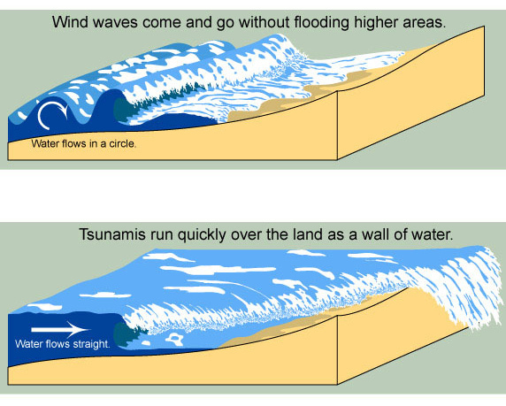

Slide 5
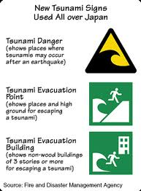

Slide 6
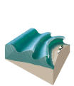
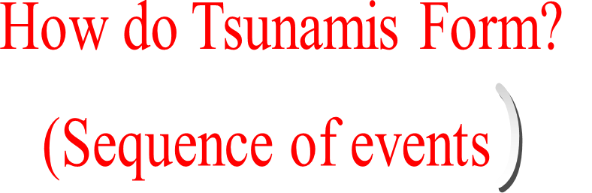
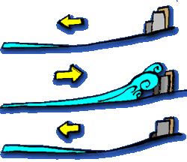
Tsunamis are formed from earthquakes. Earthquakes can occur when two plates in the earth's crust collide. The earthquake causes the seabed to move quickly and water is displaced causing waves.
The half meter waves are out at sea. They travel at extraordinary speeds of 800km/h. the waves, at this stage are hardly noticeable on the surface of the ocean
The waves slow down to about 300km/h as the water becomes shallower. The waves then become closer together and only seconds between them.
The waves become really tall as they reach the shore and pile onto one another. They can reach amazing heights of up to 35meters. As they hit the land they engulf everything then suck the debris back into the ocean.

Slide 7
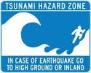

Slide 8
