Slide 1
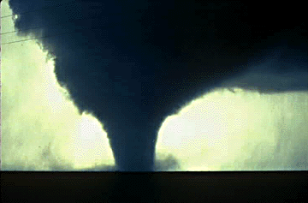

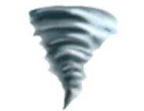
PPt by www.makemegenius.com
www.makemegenius.com Free Science Videos for Kids

Slide 2
For Free
Science Videos for Kids
www.makemegenius.com Free Science Videos for Kids
www.makemegenius.com Free Science Videos for Kids

Slide 3
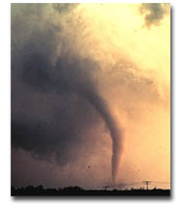
What Exactly Is A Tornado?
Violently rotating column of air (Vortex) extending from a thunderstorm to the ground
PPt by www.makemegenius.com
www.makemegenius.com Free Science Videos for Kids

Slide 4
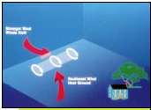
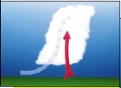

How Do They Form?
Actually, no one knows for sure!
But…We have a pretty good idea…
www.makemegenius.com Free Science Videos for Kids

Slide 5
Step 1
How Do They Form?
Before a t-storm, a change in wind direction and an increase in speed forms an invisible, horizontal spinning effect in the lower atmosphere (at the base of the storm)
www.makemegenius.com Free Science Videos for Kids

Slide 6
Step 2
How Do They Form?
Rising air within the t-storm (updrafts) tilts the rotating air from horizontal to vertical
www.makemegenius.com Free Science Videos for Kids

Slide 7
Step 3
How Do They Form?
Vertical rotation now extends 2-6 miles up into the t-storm. Now a tornado may form and extend from this area of rotation to the ground.
www.makemegenius.com Free Science Videos for Kids

Slide 8
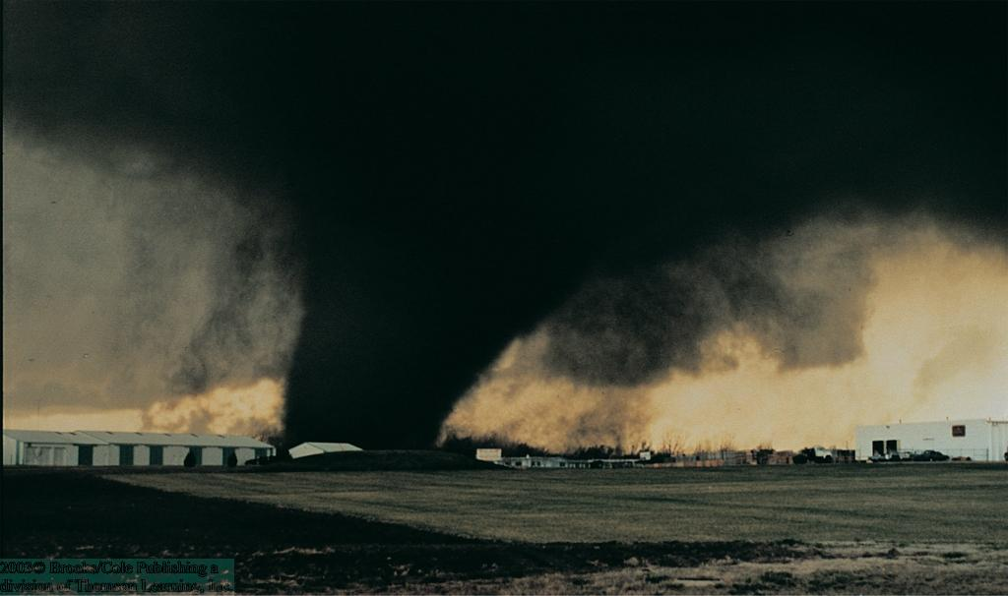
Fujita Tornado Scale
Tornado watches are issued when tornadoes are likely, while a warning is issued when a tornado has been spotted.
Once the storm is observed, or has passed, the Fujita scale of F0 – F5 is used to classify tornadoes according to their rotational speed based on damage done by the storm.
www.makemegenius.com Free Science Videos for Kids

Slide 9
Tornado Facts
Winds can exceed 300 mph!!!
Around 1,000 occur on average each year in the U.S.
Kill 80, injure 1,500 people each year on average
Can have a path up to a mile wide!!!
Can occur any time of the year, but peak during the spring (March-June)
Occur most frequently in the central U.S. in a region nicknamed “Tornado Alley”
www.makemegenius.com Free Science Videos for Kids

Slide 10
For Free
Science Videos for Kids
www.makemegenius.com Free Science Videos for Kids
www.makemegenius.com Free Science Videos for Kids

