Slide 1


Career Choices
Putting the Pieces Together

Slide 2

Career Choices
Interest
Planning
Goals
Skills
Salary
Preparation
Education

Slide 3

Planning
Steps:
  What are your interest?
  What do you want to be?
  What are your skills?
  What types of careers fit your skills and interest?
  How do you prepare for the career?

Slide 4

Interest
What are your interests?
  What do you like to do? Think about experiences you have enjoyed. What kind of school, religious, social, or sports activities do you like?

Slide 5

Interest
What are your interests?
  Make a list of 10 activities you have enjoyed doing in the past four years.

Slide 6

Interest
What are your interests?
  Evaluate those interests. Think about what you liked about the activities. What challenges did the activities offer? What skills do you need to develop further to continue in those activities?

Slide 7

Career Goal
What is your Career Goal?
  A career goal helps you focus on what you want to do for a living. A career goal can be a specific job you want to do -- such as doctor or teacher -- or a career goal can be a particular field you want to work in, such as medicine or education.

Slide 8

Career Goal
What is your Career Goal?
  Rather than limiting your future, a career goal may help you discover career possibilities that you wouldn't have thought of otherwise.

Slide 9

Career Goal
What is your Career Goal?
  A career goal will also guide you into doing what you want with your life -- rather than just drifting into a job.

Slide 10
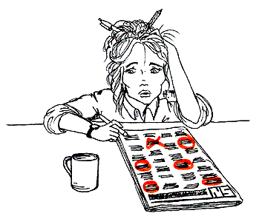
Career Goal
What is your Career Goal?
  Generally, a career goal is based on your skills and interests, career possibilities, and job trends.

Slide 11

Career Goal
What is your Career Goal?
  Once you have chosen a career, think strategically about the steps to accomplish your goal. Understanding and accomplishing your career goal will be a lot easier if you create a career plan.

Slide 12
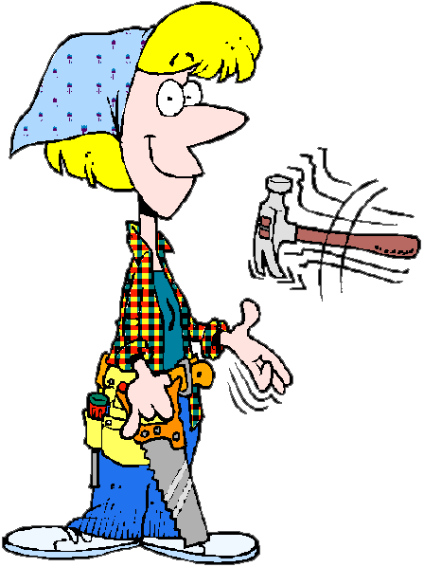
Career Goal
What is your Career Goal?
  A career plan determines your skills and interests, what career best suits your talents, and what skills and training you need for your chosen career.
http://www.mapping-your-future.org/planning/

Slide 13

Skills
What are your skills?
  Evaluate school, volunteer, work, or leisure experiences.

Slide 14

Skills
What are your skills?
  Make a list of your school activities (clubs, organizations to which you belonged). Make a list of any volunteer work you have done (either through social, civic or religious organizations).

Slide 15

Skills
What are your skills?
  After you have assessed your interests and skills, determine the relationship between skills and interests and possible careers. You may need to research types of careers.
http://www.mapping-your-future.org/planning/

Slide 16

Career + Skills
What types of careers fit your skills and interest?
  Use the Occupational Handbook below to locate a career.
Occupational
Handbook

Slide 17

Preparation
How do you prepare for the career?
  Selecting A School
  The courses you take in high school, the grades you make, your class rank, the results of your standardized tests, and the life experiences you have all play a part in determining whether or not a college will admit you.

Slide 18

Preparation
How do you prepare for the career?
  Familiarize yourself with the different types of schools.

Slide 19








Preparation
How do you prepare for the career?
  Find out what characteristics to look for when selecting a school.
College
Religious
Public
Athletics
Private
Trade
School
Academics

Slide 20
Education
What education is required for your chosen career?
Education Requirements

Slide 21
Interests
Middle school is a perfect time to explore your interests seriously and to begin investigating your career choices.
What are Your
Interests?

Slide 22
Career Choices
Information on different careers can be found at First Gov for Kids by clicking the puzzle piece below.
First Gov for Kids

Slide 23
Salary
Explore the salary information at the Career Journal by clicking the puzzle piece below.
Salary Information

Slide 24
Career Trends
Minnesota Careers provides information on career trends and options .
Career
Trends

Slide 25
Career Choices
Work through units 1-3 at the site below and find cool careers, income information, and take the Work Quiz.
Explore Careers

Slide 26
Work World
Activities designed to help you understand how to succeed in the work world.
Work World

Slide 27

Interest
Print and complete the Interest Assessment below .
Interest
Assessment

Slide 28
Interest
Complete steps 4-5 at the site below.
Scroll down to locate Steps 4-5!
Interest
Assessment

Slide 29

Explore
Ask adults questions about their jobs. They'll be happy you asked.

Slide 30

Explore
Have them tell you what they enjoy most about their jobs…and what they enjoy least! Ask them what skills someone must possess to be successful in that occupation.

Slide 31

Explore
Find out what high school and/or college classes are important to their field. Ask how much education is required for their career.

Slide 32

Jobs People Do
Explore the Jobs People Do at the site below.
Work through the text on the left of this webpage!
Jobs People Do

Slide 33
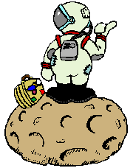
Jobs People Do
Learn about what people do at work and how they make our world a better place.
What Do
They Do?

Slide 34

Wow Careers!
See what people "on the job" say about your dream career!
WOW Careers!

Slide 35

Lifestyle
In thinking about your future, you must consider what's important to you in your daily life. What would you think about a career that required a great deal of travel? Is the amount of money you make important to you?

Slide 36

Lifestyle
How would you feel about a job that required you to move on a regular basis? What hours of the day—or night—will you be working? Choose three or four aspects of your future lifestyle that are most important.

Slide 37

Read
Ask your school librarian to help you find books on careers that might match your interests and abilities. Many publications can provide you with information about careers that you may never have considered.

Slide 38

Talk
Visit with your counselor about your interests and abilities. Find out if your school offers tests or interest inventories that can assess your skills and interests. Some schools also have computer software programs that assist with career exploration.

Slide 39
Put the pieces together.

Slide 40

Resources
These Internet sites can provide career information and were used in this presentation.
Ready, Set, Go
Middle School Students Start Off Right
Career Test
BLS Career Information
Job Star Central
First Gov for Kids
Careers 2001
Career Info Net
interest assessment
Jobs People Do
What Do They Do?
Wow Careers!
Career Education
Interactive Learning Network

