Slide 1

Copyright © 2005 – 2006 MES-English.com

Slide 2
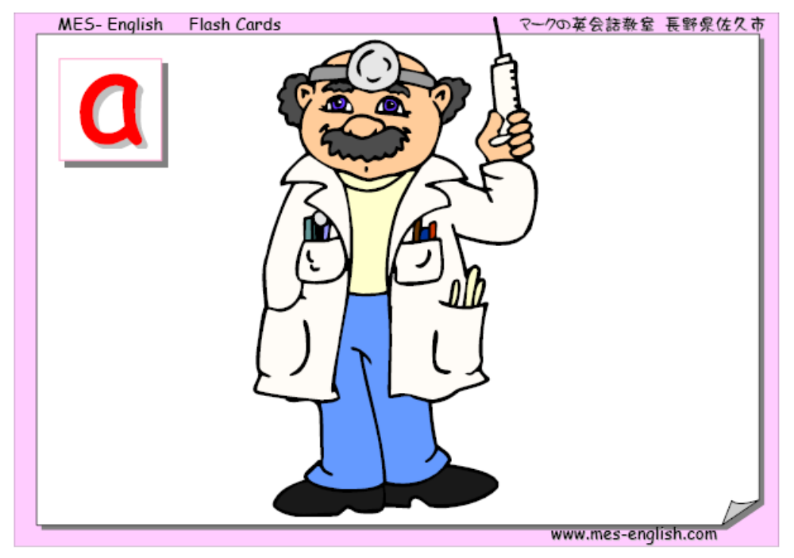
Doctor

Slide 3

Policeman

Slide 4
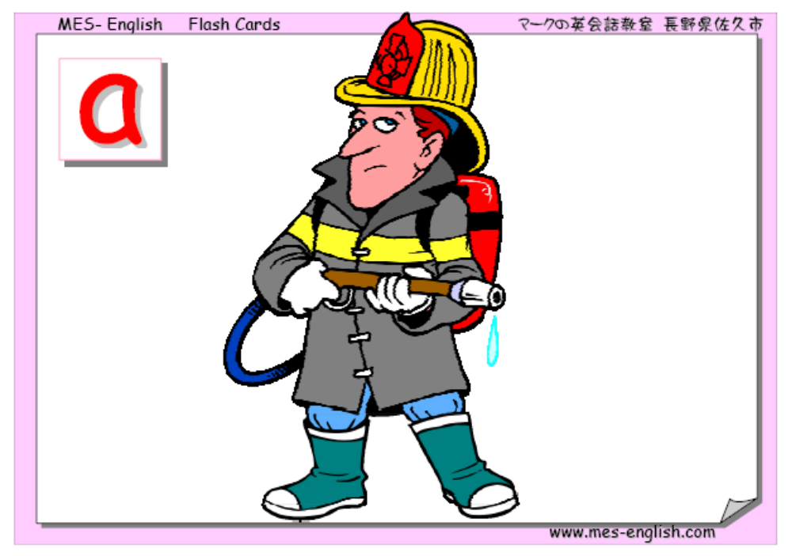
Fireman

Slide 5

Postman

Slide 6

Nurse

Slide 7

Driver

Slide 8

Pilot

Slide 9

Teacher

Slide 10

Waiter

Slide 11
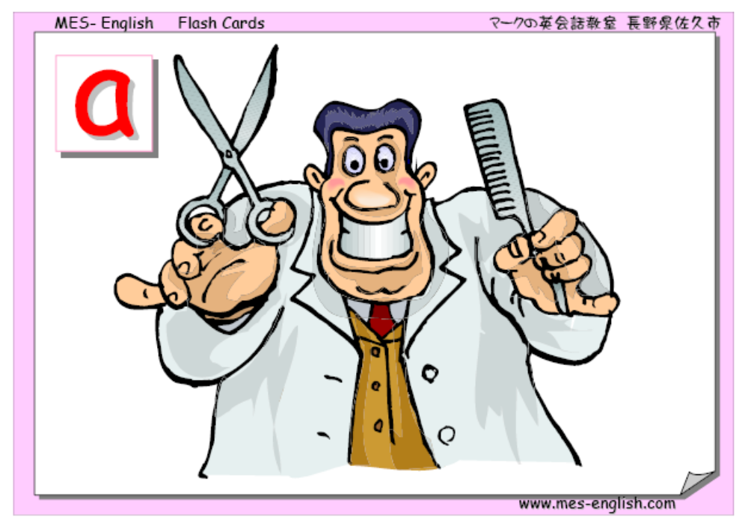
Hairdresser

Slide 12

Student

Slide 13
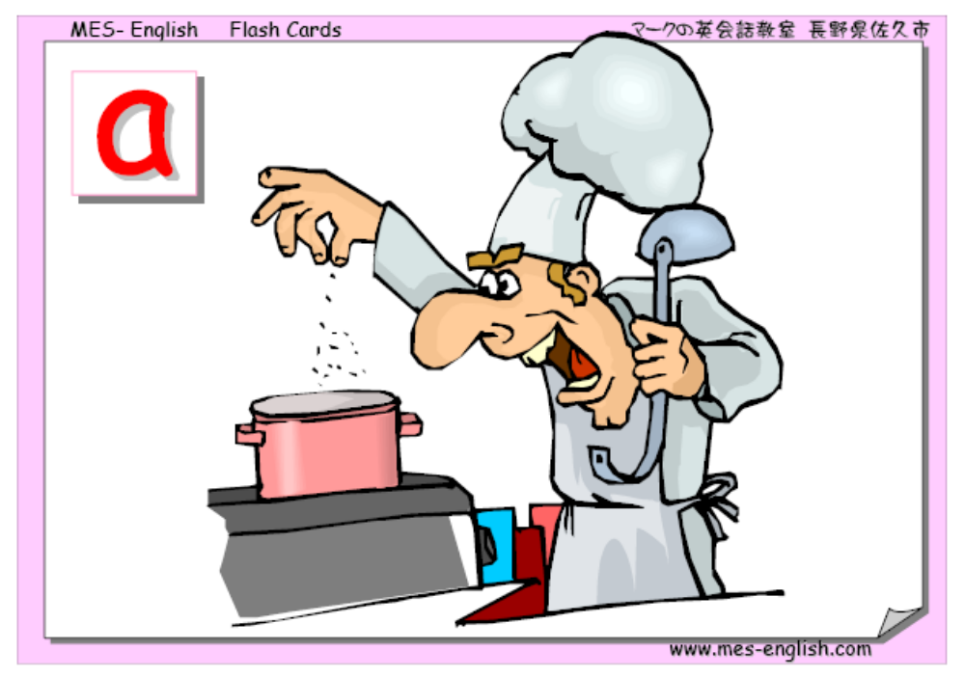
Cook

Slide 14

Actor

Slide 15

Actress

Slide 16

Astronaut

Slide 17

Carpenter

Slide 18

Cashier

Slide 19

Construction worker

Slide 20

Dentist

Slide 21

Engineer

Slide 22

Plumber

Slide 23

Reporter

Slide 24

Secretary

Slide 25
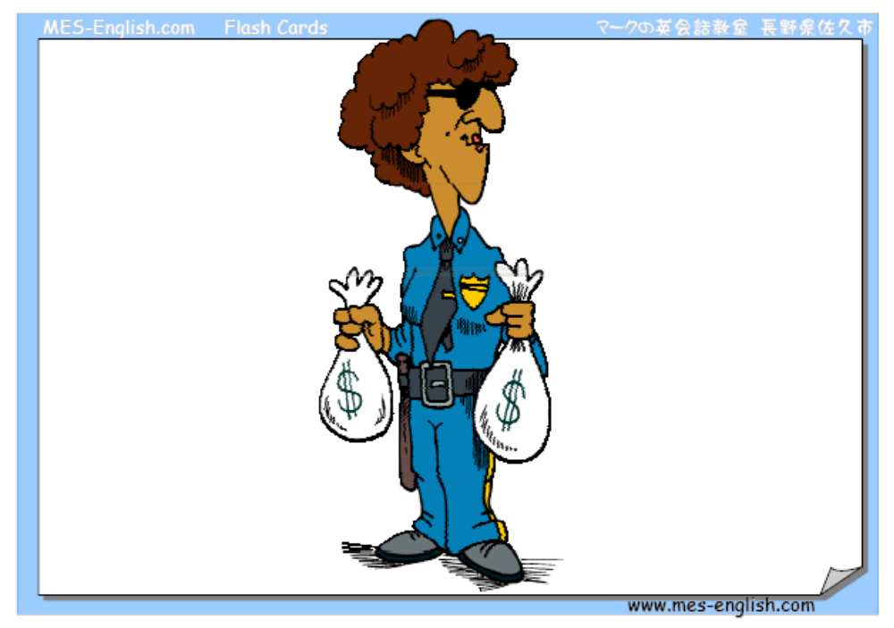
Security guard

Slide 26

Soldier

Slide 27

Veterinarian (Vet)

Slide 28

Waitress

Slide 29

Optician (Eye doctor)

Slide 30

Dancer

Slide 31

Farmer

