Slide 1

www.makemegenius.com– Full of ingredients to make your child a genius.
“Don’t make me read, make me understand “

Slide 2

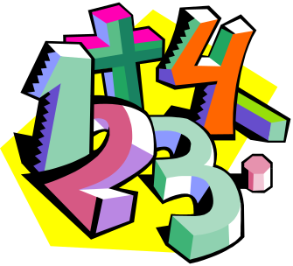
Multiplication and Division
Rules to help!

Slide 3
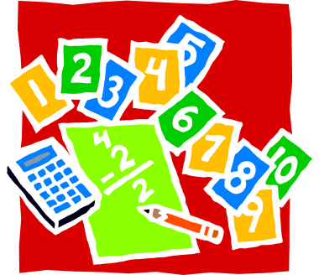
Multiplication and Division are opposites
See the Family of Facts:
4 x 3 = 12
12 ÷ 3 = 4

Slide 4
It’s all about Groups
Multiplication means groups of
Division means share into groups
e.g. 3 x 2 means 3 groups of 2
e.g. 6 ÷ 3 means 6 shared into 3 groups

Slide 5

Multiplying by 0
When you multiply by 0 the answer is always 0
e.g. 4 x 0 = 0
e.g. 57,000 x 0 = 0

Slide 6
Multiplying by 1
e.g. 35 x 1 = 1
When you multiply a number by 1, the answer is always the same as the number
e.g. 23,000 x 1 = 23,000
e.g. 3 x 1 = 3
e.g. 5 x 1 = 1

Slide 7
Multiplying by 2
Multiplying by 2 is the same as Doubling or adding the number to itself
e.g. 5 x 2 = 10
Double 5 is 10
5 + 5 = 10

Slide 8

Dividing by 2
When you divide by 2 it is the same as halving the number
e.g. 50 ÷ 2 = 25
Half of 50 is 25

Slide 9
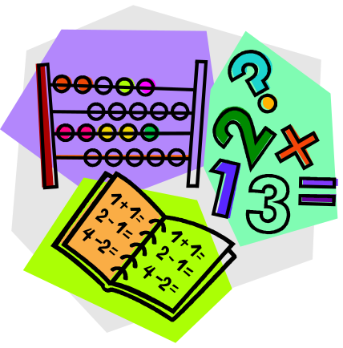
Multiplying by 4
If you want to quickly multiply a number by 4, then just double it twice!
e.g. 6 x 4 = 24
double 6 is 12
double 12 is 24

Slide 10
Multiplying by 5
The 5 times table is easy to learn, if you remember that all answers end in a 5 or a 0
10
45
5
15
20
25
30
50
40
35

Slide 11
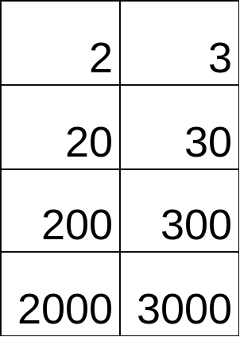
Multiplying by 10
When you multiply by 10, all the digits move 1 place to the left and a 0 is added.
X 10
X 10

Slide 12

Thanks
Submitted by
Adesh
Mumbai

Slide 13
If you also want to share your own or your kid’s presentation(ppt) please send it on info@makemegenius.com

Slide 14
www.makemegenius.com– Full of ingredients to make your child a genius.
“Don’t make me read, make me understand “

