Slide 1
Animal Adaptations
www.makemegenius.com Free Science Videos for Kids

Slide 2
Visit
www.make me genius.com
foe free video on Animal Adaptations
It is free.
www.makemegenius.com Free Science Videos for Kids

Slide 3
1ST LEARN ABOUT HABITATS
www.makemegenius.com Free Science Videos for Kids

Slide 4

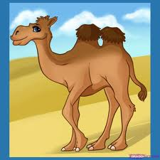
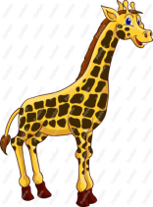
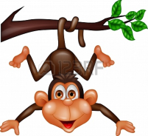

What is a Habitat?
Water
On trees
Dry area ,Sandy
Forest, on land
Cold areas, Poles
Aquatic
Desert
Terrestrial
Polar
Arboreal
Habitat :
The natural home or environment of an animal or a plant.
www.makemegenius.com Free Science Videos for Kids

Slide 5
NOW LEARN ABOUT ADAPTAIONS
www.makemegenius.com Free Science Videos for Kids

Slide 6
Meaning
Adaptations are body features and habits that enable a living thing to live comfortably in its natural surroundings (habitat)
Examples of the basic adaptations that help creatures survive:
shape of a bird's beak,
the number of fingers,
colour of the fur,
the thickness or thinness of the fur,
the shape of the nose or ears
www.makemegenius.com Free Science Videos for Kids

Slide 7
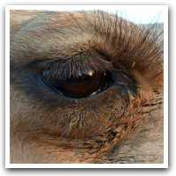
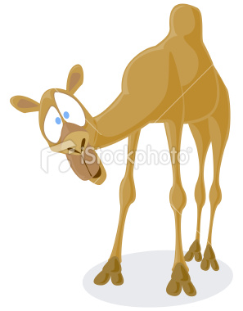
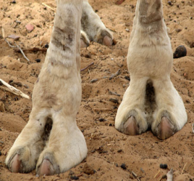
Camel –Lives in Desert
Hump
For storing food
Two Eyelashes
To stop the sand
entering the eyes
Padded Feet
Stop Sinking into the sand
And protect from ground-heat
www.makemegenius.com Free Science Videos for Kids

Slide 8
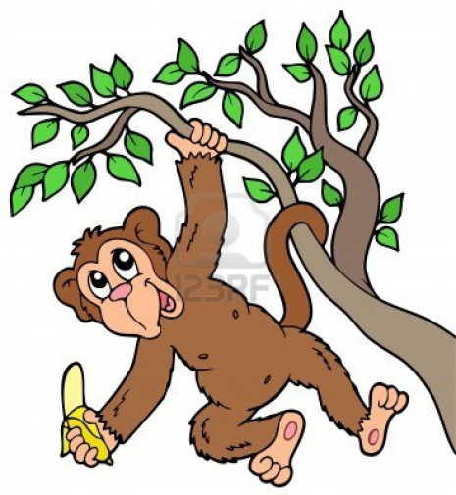
Monkey
A tail
Helps them to swing and
balance their bodies. It also
helps them to pick food
Sound
They make different
sounds to locate and
greet each other
Long arms and legs
to help them swing
www.makemegenius.com Free Science Videos for Kids

Slide 9
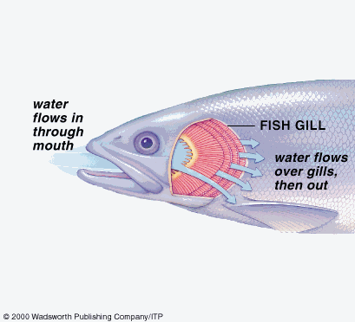
Fish
Oxygen is absorbed
Carbon dioxide comes out
Have special gills to take oxygen from water for respiration
www.makemegenius.com Free Science Videos for Kids

Slide 10
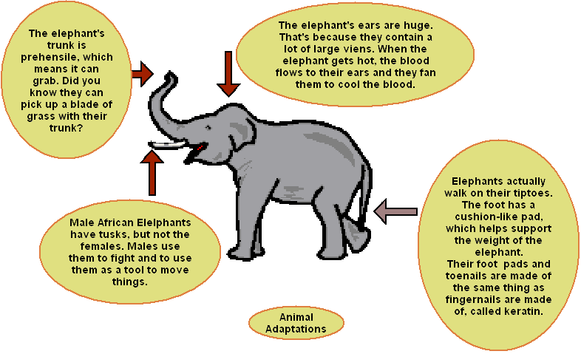

Elephants
www.makemegenius.com Free Science Videos for Kids

Slide 11
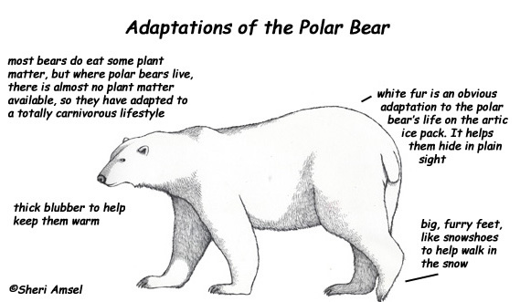
Polar Bear
www.makemegenius.com Free Science Videos for Kids

Slide 12
Visit
www.make me genius.com
foe free video on Animal Adaptations
It is free.
www.makemegenius.com Free Science Videos for Kids

