Slide 1

www.makemegenius.com– Full of ingredients to make your child a genius.
“Don’t make me read, make me understand “

Slide 2
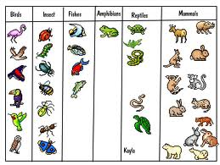
Animal Groups

Slide 3
Why do some animals live in groups?
Some animals live in groups for protection
Some animals live in groups in order to search for food

Slide 4

Some animals live together for protection.
Fish swim together in schools to warn each other of approaching danger.

Slide 5
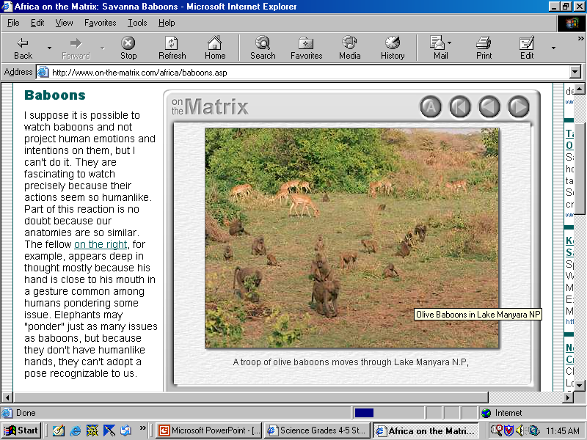
Some animals live together for protection.
Baboons move together in a troop.

Slide 6
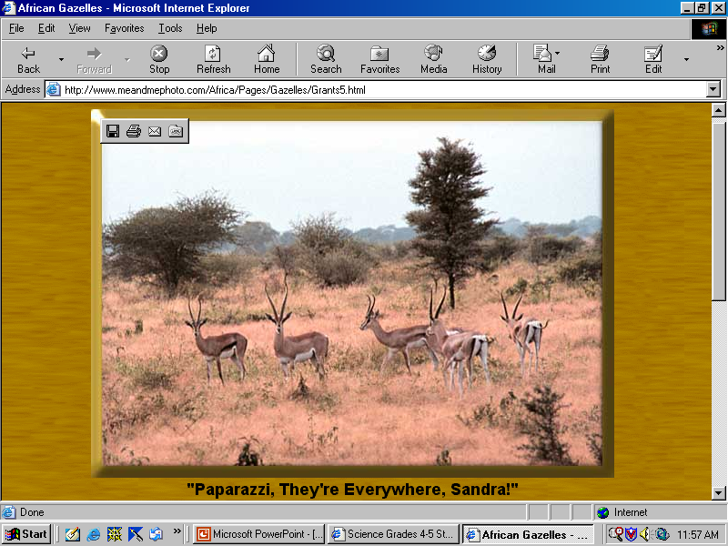
Some animals live together for protection
Gazelles live together in a group called a harem.

Slide 7
Some animals live in specialized groups called colonies.
In a colony each animal has a specific job.
Animals in a colony communicate in a unique way.

Slide 8


Some animals live in specialized groups called colonies.
Bees live in a colony called a hive.
A hive has one queen bee.
The worker bees search for pollen

Slide 9
Some animals live in specialized groups called colonies
Honeybees communicate the location of food by doing a dance.

Slide 10
What do you know about animal groups?
What do you call…
a group of kangaroos?
a group of foxes?
a group of monkeys?

Slide 11

Thanks
Submitted by
Swati Sharma
KV, Delhi

Slide 12
If you also want to share your own or your kid’s presentation(ppt) please send it on info@makemegenius.com

Slide 13
www.makemegenius.com– Full of ingredients to make your child a genius.
“Don’t make me read, make me understand “

