Slide 1

www.makemegenius.com– Full of ingredients to make your child a genius.
“Don’t make me read, make me understand “

Slide 2

What are batteries?
Batteries store electricity for appliances
that you can not or do not want to plug in.
Batteries can be put in and taken out of
appliances.
Batteries can “run out” of electricity.
Some batteries can be recharged (refilled) with electricity.

Slide 3
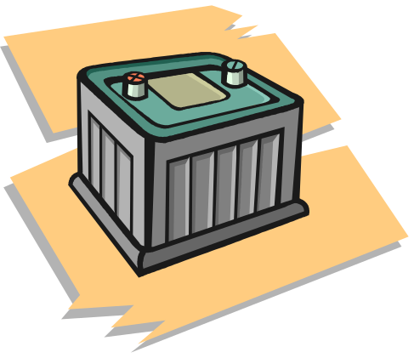
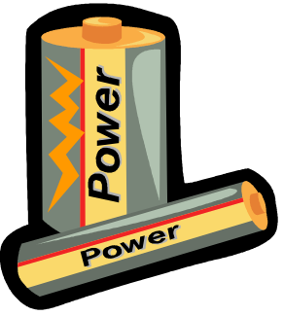
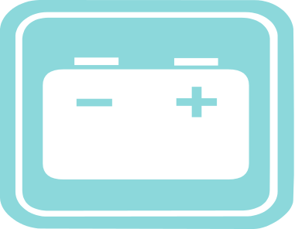
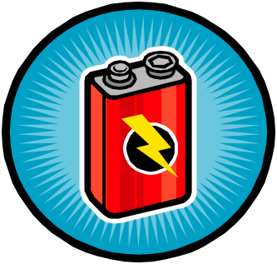
Batteries
Batteries can come in different colours, shapes and sizes …
Each appliance has to have the correct battery to work properly.

Slide 4

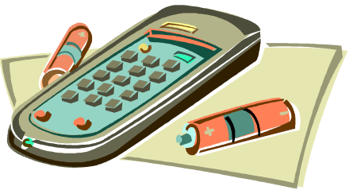
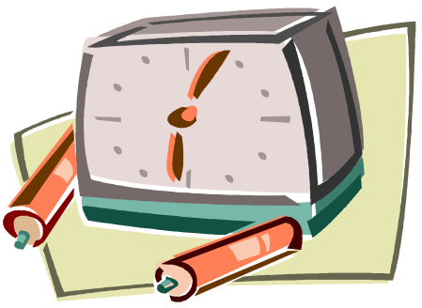



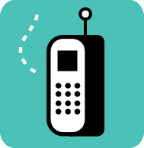
What appliances can you think of that use batteries?

Slide 5
+ and -
The + and – signs help you to know which way the battery should be inserted.
If a battery is not put in correctly then the appliance will not work!!!

Slide 6
Can you put the batteries in the torch properly? How will you know if the batteries have been inserted the right way?

Slide 7
metal light bulb two batteries electricity light batteries
A torch is a useful kind of _____________ . It uses
______________ to make light. A torch gets its
electricity from _____________ . Most torches
have _____________batteries. All torches have a
small ________________ and a switch. When you
press the switch of a torch electricity flows from the
__________________ . The electricity flows
along thin strips of _____________ to the bulb. It
Makes the bulb ______________ up. Then the
electricity goes back into the ________________ .

Slide 8
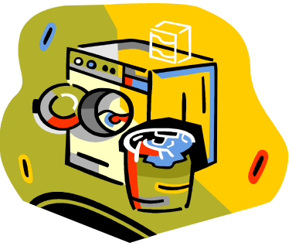

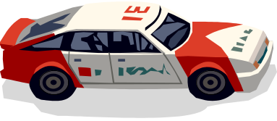

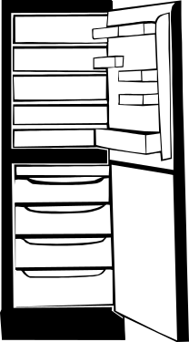

Which of these appliances do you think need batteries to work?

Slide 9

Thanks
Submitted by
Adit
DAV Public School
Delhi

Slide 10
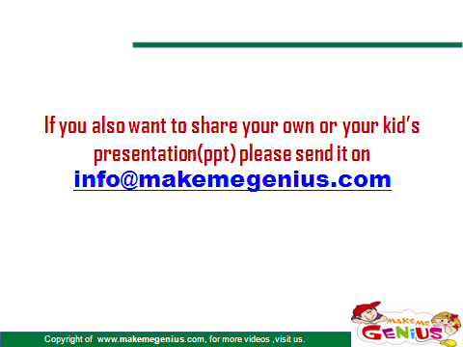

Slide 11
www.makemegenius.com– Full of ingredients to make your child a genius.
“Don’t make me read, make me understand “

