Slide 1

www.makemegenius.com– Full of ingredients to make your child a genius.
“Don’t make me read, make me understand “

Slide 2

Fossils

Slide 3
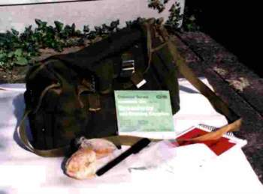
These are some of the tools people use to find fossils. You should not use hammers or chisels because it can damage the fossils or damage the land.

Slide 4
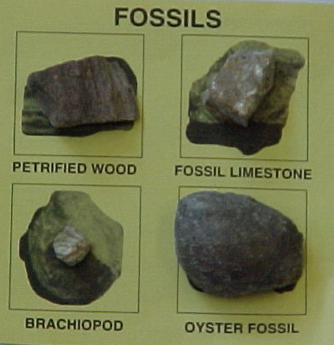
There are many kinds of fossils. In this picture you see petrified wood, fossil limestone, brachiopod, and oyster fossil.

Slide 5
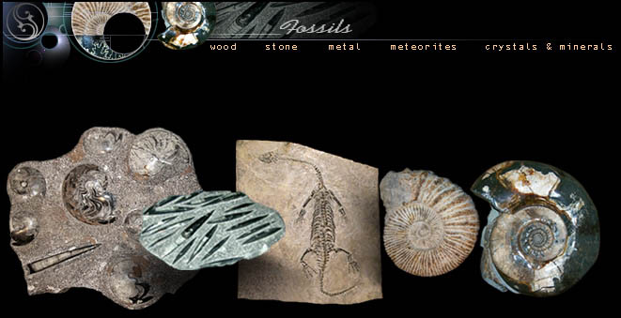
Most animals and plants are destroyed when they die. But sometimes the remains are buried before they are destroyed. The remains may become fossils if the conditions are right.

Slide 6
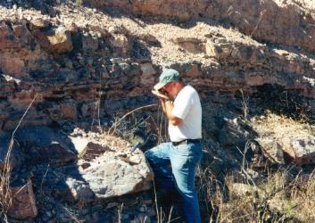
To find fossils paleontologists go on field trips. When they find fossils they use hand tools such as pry bars, hammers, and chisels. After that they mark it with a number.

Slide 7
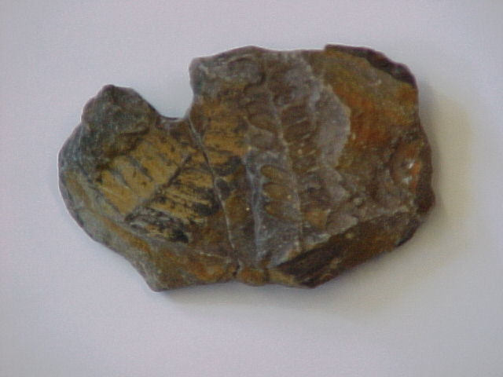
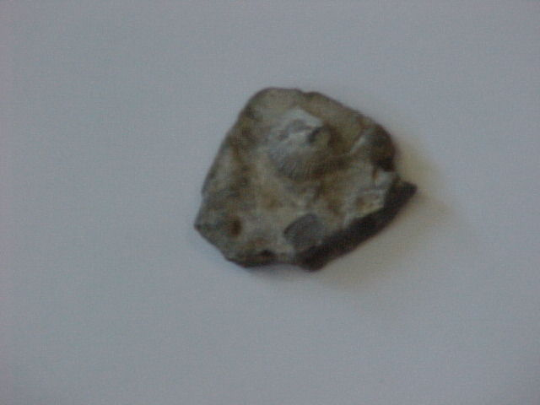
I took these pictures of fossils using the digital camera. On the left is a leaf and on the right is a shell.

Slide 8

Thanks
Submitted by
Ashutosh
Kendriya Vidhyalaya

Slide 9
If you also want to share your own or your kid’s presentation(ppt) please send it on info@makemegenius.com

Slide 10
www.makemegenius.com– Full of ingredients to make your child a genius.
“Don’t make me read, make me understand “

