Slide 1

www.makemegenius.com– Full of ingredients to make your child a genius.
“Don’t make me read, make me understand “

Slide 2
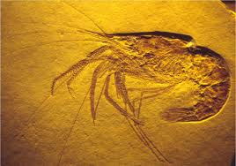
Fossils Tell of Long Ago
Notes:
http://www.opencourtresources.com

Slide 3
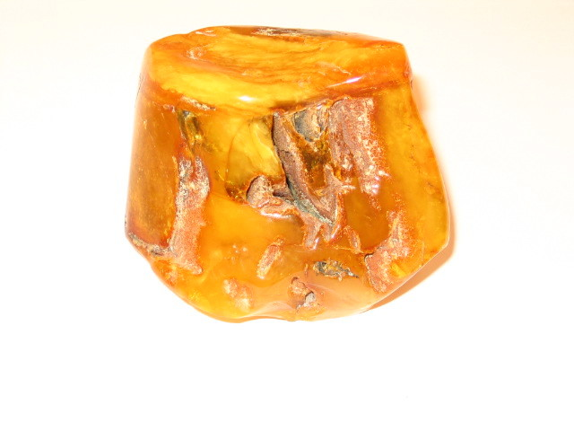
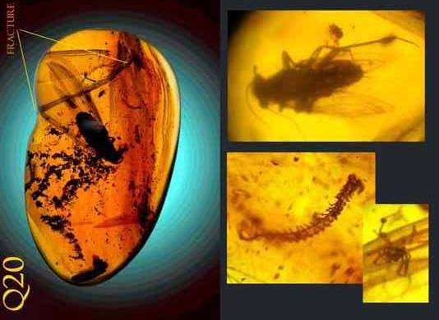
Amber
A yellowish sap from plants that hardens and becomes a fossil.
Many insects have been found preserved in amber.

Slide 4
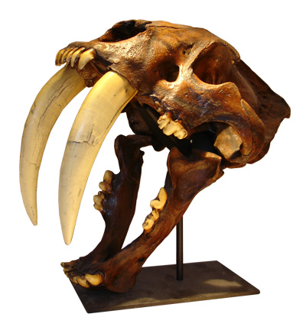
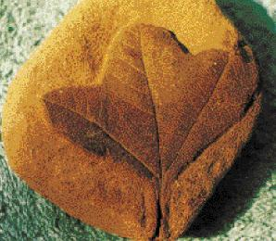
Fossil
A plant, animal, or imprint that has turned to stone.
The fossil of the leaf imprint was found in sandstone.

Slide 5
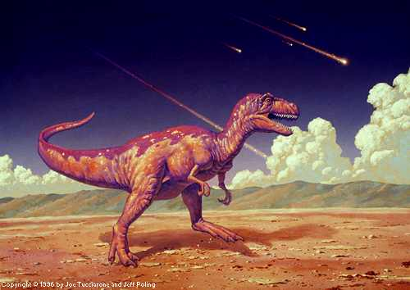
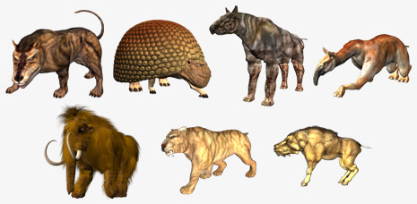
Extinct
Not alive today; all members of the group or species have died out.
Many animals have become extinct, there are none of them left in the world.

Slide 6
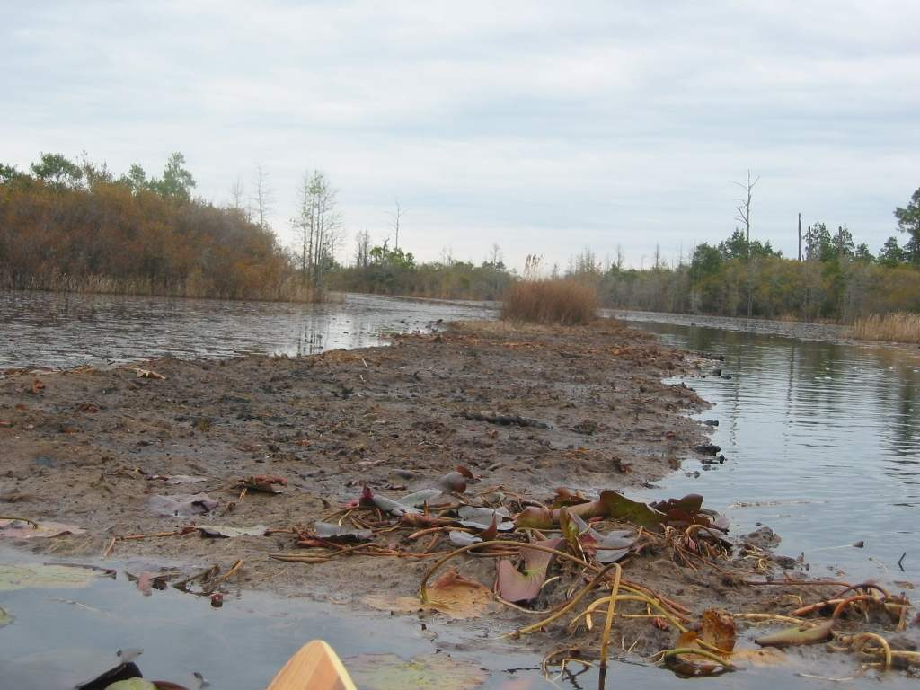
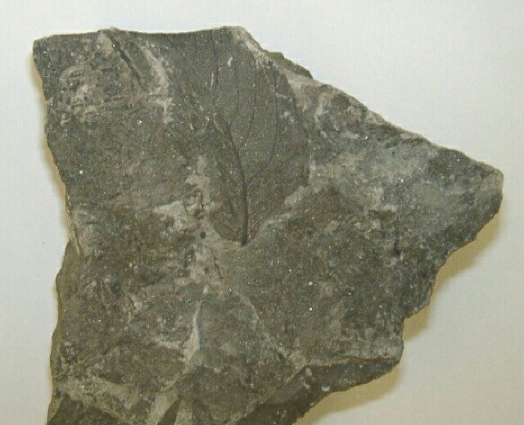
Peat
Swampy forest soil
The peat, with the leaf imprint, hardened into coal.

Slide 7
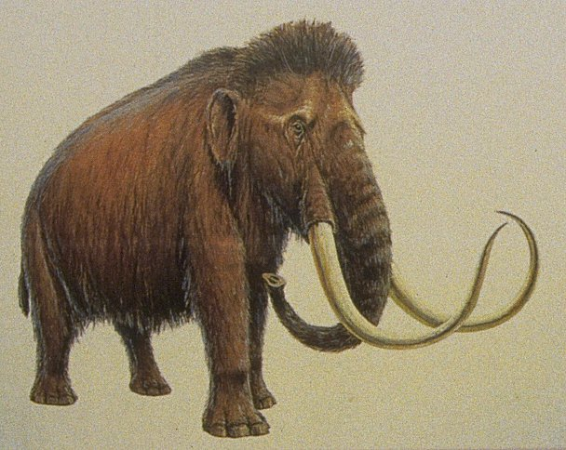
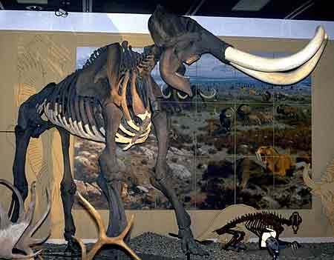
Mammoth
A kind of elephant that lived millions of years ago.
The fossils of a mammoth look similar to an elephant.

Slide 8

Thanks
Submitted by
Piyush
St.Paul Public School
Noida

Slide 9
If you also want to share your own or your kid’s presentation(ppt) please send it on info@makemegenius.com

Slide 10
www.makemegenius.com– Full of ingredients to make your child a genius.
“Don’t make me read, make me understand “

