Slide 1

www.makemegenius.com– Full of ingredients to make your child a genius.
“Don’t make me read, make me understand “

Slide 2
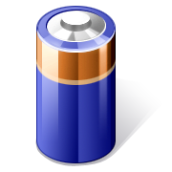
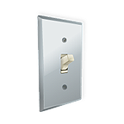


Energy

Slide 3
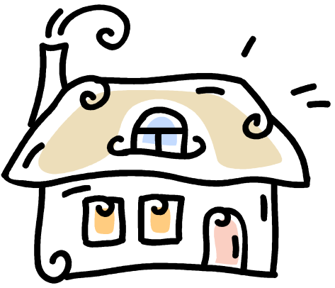
Electrical Energy
Electricity is very important in our lives.
We would find it very hard to do without it.
There are so many things in our homes that are powered by electricity that we have begun to depend on them.
Imagine you woke up this morning and had no electricity.
What difference would it make to
your normal morning routine?

Slide 4

Mains Electricity
Most of the large appliances in our home are powered by Mains Electricity.
Mains Electricity is a supply of electrical energy
Mains appliances change or convert this electrical energy into other forms of energy
Can you name them?

Slide 5

Types of Energy
Heat energy
Light energy
Sound energy
Movement energy
Can you think up some examples for each type of energy?

Slide 6
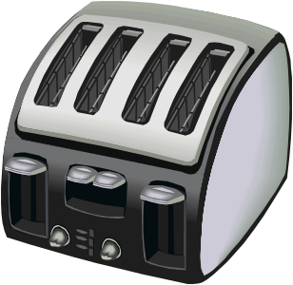
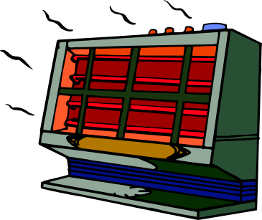
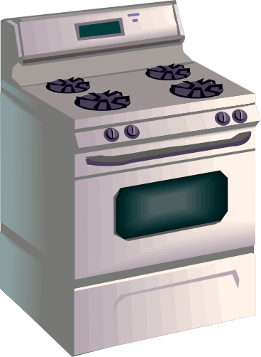


Heat Energy

Slide 7
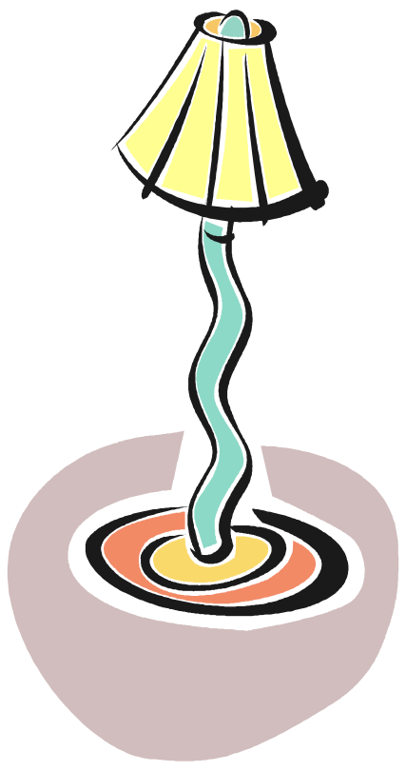



Light Energy

Slide 8
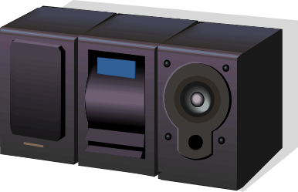

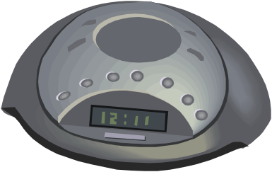
Sound Energy

Slide 9
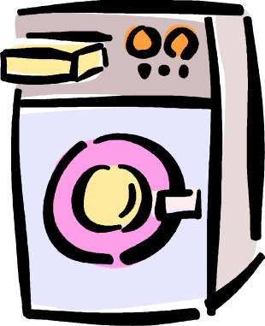


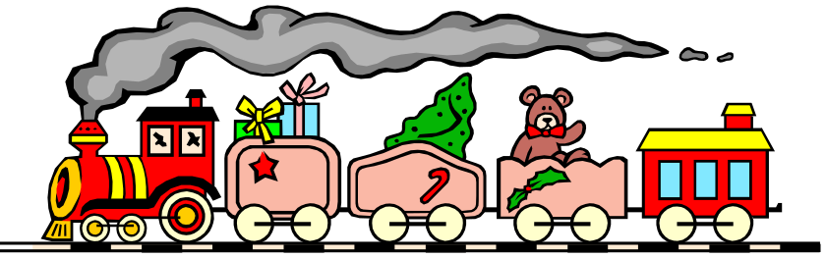
Movement Energy

Slide 10
Battery Power
Many small electrical appliances use batteries.
Batteries are also a source of electrical energy
Battery powered appliances also convert electrical energy into heat, light, sound and movement energy
Can you think of some battery powered appliances for each source of energy?

Slide 11


Light Energy

Slide 12
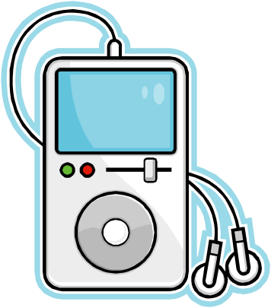
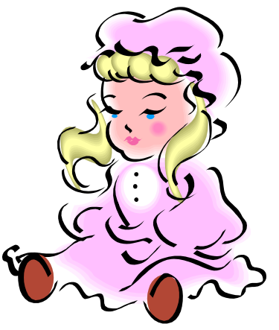

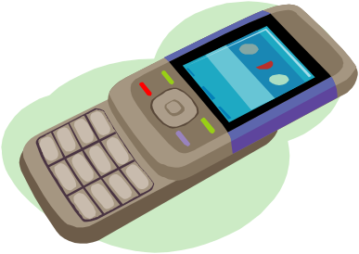
Sound Energy

Slide 13



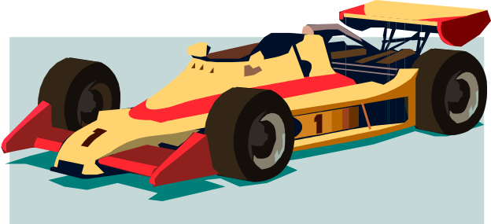
Movement Energy

Slide 14

Thanks
Submitted by
Deepanka Mishra
DAV Public School
Chandigarh

Slide 15
If you also want to share your own or your kid’s presentation(ppt) please send it on info@makemegenius.com

Slide 16
www.makemegenius.com– Full of ingredients to make your child a genius.
“Don’t make me read, make me understand “

