Slide 1
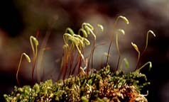
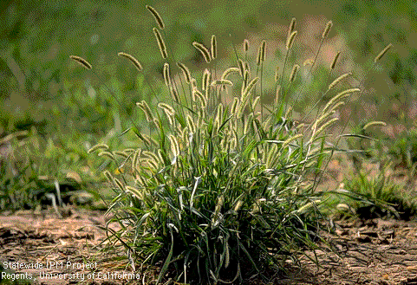
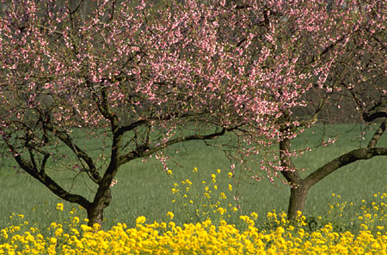
Three Main Types of Plants
Mosses(No Flowers)
www.bio.umass.edu/biology/ conn.river/
mosses.html
Grasses (Monocots)
http://www.ipm.ucdavis.edu/
Trees, Shrubs and
Weeds (Dicots)

Slide 2
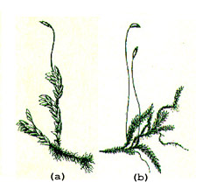
Characteristics of Mosses
No flowers
Fruiting bodies with spores instead of seeds
Usually very small plants with tiny leaves
No true roots, but they are anchored down by filaments (thin, hair-like structures)
www.bio.umass.edu/biology/conn.river/mosses.html

Slide 3
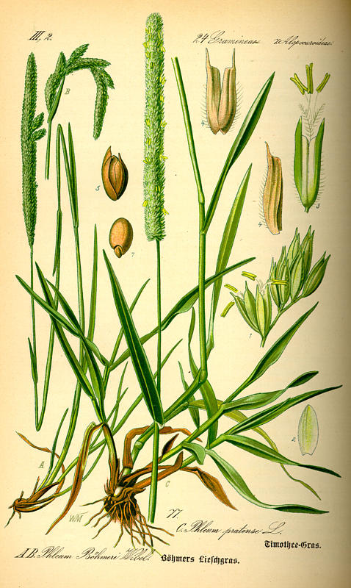
Characteristics of Grasses
Flowers usually tiny and not showy.
Flowers have 3 or six parts
Leaf veins parallel, leaves are narrow
Roots in clumps, no taproot

Slide 4
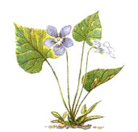
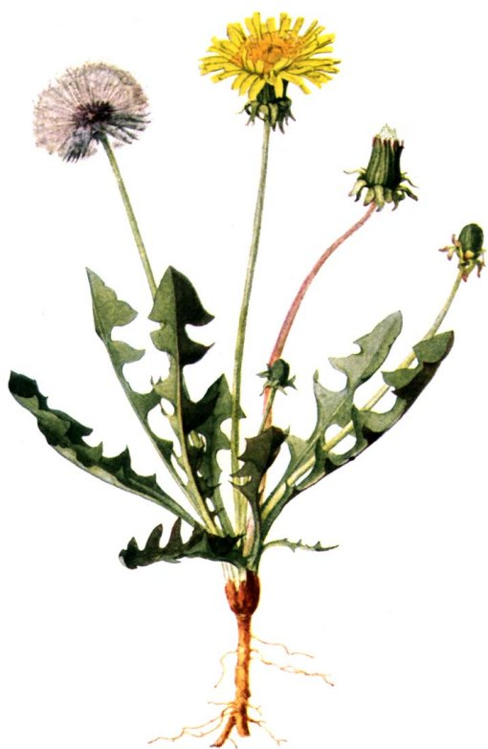
Characteristics of Dicots (Most trees, shrubs and weeds)
Flowers have petals in groups of four or five or more
Leaves have netted veins
Usually have a tap root

