Slide 1

www.makemegenius.com– Full of ingredients to make your child a genius.
“Don’t make me read, make me understand “

Slide 2

How do I know which colors to use?

Slide 3
Let’s start with the Basics…
What are the Primaries?

Slide 4
the Primaries are…
Red…
Rojo

Slide 5
Yellow… amarillo

Slide 6
And …Blue

Slide 7
the secondaries are…

Slide 8
Green… verdi

Slide 9
Orange
ananaranjo

Slide 10
violet
violeta

Slide 11
The intermediaries are…

Slide 12
Red-violet… rojo - violeta
Red-orange
Rojo-anaranjo

Slide 13
Blue green
Blue violet

Slide 14
Yellow orange amarillo anaranjo
Yellow green amarillo verdi

Slide 15
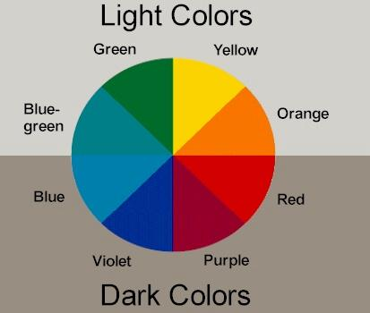

Slide 16
Now… how do I know which colors look good together?
Chose one of the five harmony groups

Slide 17
What are the 5 harmony groups?
they are….

Slide 18
1.monochrome

Slide 19
monochrome
This is also monochrome….

Slide 20
and this….
monochrome

Slide 21
monochrome
Definition: One color with different shades and tints
To tint a color you add white … to shade a color you add black

Slide 22
2.complimentary
And this is complimentary

Slide 23
…And this is complimentary

Slide 24
Definition: two colors that are opposite from each other on the color wheel

Slide 25
3.Split-complimentary
Definition: One color plus the two colors on either side of its opposite

Slide 26
Blue is the base color
RO and yo are the split-opposites

Slide 27
This is also an example of a split-complimentary harmony

Slide 28
4. Triadic definition: 3 equally spaced colors

Slide 29
This is a triad also… green orange and violet

Slide 30
5. Analogous
Definition: 2 or more colors between primaries, except both primaries

Slide 31
blue blue-violet violet red-violet

Slide 32

Thanks
Submitted by
Deepanka Mishra
DAV Public School
Chandigarh

Slide 33
If you also want to share your own or your kid’s presentation(ppt) please send it on info@makemegenius.com

Slide 34
www.makemegenius.com– Full of ingredients to make your child a genius.
“Don’t make me read, make me understand “

