Slide 1
Bellwork
Find the x and y values
Y
(-5,2)
(3,3)
X
(-3,-1)
(4,-3)

Slide 2
Bellwork
x values: {-5, -3, 3, 4}
y values: {3, 2, -1, -3}

Slide 3
Today’s Objective
To be able to make a “T” Table…. And then GRAPH the linear equation from the table

Slide 4
Solving Equations in 2 Variables
x + y = 5
What are some Solutions?
{(2,3), (1,4), (0,5), (-1,6),(.5,4.5), etc…}

Slide 5
Solving Equations in 2 Variables
y = 2x + 1
Make a “T” table.
Pick 4 numbers for x and plug them into the equation one at a time.

Slide 6
The “T” Table
X Y
4
-2
0
1

Slide 7
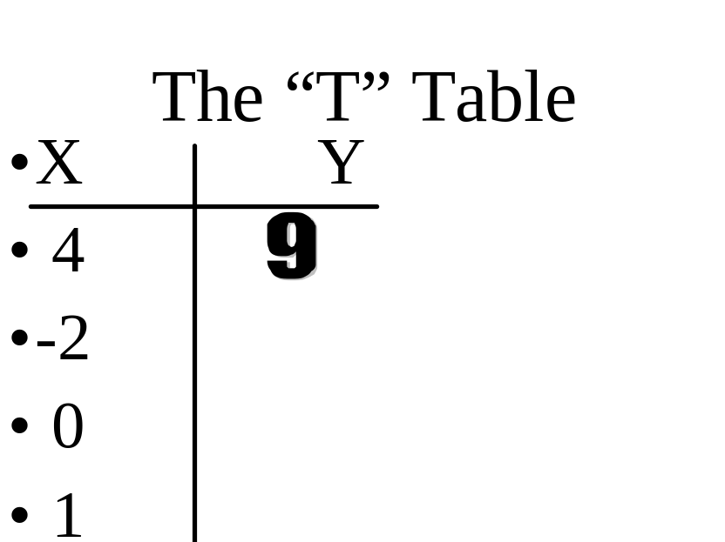
First pick for x is 4
y = 2x + 1
y = 2(4) + 1
y = 8 + 1
y = 9

Slide 8
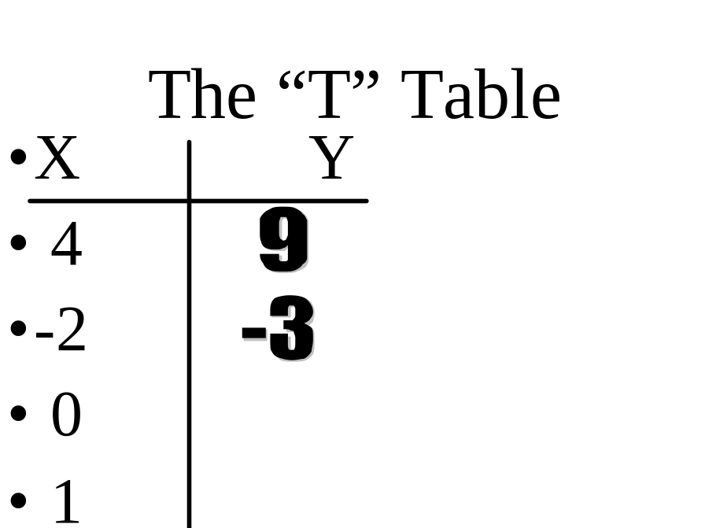
Second pick for x is -2
y = 2x + 1
y = 2(-2) + 1
y = -4 + 1
y = -3

Slide 9
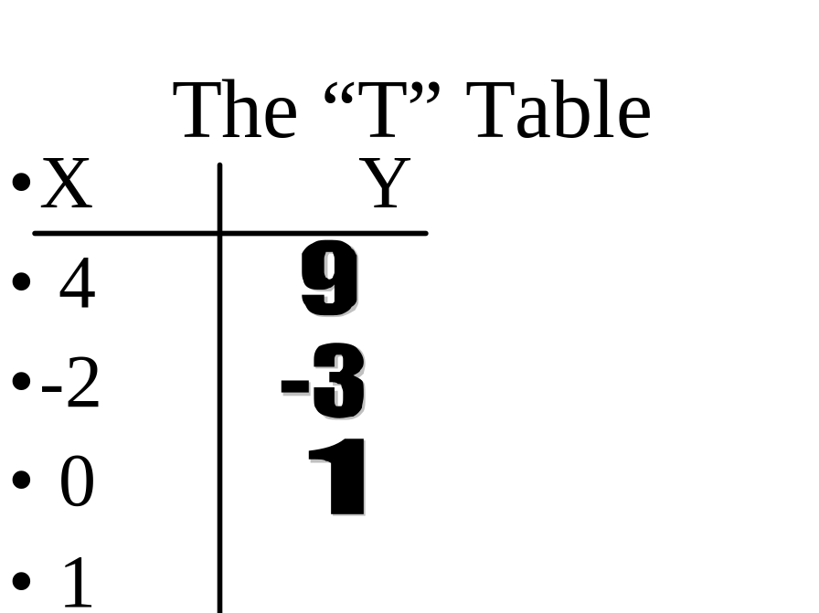
Third pick for x is 0
y = 2x + 1
y = 2(0) + 1
y = 0 + 1
y = 1

Slide 10
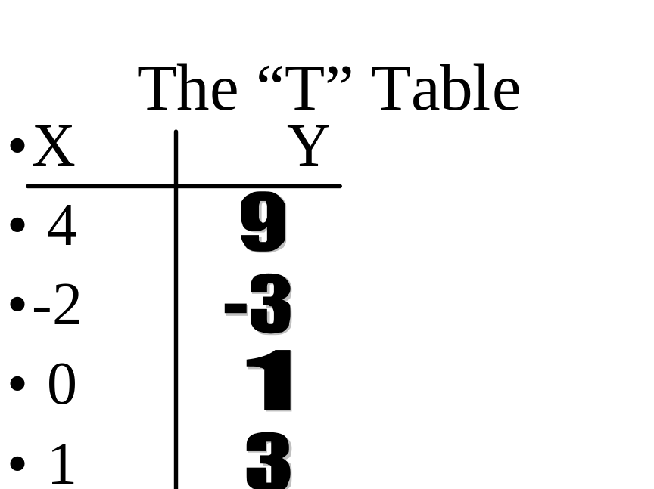
Fourth pick for x is 1
y = 2x + 1
y = 2(1) + 1
y = 2 + 1
y = 3

Slide 11
Plot the Points (4,9), (-2,-3), (0,1),(1, 3)
Y
(4,9)
(1,3)
X
(0,1)
(-2,-3)

Slide 12
What do you notice about the 4 points?
Y
(4,9)
(1,3)
X
(0,1)
(-2,-3)

Slide 13
Now DRAW the Line
Y
(4,9)
(1,3)
X
(0,1)
(-2,-3)

Slide 14
Solving Equations in 2 Variables
3x - 2y = 6
1.) Solve the equation for y.
2.) Make a “T” table.
3.) Pick 4 numbers for x and plug them into the equation one at a time.

Slide 15

1.) Solve the equation for y.
3x - 2y = 6
3x -3x -2y = 6 - 3x
-2y = 6 - 3x
-2y/-2 = (6 - 3x)/-2
y = -3 + 3/2x
y = 3/2x -3

Slide 16
The “T” Table
X Y
1
2
0
-1

Slide 17
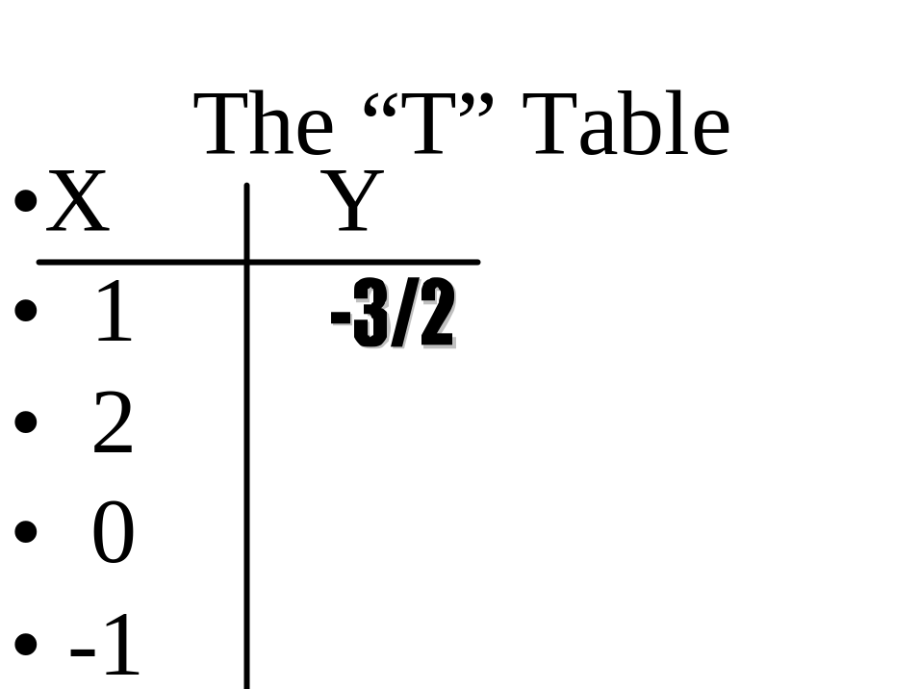
First pick for x is 1
y = 3/2x - 3
y = 3/2(1) - 3
y = -3/2

Slide 18
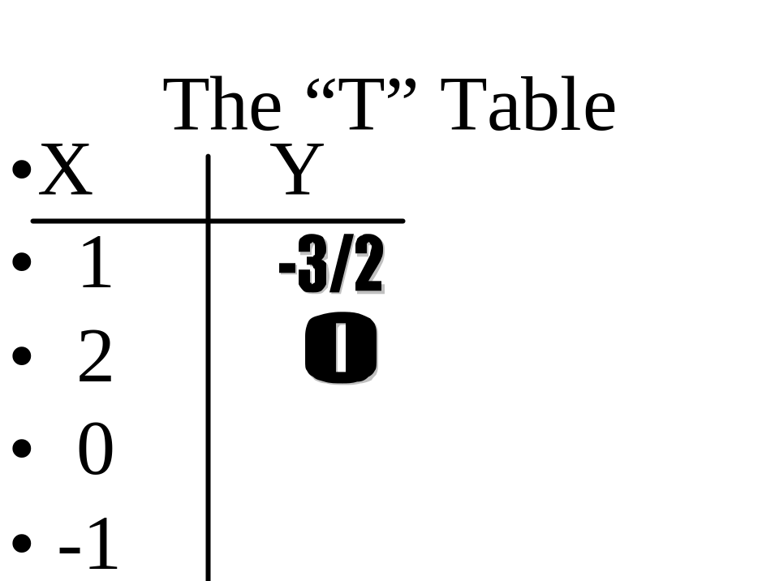
Second pick for x is 2
y = 3/2x - 3
y = 3/2(2) - 3
y = 3 - 3
y = 0

Slide 19
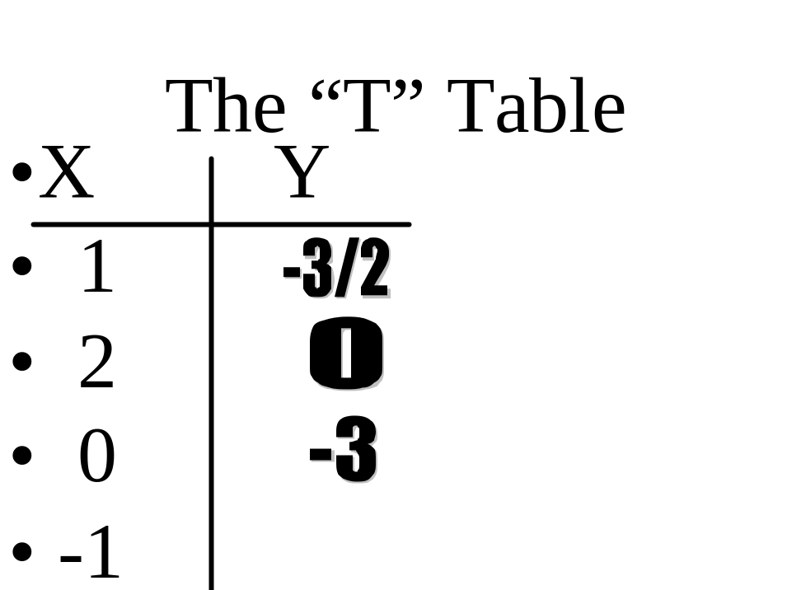
Third pick for x is 0
y = 3/2x - 3
y = 3/2(0) - 3
y = -3

Slide 20
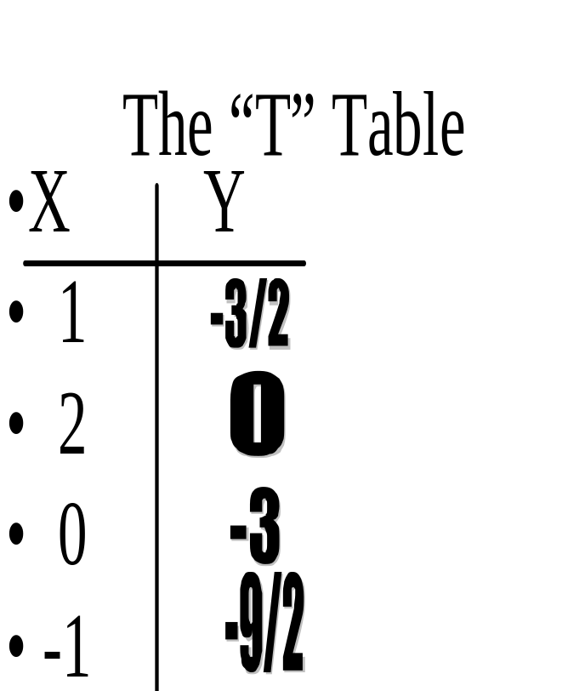
Fourth pick for x is -1
y = 3/2x - 3
y = 3/2(-1) - 3
y = -3/2 - 3
y = -4 1/2 or -9/2

Slide 21
The “T” Table
X Y
1 -3/2
2 0
0 -3
-1 -9/2

Slide 22
Plot the Points (1,-3/2),(2,0), (0,-3),(-1, -9/2)
Y
(1,-3/2)
(0,-3)
X
(2,0)
(-1,-9/2)

Slide 23
What do you notice about the 4 points?
Y
(1,-3/2)
(0,-3)
X
(2,0)
(-1,-9/2)

Slide 24
Now DRAW the Line
Y
(1,-3/2)
(0,-3)
X
(2,0)
(-1,-9/2)

Slide 25
You try this one
4x + 2y = 1
1.) Solve the equation for y.
2.) Make a “T” table.
3.) Pick 4 numbers for x and plug them into the equation one at a time.

Slide 26
1.) Solve the equation for y.
4x + 2y = 1
4x - 4x + 2y = 1 - 4x
2y = 1 - 4x
2y/2 = (1 - 4x)/2
y = 1/2 - 2x

Slide 27
The “T” Table
X Y
1
2
0
-1

Slide 28
First pick is 1
y = -2x + 1/2
y = -2(1) + 1/2
y = -2 + 1/2
y = 1 1/2 = 3/2

Slide 29
Second pick is 2
y = -2x + 1/2
y = -2(2) + 1/2
y = -4 + 1/2
y = -3 1/2 = -7/2

Slide 30
Third pick is 0
y = -2x + 1/2
y = -2(0) + 1/2
y = 1/2

Slide 31
Fourth pick is -1
y = -2x + 1/2
y = -2(-1) + 1/2
y = 2 + 1/2
y = 2 1/2 = 5/2

Slide 32
The “T” Table
X Y
1 3/2
2 -7/2
0 1/2
-1 5/2

Slide 33
Plot the Points (1,-3/2), (2,-7/2), (0,1/2),(-1, 5/2)
Y
(1,-3/2)
(-1,5/2)
X
(2,-7/2)
(0,1/2)

Slide 34
Now DRAW the Line
Y
(1,-3/2)
(-1,5/2)
X
(2,-7/2)
(0,1/2)

Slide 35
When Picking #’s for the T Table
Try to pick small x values
The x values that you pick should also have some negative numbers like -1,-2, or -3.
Don’t forget to pick 0 also!

Slide 36
Now You solve the following:
x y
5x + 2y = 10
0
2
4
-2

Slide 37
Now You solve the following & Graph:
x y
5x + 2y = 10
0 5
2 0
4 -5
-2 10

Slide 38
Now DRAW the Line
Y
(0,5)
(-2,10)
(2,0)
X
(4,-5)

Slide 39
Classwork
Do Worksheet 4.2
Homework
page186 (5-16 & 21-24)

