Slide 1
%
Percents
by
Nancy Gray
BEGIN

Slide 2

Working with Percentages
% 100%
c P/B=n/100
$

Slide 3
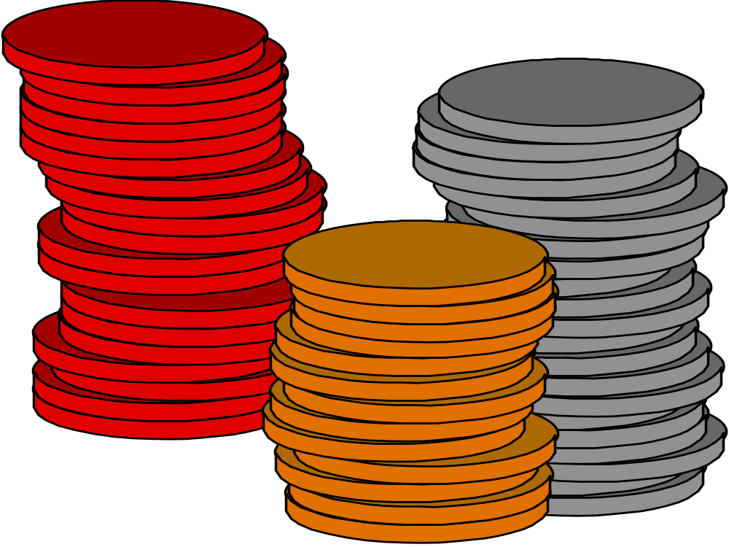
What is percent?
The word percent comes from the Latin words meaning “parts per hundred.”

Slide 4
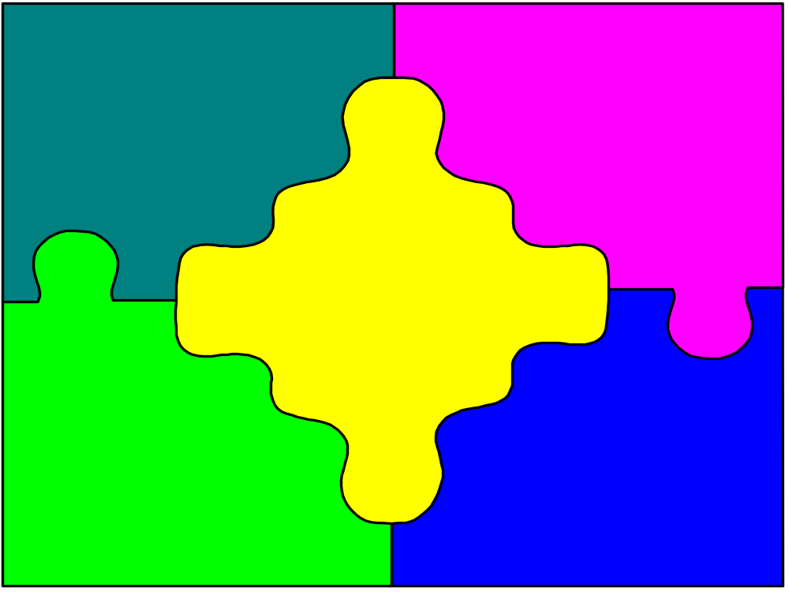
How may percents be expressed?
As words -- fifty percent
As a number with a symbol -- 50 %
As a decimal -- .5
As a fraction -- 1/2

Slide 5

Percents may also be written as equations or by using the percent proportion.

Slide 6
P/B = n/100
P is the part that is being compared to B, the base number or the whole number that is represented by B. n/100 is the ratio that represents the percent.

Slide 7
An example of this could be written as follows:
3 is what percent of 4?

Slide 8
This problem can be written into the equation:
3 = n% • 4

Slide 9

To solve this problem, both sides must be divided by four.
3 = 4n
4 4

Slide 10

Divide three by four
.75
4 3.0 0
- 2 8
2 0
-2 0

Slide 11

On the other side of the equals sign, divide
n4
4
Therefore all that is left is: n

Slide 12

After dividing 4 into both sides of the equation, the result is:
3 = n4
4 4
.75 = n

Slide 13
Another way of solving this problem is to cross multiply the fractions after writing the problem in this format:
P = n
B 100
3 = n
4 100

Slide 14
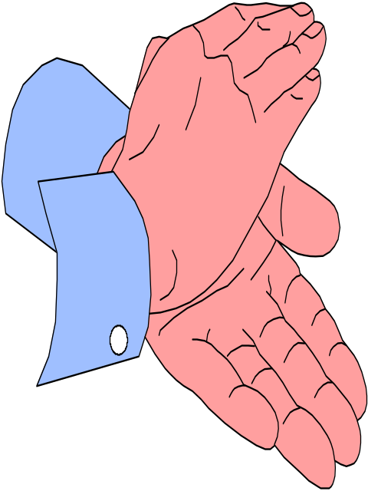
First cross multiply the two fractions:
3 = n
4 100

Slide 15
Think: 3 times 100 is 300
and
4 times n is 4n
3 • 100 = 300 and 4 • n = 4n

Slide 16
The problem should be written as:
300 = 4n
To solve this problem, divide 300 by 4 and divide 4n by 4.
300 ÷ 4 = 75 and 4n ÷ 4 = n

Slide 17

75% = n
or
n = 75%
As a result,

Slide 18
Large numbers
can also be
percentages of
smaller numbers.

Slide 19

For example,
6 is what percent of 3?
There are two ways this
problem can be solved.

Slide 20

One way to solve this
is to think -- abstractly,
6 divided by 3 is 2,
and 3 is 100 percent of 3,
so 6 is 200 percent of 3
because 100 % times 2 is 200%.

Slide 21

Another way to solve this is to think,
6 = n
3 100%
Cross multiply so that
6 times 100% is 600%,
and 3 times n is 3n.

Slide 22

3n = 600%
Divide 3 into both sides
And, the result is
n = 200%.

