Slide 1
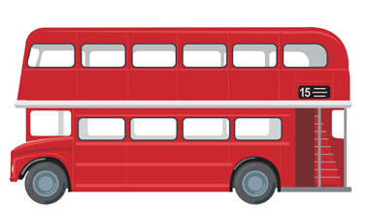

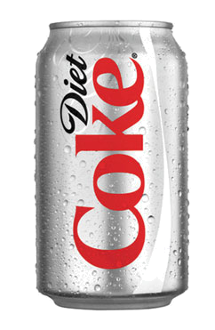
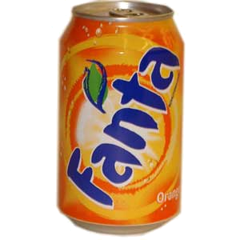

Combinations
Z
Tick the LO you
are aiming for today
Learning Objectives
D
Identify basic combinations of items (E)
Identify all combinations of two different item (3 choices) (D)
Identify combinations in real life situations (D)
Starter: Combinations
Pick one chocolate bar & one drink
How many different combinations are there?
KS3 Statistics

Slide 2
Starter: Combinations
Pick one chocolate bar & one drink
How many different combinations are there?

Slide 3


More Combinations
If there were three drinks and three chocolate bars, list the combinations

Slide 4



Your Turn: Combinations

Slide 5
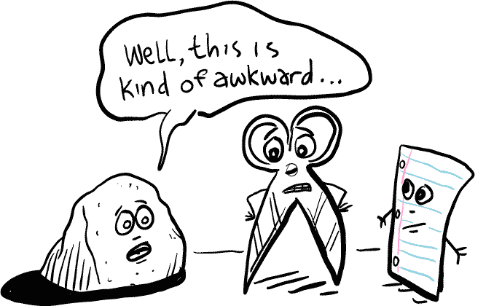
Z

Slide 6
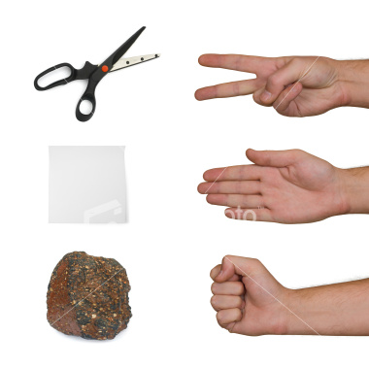
Z
Rock Paper Scissors
Play the game for 5 minutes, then write down all the combinations you can get
How many combinations are there in total?
How many combinations lead to a win?
How many combinations lead to you winning?
How many combinations lead to your opponent winning?
Scissors beats paper (cuts it)
Paper beats Rock (wraps it)
Rock beats scissors (blunts it)
Showing the same is a draw
Can you work out the probability of a draw?

Slide 7

Time to Shop!

Slide 8

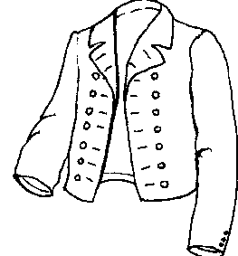
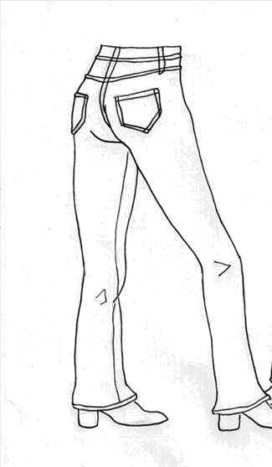

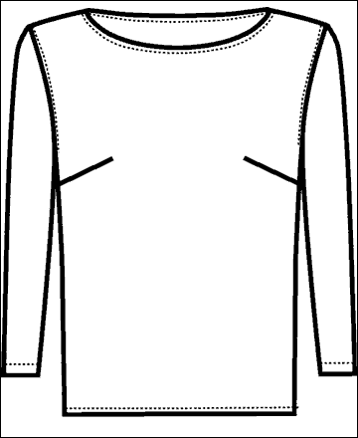



If you only buy one item in each shop, what are all the different combinations you could buy?
Shop 1: Primark
Shop 2: Top Shop
Create your own shopping question

Slide 9



Z
Learning Objectives
Identify basic combinations of items (E)
Identify all combinations of two different item (3 choices) (D)
Identify combinations in real life situations (D)
How did you do?

