Slide 1

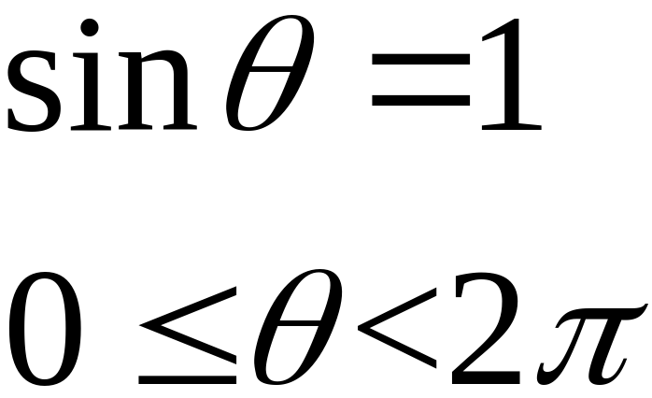

Tuesday February 13th 2001
Hint:
ANSWER:

Slide 2
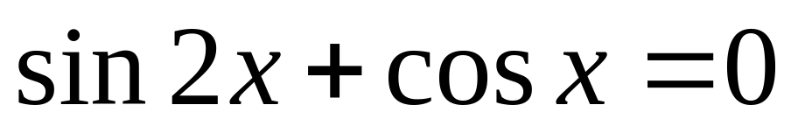
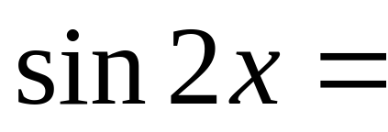
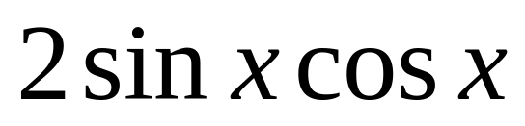
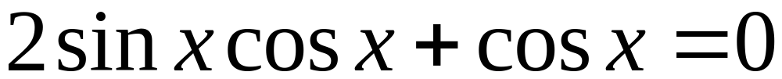
Double Angle Replacements
FACTOR SET EQUAL TO ZERO SOLVE

Slide 3

Double Angle Replacements
Which replacement for cos2x will you use?
FACTOR SET EQUAL TO ZERO SOLVE

Slide 4

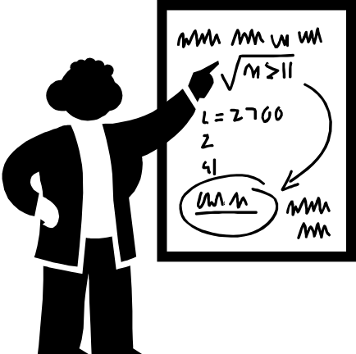
Double Angle Replacements
LCD
METHOD!!

Slide 5
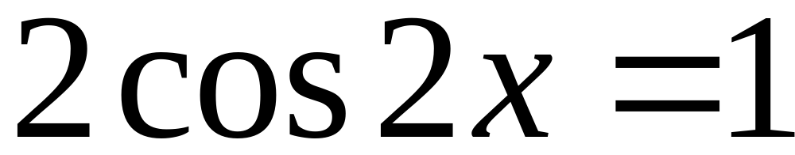
Double Angle Replacements

Slide 6

In Closing…..
HW: pg620:
26,28,29,30,38
Test on FRIDAY!
Review 10th period Tues, Wed, Thurs

Slide 7
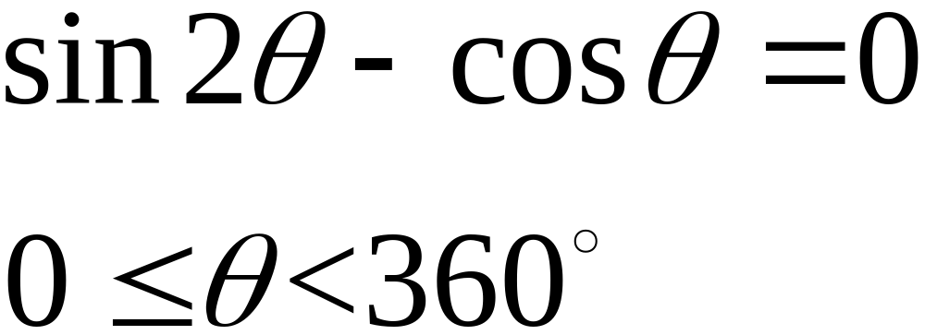
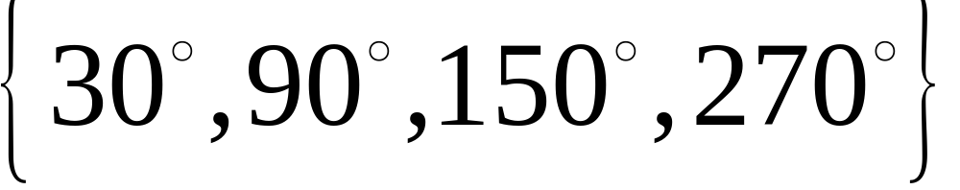
Wednesday Feb 14th, 2001
ANSWER:

Slide 8

Day 1 Trig Equation Review
Go over HW
Practice Moving Angles around the circle
Regent’s Part II Exam Practice Problems

Slide 9
Practice Moving Angles around the Circle.
Find all the angles whose reference angle is 36 degrees.
Hint
144
36
180-
324
216
180+
360-

Slide 10
Practice Moving Angles around the Circle.
A solution to your problem is –25 degrees and you are working with sine. Find the positive angle answers.
Hint
S
A
335
205
T
C

Slide 11
Practice Moving Angles around the Circle.
A solution to your problem is 110 degrees and you are working with cosine. Find the positive angle answers.
110
Hint
S
A
205
T
C

Slide 12
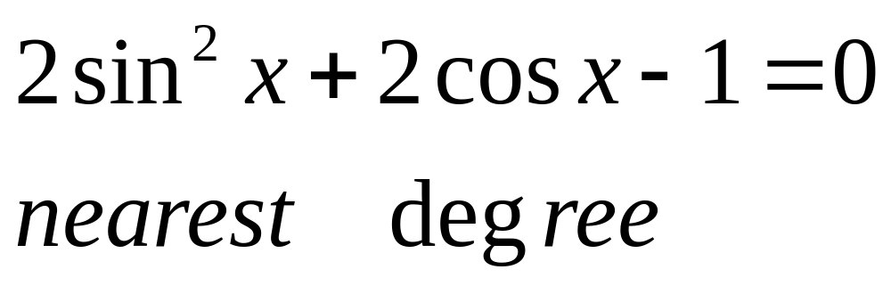

Part II 10 point problem
What needs to be replaced?
What technique will you use to solve this?

Slide 13
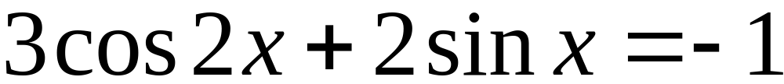
Part II 10 point problem
Nearest Ten Minutes
Which formula is most appropriate to use?

Slide 14
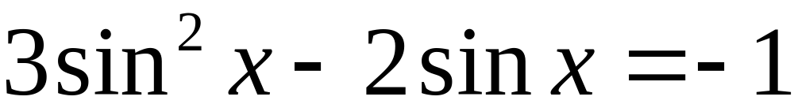
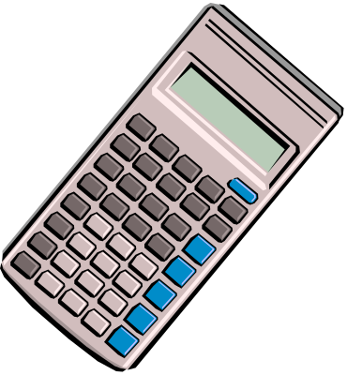
Part II 10 point problem
Nearest Ten Minutes

Slide 15

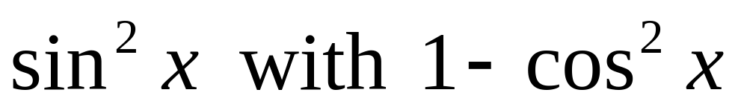

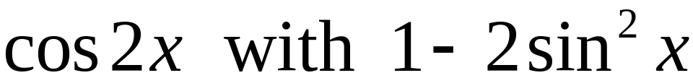
Study Questions:
Look back at the last three problems and find these three KEY techniques:
Replacing
Replacing
Using the Quadratic Formula

Slide 16
In Closing…..
HW: pg 623:7-14
Test on FRIDAY!
Review 10th period Tues, Wed, Thurs

Slide 17
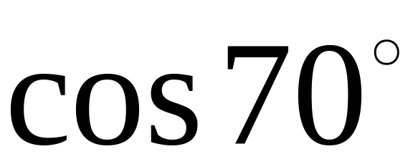
Thursday 2-15-01
ANSWER: leave as a function of a positive angle.

