Slide 1
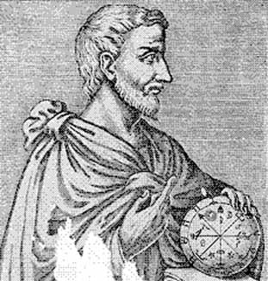

Pythagorean Theorem
What is it and how does it work?
a² + b² = c²

Slide 2
Pythagorean Theorem
Find the legs and hypotenuse
Square the legs (this is a and b)
Add them together
Square root them
This is the length of the hypotenuse (this is c)

Slide 3
The Right Triangle
hypotenuse
leg
leg
Right angle

Slide 4
1. Square both legs
1
2
3
4
5
6
7
8
9
10
11
4 ft
12
13
14
15
16
3 ft
4ft
1
2
3
4
5
6
3 ft
7
8
9

Slide 5
2. Count the total squares
1
2
3
4
5
6
7
8
9
10
11
4 ft
12
13
14
15
16
3 ft
4ft
1
2
3
9 + 16 = 25
4
5
6
3 ft
7
8
9

Slide 6
3. Put that number of squares on the hypotenuse
21
16
22
11
17
23
12
18
24
6
7
13
19
25
1
1
2
3
4
2
8
14
20
5
6
7
8
3
15
9
4
11
4 ft
10
9
10
12
5
13
14
15
16
3 ft
4ft
1
2
3
9 + 16 = 25
4
5
6
3 ft
7
8
9

Slide 7
4. Count the number of squares that touch the hypotenuse.
21
16
22
11
17
23
12
18
24
6
7
13
19
25
1
1
2
3
4
2
8
14
20
5
6
7
8
3
15
9
4
11
4 ft
10
9
10
12
5
13
14
15
16
3 ft
# = 5
4ft
1
2
3
9 + 16 = 25
4
5
6
3 ft
7
8
9

Slide 8
5.That number is the length of the hypotenuse.
21
16
22
11
17
23
12
18
24
6
7
13
19
25
1
1
2
3
4
2
8
14
20
5
6
7
8
3
15
9
4
11
4 ft
10
9
10
12
5
13
14
15
16
3 ft
# = 5
4ft
1
2
3
Length = 5
9 + 16 = 25
4
5
6
3 ft
7
8
9

Slide 9
Summary
Find the legs and hypotenuse.
Square the legs (this is a and b)
Add them together
Square root them
This is the length of the hypotenuse (this is c)

