Slide 1
Parts of Plant
ROOTS – take in water and mineral salts from the soil. They anchor the plant into the ground.
STEM – is like a straw. It moves water around the plant. It raises the leaves and flowers of the plant off the ground.
LEAVES – make the food for the plant. They take the water and mineral salts and use them together with sunlight and carbon-dioxide to make food.
FLOWERS – Produce seeds which the form new plants

Slide 2
Can you remember the Seven Processes of Life?
M
R
S
N
E
R
G

Slide 3

Plants - Seven Processes of Life
Movement
Stems and leaves curve round to face the light.
Light is needed by the leaves to make food.

Slide 4

Plants - Seven Processes of Life
Reproduction
The flowers of a plant contain the reproductive organs.
The male organs (stamen) produce pollen which is transferred to the female organs (stigma) – POLLINATION. This allows the plant to produce eggs - FERTILISATION.
When the flower dies these seeds fall from the plant, landing in the earth below.

Slide 5
Plants - Seven Processes of Life
Sensitivity
Stems curve to face the light.
Roots grow towards water.

Slide 6
Plants - Seven Processes of Life
Nutrition
Plants need food. The roots take in minerals from the soil.
The leaves then turn these mineral salts and water into food using energy from the sun. This is called photosynthesis.

Slide 7
Plants - Seven Processes of Life
Excretion
Plant release oxygen. This is a waste product of photosynthesis.

Slide 8
Plants - Seven Processes of Life
Respiration
Plants take in Carbon dioxide (gas), They use this to make food.

Slide 9
Plants - Seven Processes of Life
Growth
Plant use the food made during photosynthesis to grow.

Slide 10
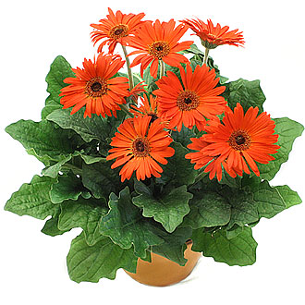
A Healthy Plant

