Slide 1
Science: Cells to Body Systems
Grade 5
Goal: My goal is to show students through a Powerpoint presentation how cells work together to form body systems.
The text will be used as the main source with the presentation being supplemental.
Web sites used : www.harcourtschool.com and http://trackstar.hprtec.org/main/display.php3?trackid=128390.
This incorporates ETS 10.6, 10.14, and 10.16

Slide 2
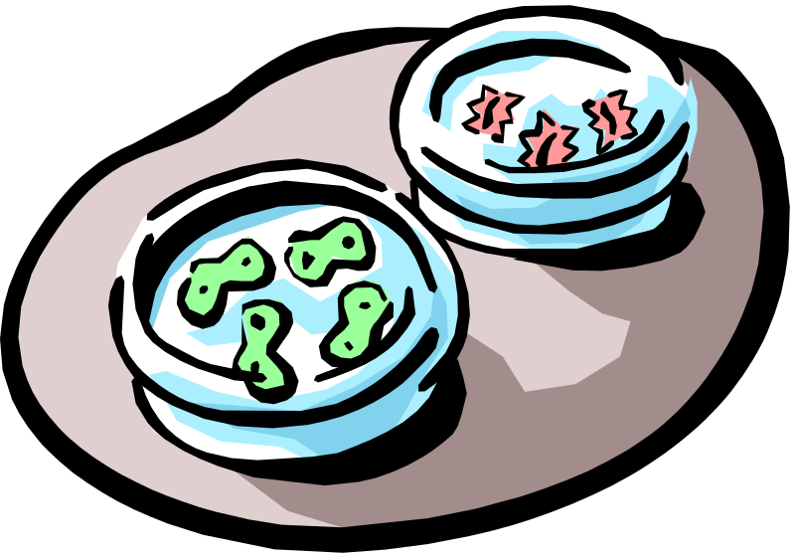
Cells
Simple organisms such as bacteria, are single cell.
Plants and animals are made up of many cells.
Each kind of cell has a particular function.

Slide 3
Cells: Size & Shape
Size and Shape depend upon its function.
Red blood cells are small and disc shaped to fit through the smallest blood vessel.
Muscle cells are long and thin. When they contract they produce movement.
Nerve cells which carry signals to the brain are very long.

Slide 4
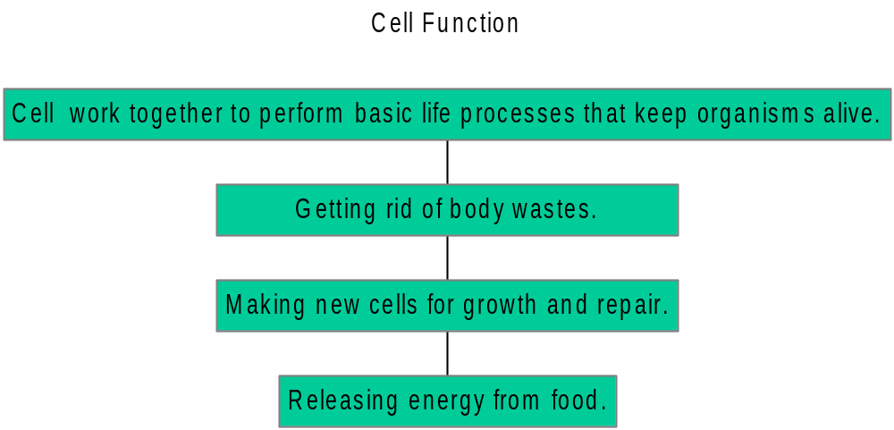
Functions of Cells

Slide 5
Plant /Animal Cell Definitions
Nucleus: The organelle that determines all of a plant’s cell activities and prduces new cells. | Cytoplasm: A jellylike substance that contains many chemicals to keep the cell functiong. | Nucleus: The organelle that determines all of the animal cells activities and produces new cells. | Vacuoles: Organelles that store food, waste, or water.
Chromosones: Threadlike structures that contain information about plant. | Chloroplasts: Organelles that make food for the plant cell. | Chromosones: Threadlike structures that contain information about the animal. | Mitochondria: Organelles that release energy from food.
Cell Membrane: A covering that hold the plant cell together and separates it from surroundings. | Vacuole: An organelle that stores food, water, and waste. | Cell Membrane: a covering that holds the animal cell together and separates it from its surroundings.
Cell Wall: A rigid layer that supports and protects plant cells. | Mitochondria: Organelles that release energy from food. | Cytoplasm: a jellylike substance that contains many chemicals to keep the cell functioning.

Slide 6
Tissues, Organs, & Systems
Cells that work together to perform a specific function form a tissue.
Just as cells that work together form a tissue, tissues that work together form an organ.
Organs that work together to perform a function form a system. Example: circulatory system.
Plant cells also form tissues, such as the bark of a tree. And plant cells work together, forming organs, such as roots and leaves.

Slide 7
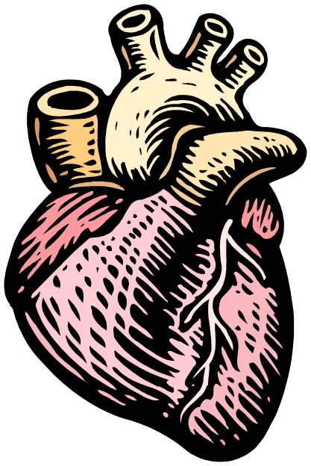
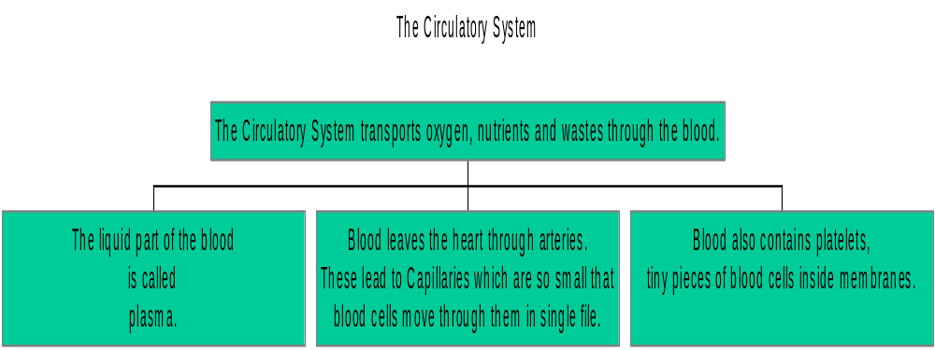
The Circulatory System

Slide 8
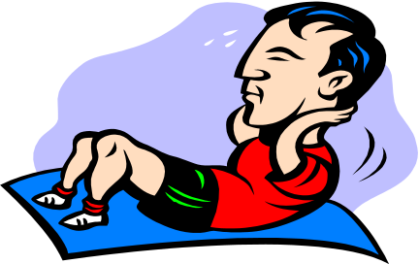
The Respiratory System
Air enters the body through nasal passages is filtered, then travels down the trachea.
The trachea branches into two tubes called bronchi, which lead to the lungs.
At the end of the bronchi are tiny tubes called aveoli, small air sacs.
Carbon dioxide and oxygen are exchanged in the aveoli and the oxygen rich blood enters the body through the pulmonary veins.

Slide 9
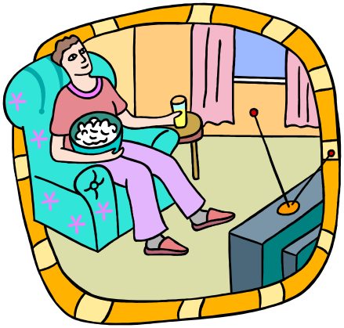
The Digestive System
Digestion begins as you chew food.
Glands in your mouth produce saliva to moisten food.
The food passes through the esophagus to the stomach and moves to the small intestine.
Nutrients diffuse through the villi, tiny projections from the intestine, into the blood.

Slide 10
The Excretory System
The function of the excretory system is to remove wastes from the body.
Cell wastes include carbon dioxide and ammonia.
The kidneys, ureters, bladder, and urethra make up the excretory system.
The body also removes wastes through sweating. Sweat is a salty liquid that evaporates from the skin.

Slide 11
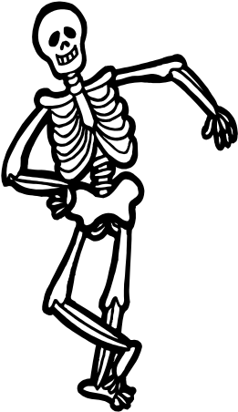
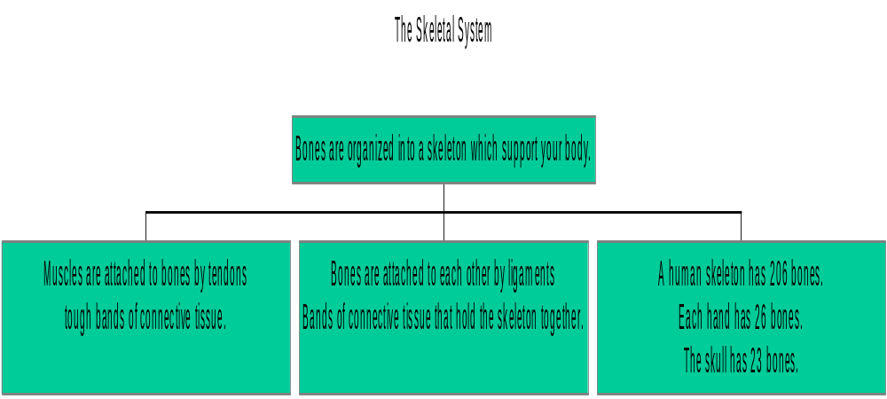
Systems Working Together

Slide 12

The Muscular System
Voluntary Muscles: move bones and hold your skeleton upright.
Smooth Muscles: contract slowly and move substances through the organs they surround.
Cardiac Muscles: make up the walls of the heart. Their function is to pump blood.

Slide 13
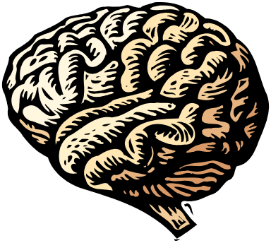
The Nervous System
The nervous system connects all the tissues and organs to your brain.
It consists of two parts: The central nervous system and peripheral nervous system.
The central nervous system consists of brain and spinal cord.
The peripheral nervous system consists of sensory organs, such as eyes, ears and body nerves.

Slide 14
Assignments
Read Chapter 1, Unit A of Harcourt Science Textbook and complete tasks related to the reading.
Go to www.harcourtschool.com and complete the activities relating to cell biology.
Go to http://trackstar.hprtec.org/main/display.php3?trackid=128390 and complete activities relating to cell biology.

Slide 15
Assessment
Assessment will be based upon:
Successful completion of the assigned tasks within the websites and;
Successful completion of a cell, body transport system, and body movement systems created by the student using Microsoft Paintbrush.

