Slide 1
Subject Area - Science
Grade Level - 4th

Slide 2

LESSON 2
Respiratory System
and
Circulatory System

Slide 3

Respiratory System

Slide 4
What it does:
1. Provides Oxygen
2. Removes Carbon Dioxide

Slide 5
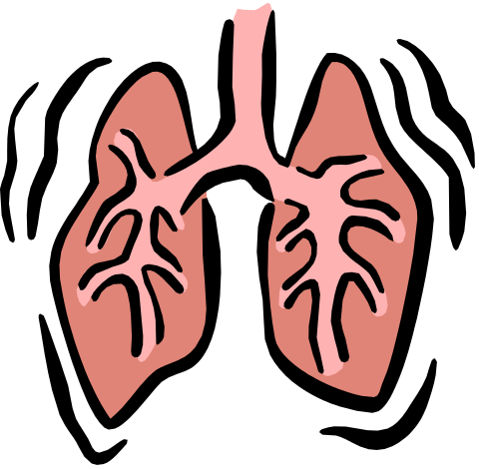
Main part of the Respiratory System
LUNGS

Slide 6
CIRCULATORY
SYSTEM

Slide 7
What it does:
1. Carries blood to and from body
cells

Slide 8
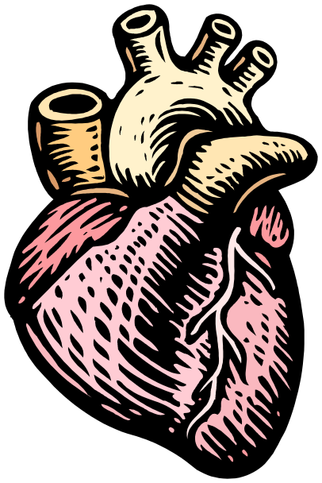

Main part of the Circulatory System
1. Heart
2. Arteries
3. Veins
4. Capillaries

Slide 9

VOCABULARY

Slide 10
Lungs-
The main organs of the
respiratory system.

Slide 11
Capillary-
The tiny blood vessels that
allows gases and nutrients
to pass from blood cells.

Slide 12
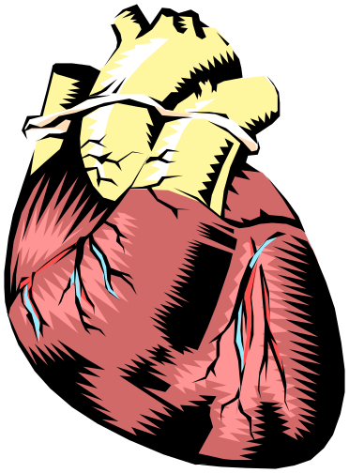
Heart-
The muscle that pumps
blood through your
blood vessels to all
parts of your body.

Slide 13
Artery-
A blood vessel that carries
blood away from the heart.

Slide 14
Vein-
The large blood vessels that
return the blood to your heart.

