Slide 1
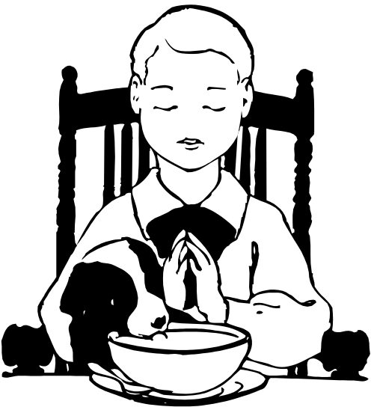
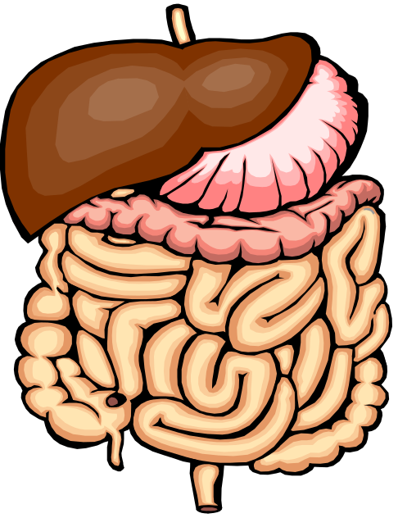
Digestive Process Begins
Section 3

Slide 2
Functions of Digestive System
Breaks down food into molecules
Molecules are absorbed into blood and carried throughout the body

Slide 3
Functions of Digestive System. Cont.
Wastes are eliminated from the body

Slide 4
Digestion
Process by which the body breaks down food into small nutrient molecules

Slide 5
Two Kinds of Digestion
Mechanical
And
Chemical

Slide 6
Mechanical Digestion
Foods are physically broken down into smaller pieces.
Begins when you take your first bite of food
Your teeth are the first stage in mechanical digestion

Slide 7

Chemical Digestion
Chemicals produced by the body break foods into smaller chemical building blocks.
Begins in the mouth

Slide 8
Chemical Digestion, Cont.
Accomplished by enzymes
Enzymes – protein that speeds up chemical reactions in the body

Slide 9
Absorption
Occurs after food has been digested.
Process by which nutrient molecules pass through the wall of the digestive system into the blood

Slide 10
The Mouth
Saliva – fluid released when your mouth waters
Important role in both mechanical and chemical digestive processes.

Slide 11
The Esophagus
A muscular tube that connects the mouth to the stomach
Is lined with mucus – a thick slippery substance – makes food easier to swallow and move through the system

Slide 12
The Esophagus, Cont.
The epiglottis seals off the windpipe to prevent food from entering.
Peristalsis are involuntary waves of muscle contraction

Slide 13
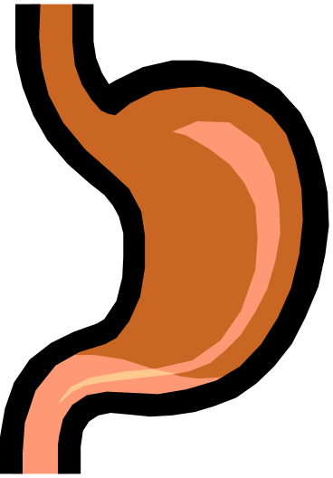
The Stomach
A j-shaped muscular pouch located in the abdomen
Most mechanical digestion occurs in the stomach along with chemical digestion

Slide 14
The Stomach, Cont.
Digestive juice contains the enzyme pepsin and hydrochloric acid
Pepsin kills bacteria that enters with food

Slide 15
The Stomach, Cont.
Hydrochloric acid helps the stomach to function properly.
Mucus coats and protects the stomach from acids

Slide 16
The Stomach, Cont
Food remains in the stomach until all solid material has been broken down into liquid form.
Only takes a few hours for food to digest.

